Slide 1
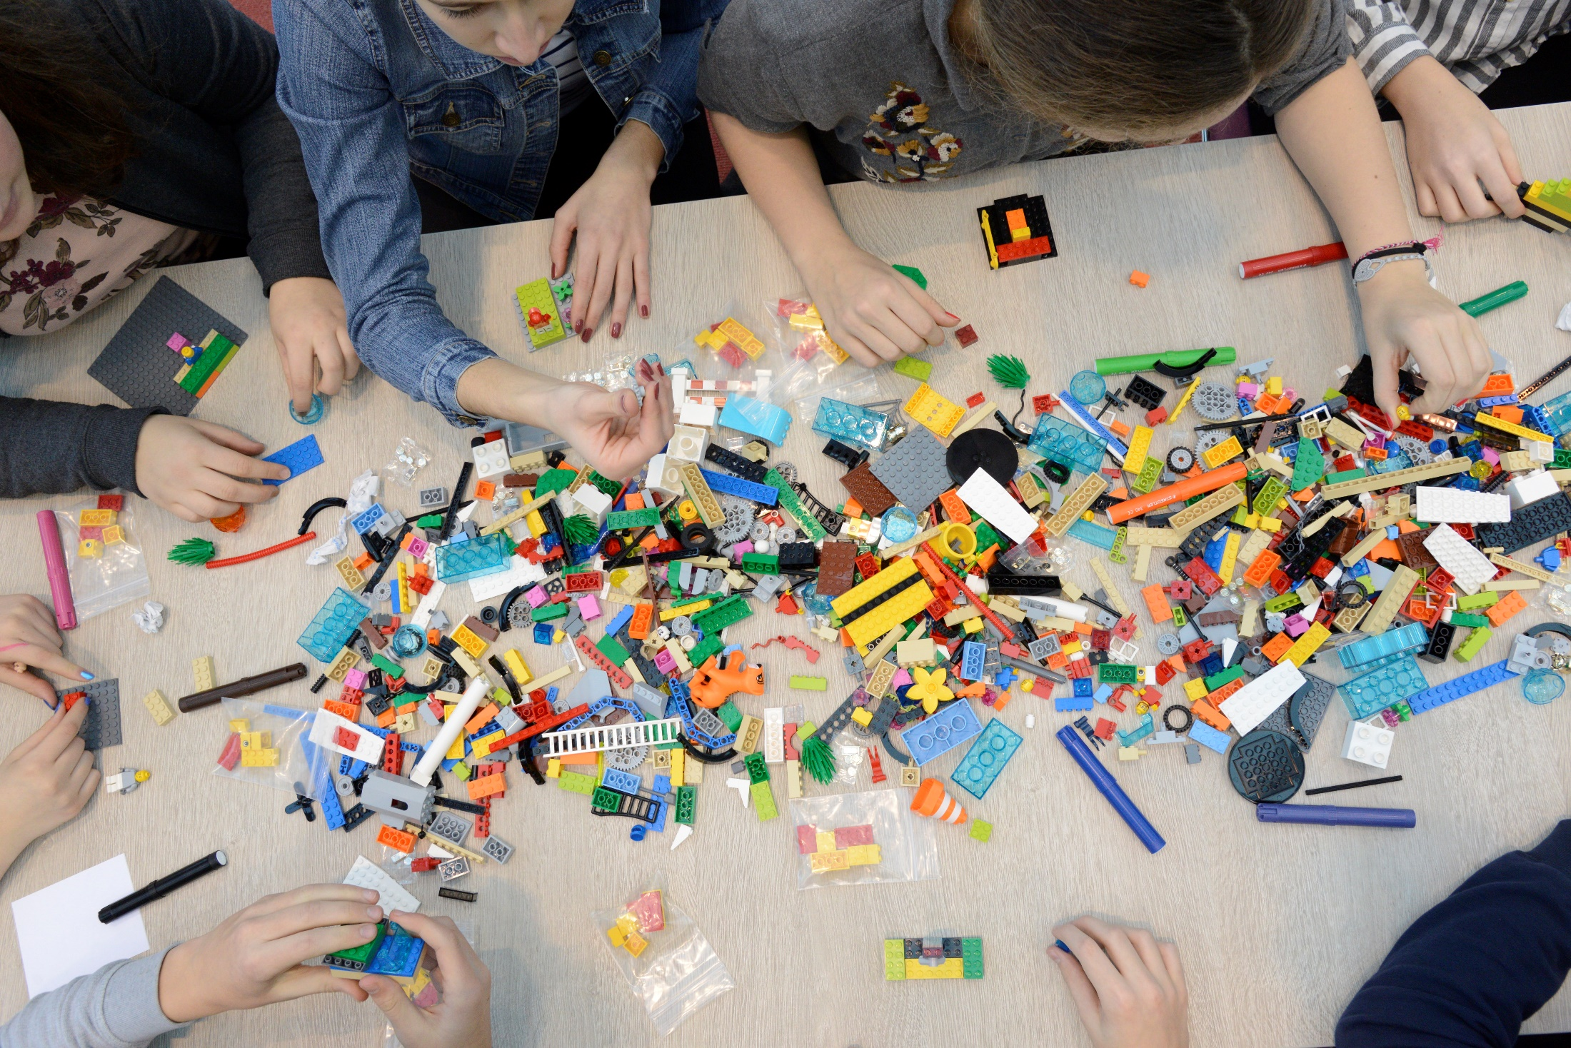
HearMe Bringing Youth and Museums Together

Slide 2
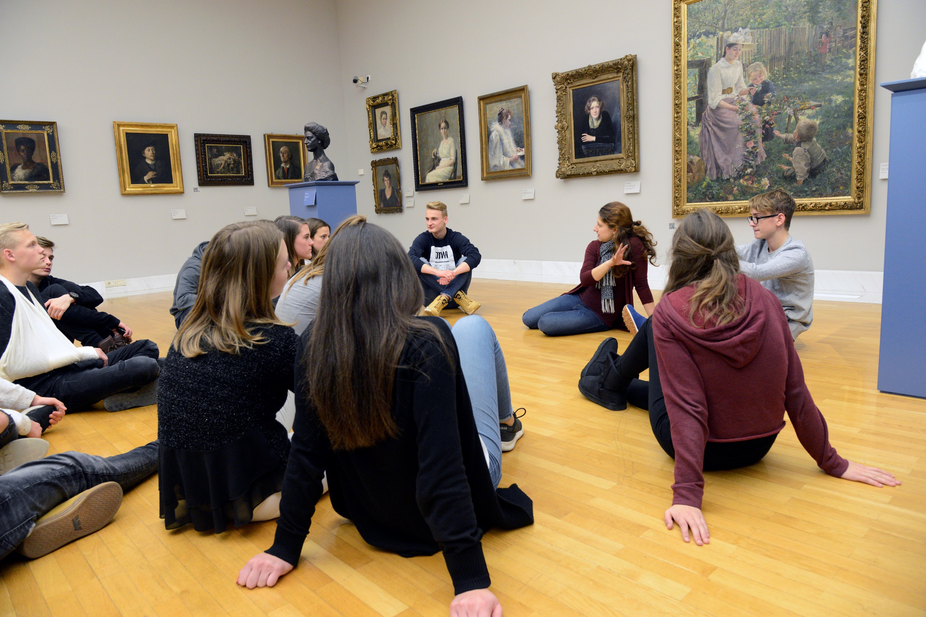
National Gallery of Slovenia

Slide 3
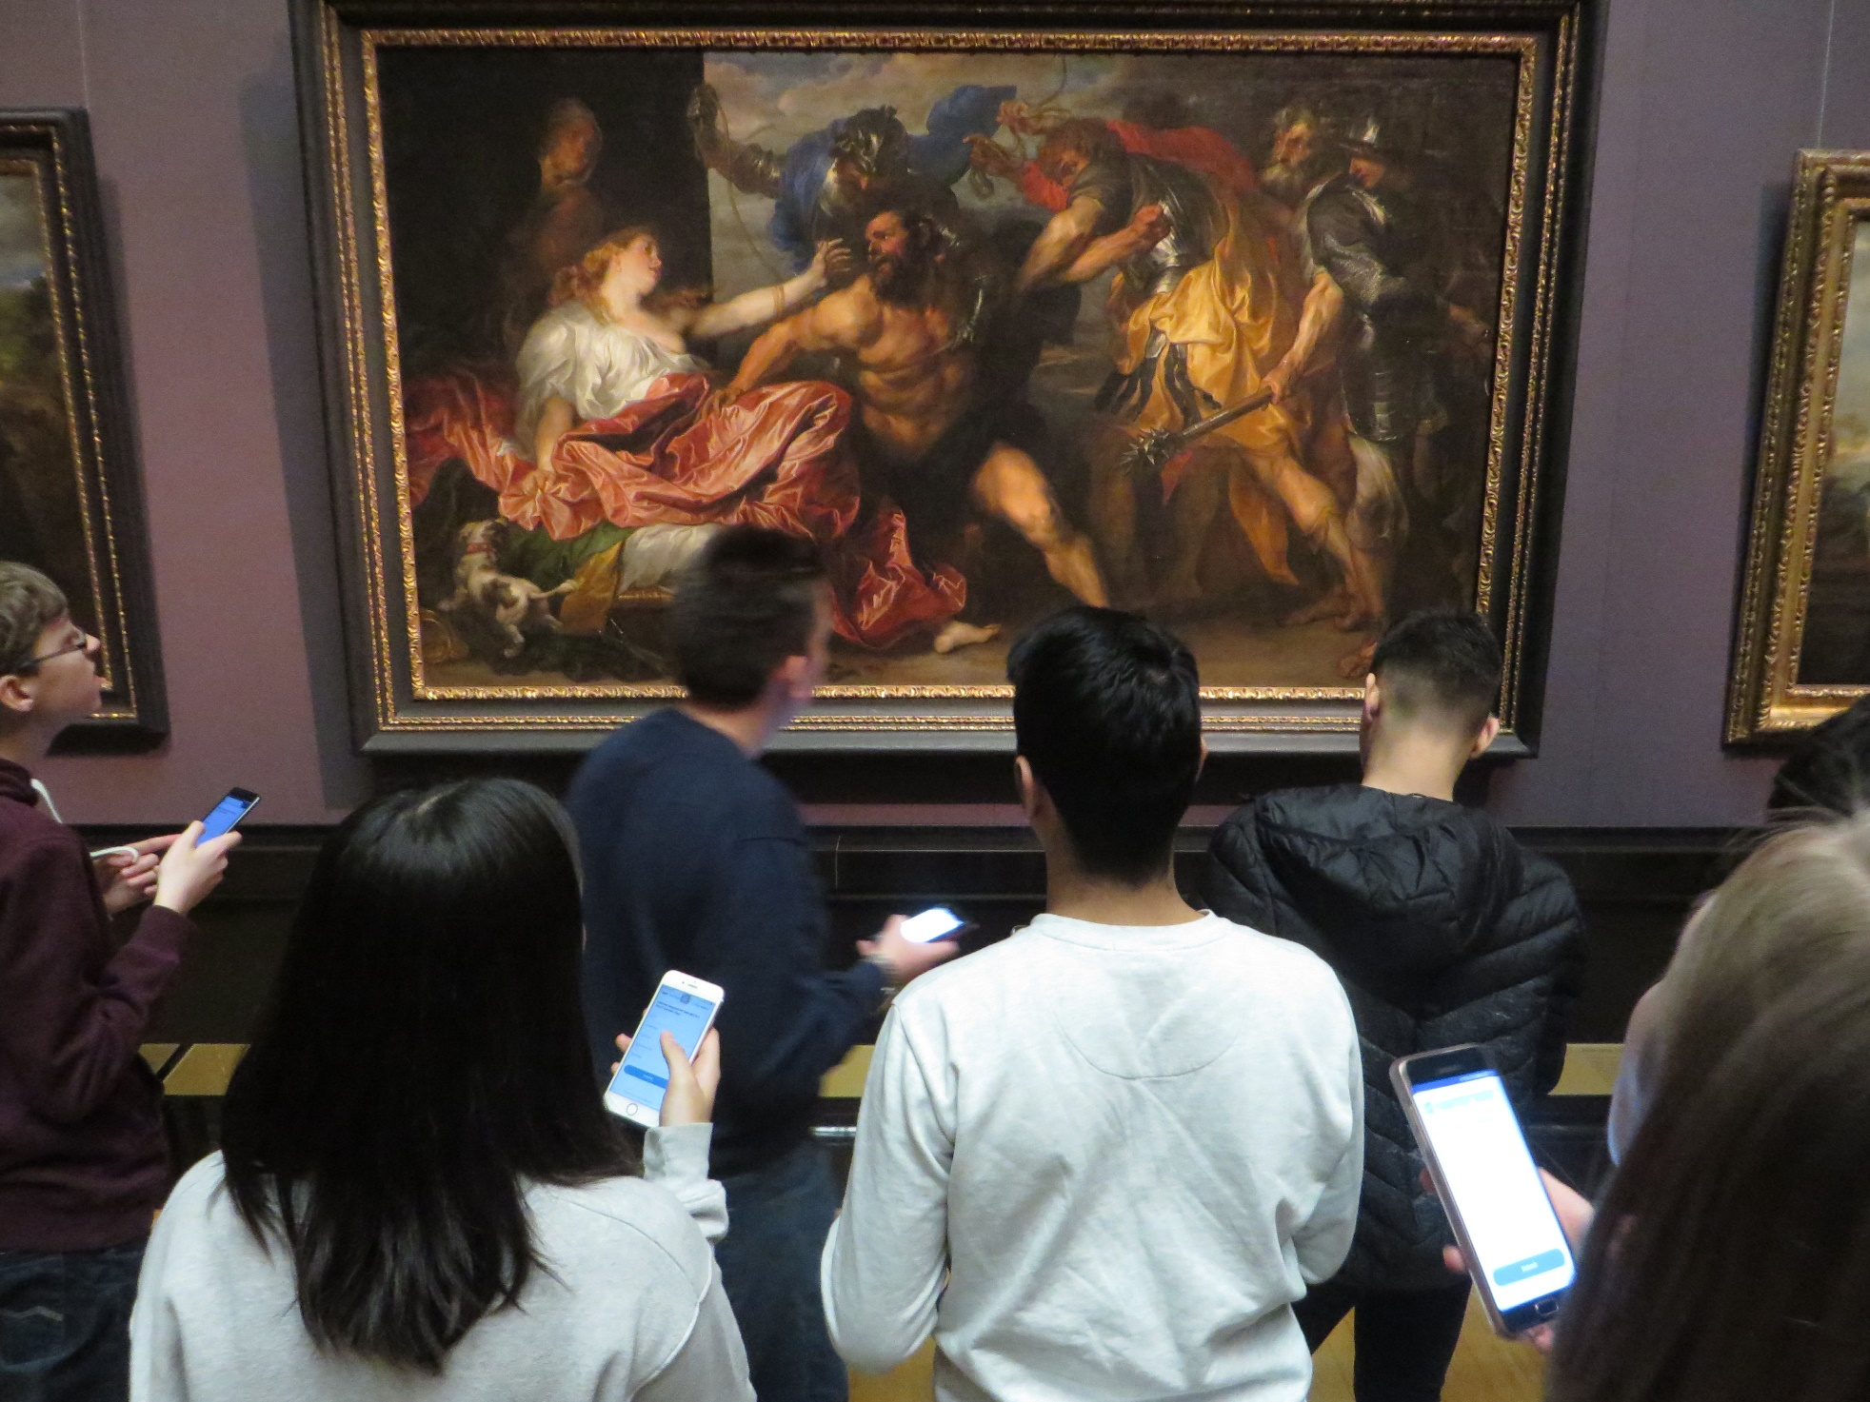
Kunsthistorisches Museum Wien

Slide 4
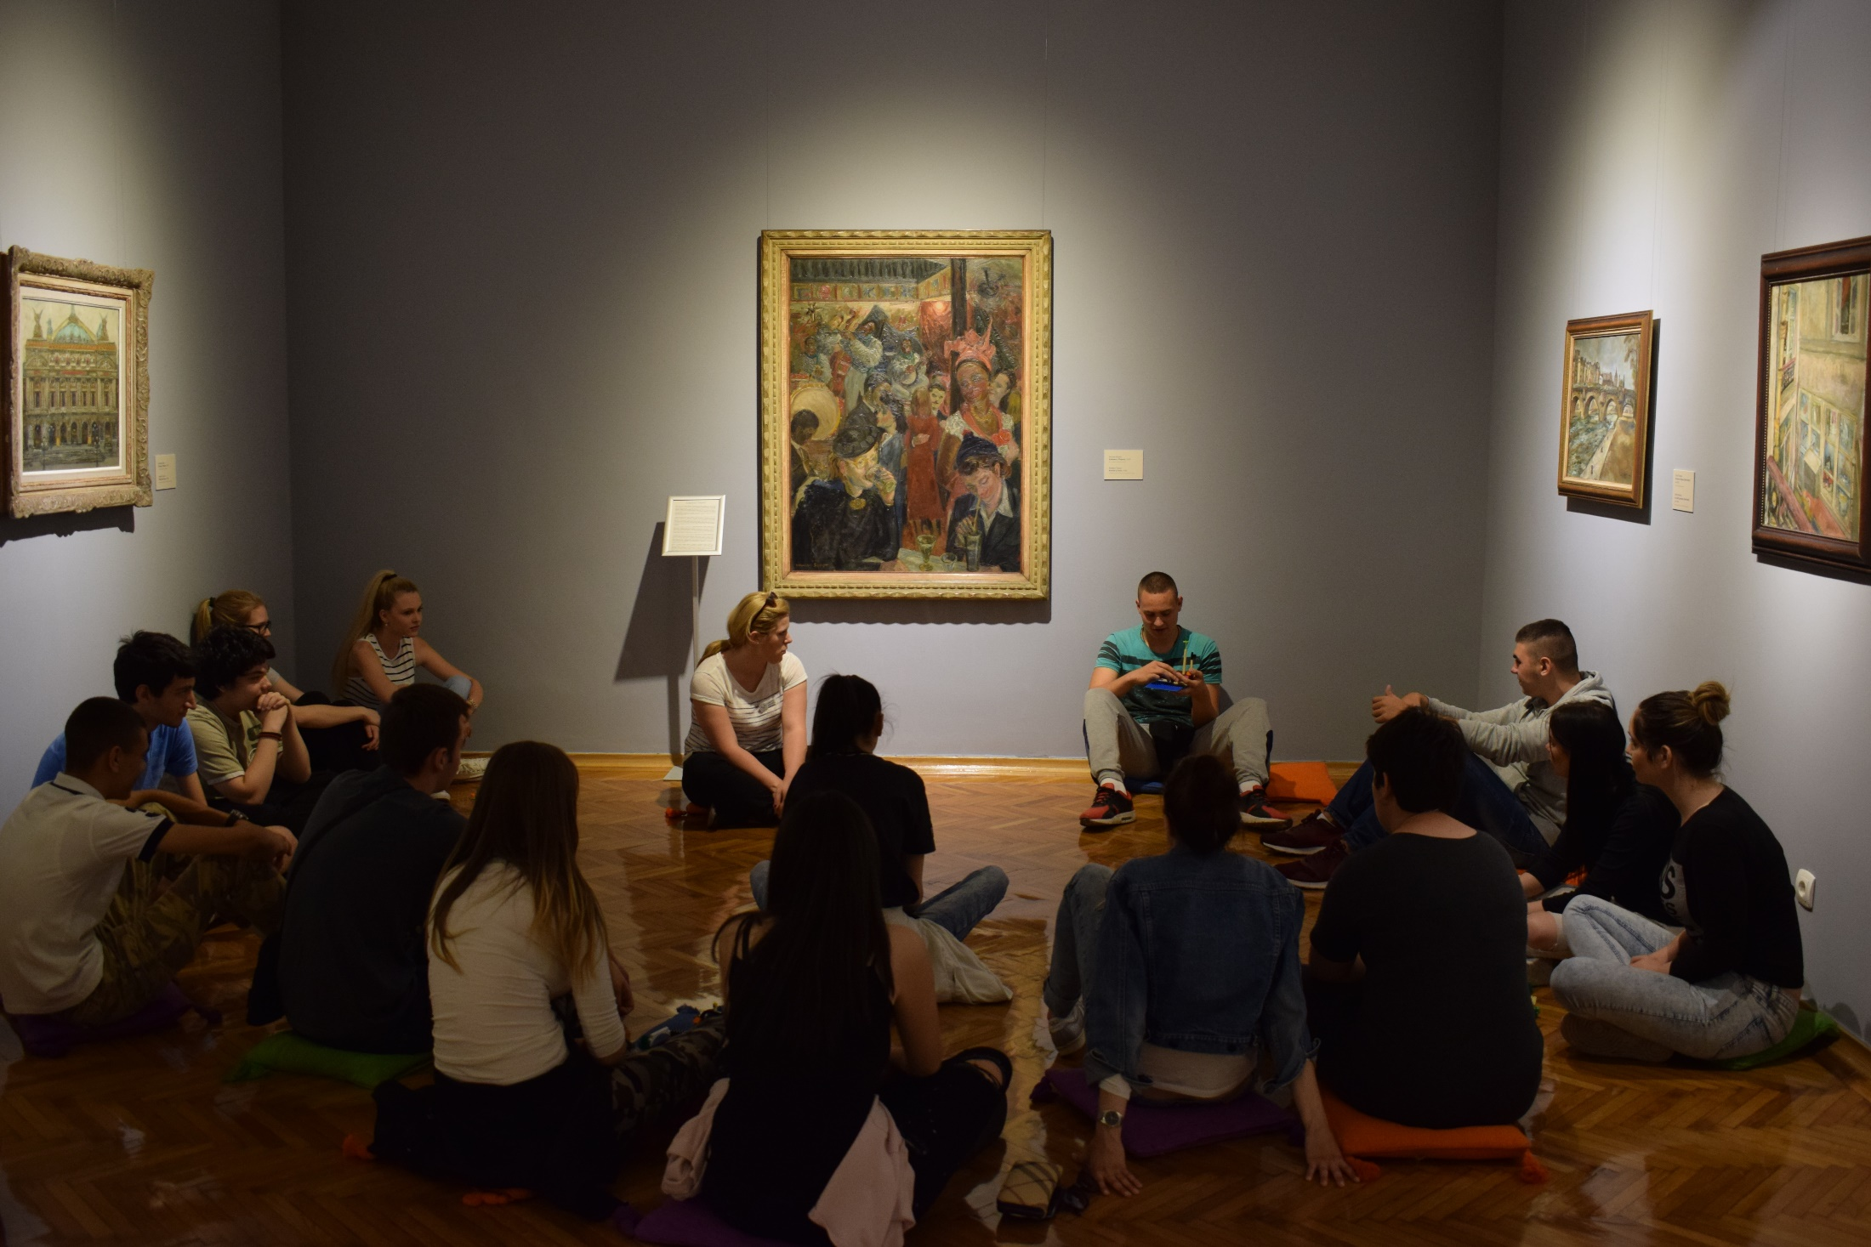
Gallery of Matica srpska

Slide 5
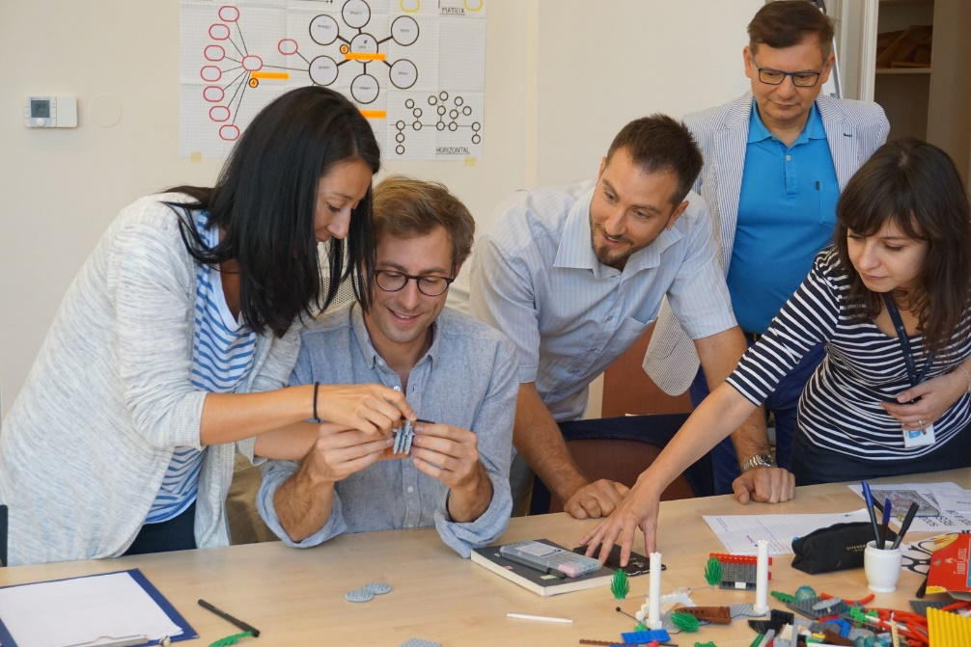
SISE

Slide 6
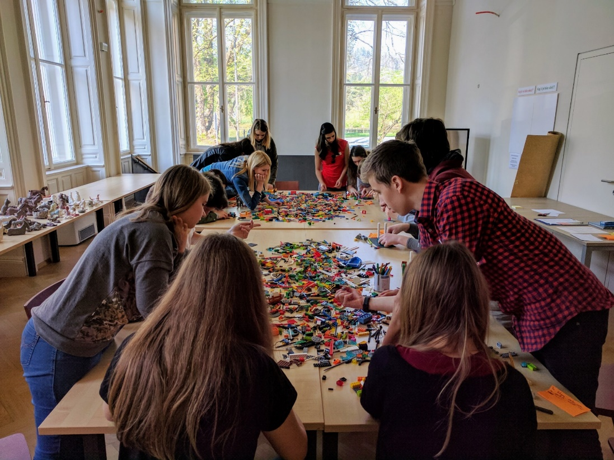
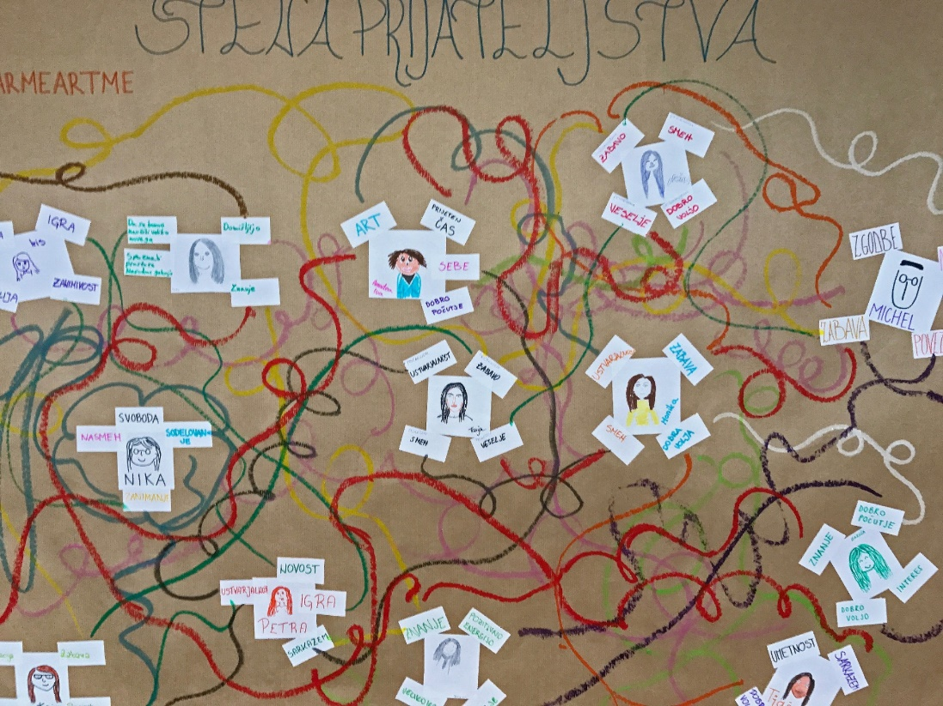
Goals and priorities …
Better relationship with young people
Develop skills of museum educators
Introduce new methodologies

Slide 7
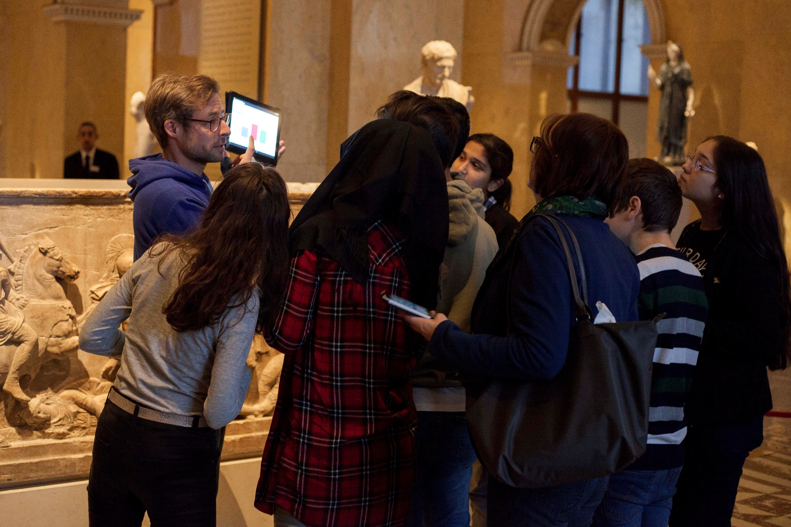

Slide 8
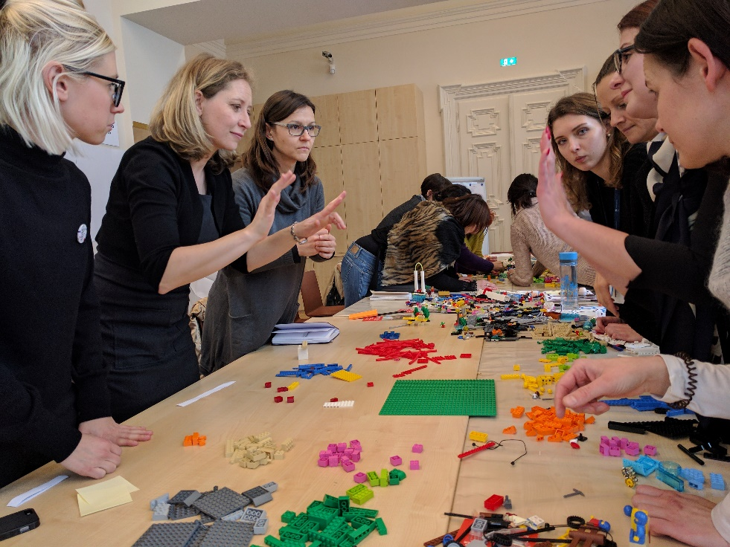
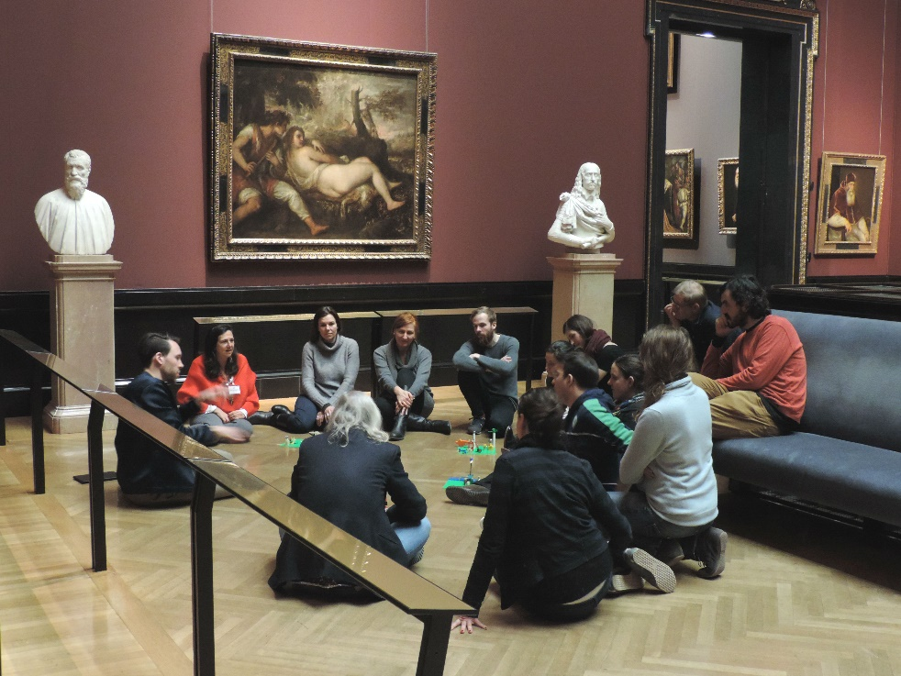
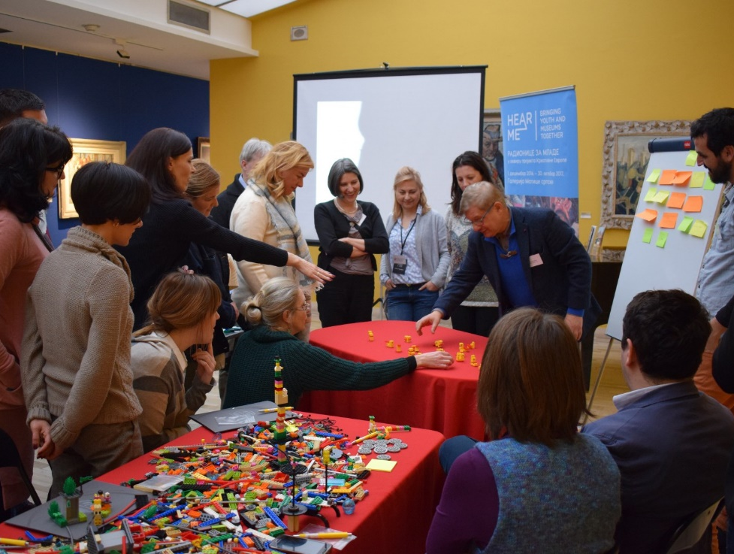
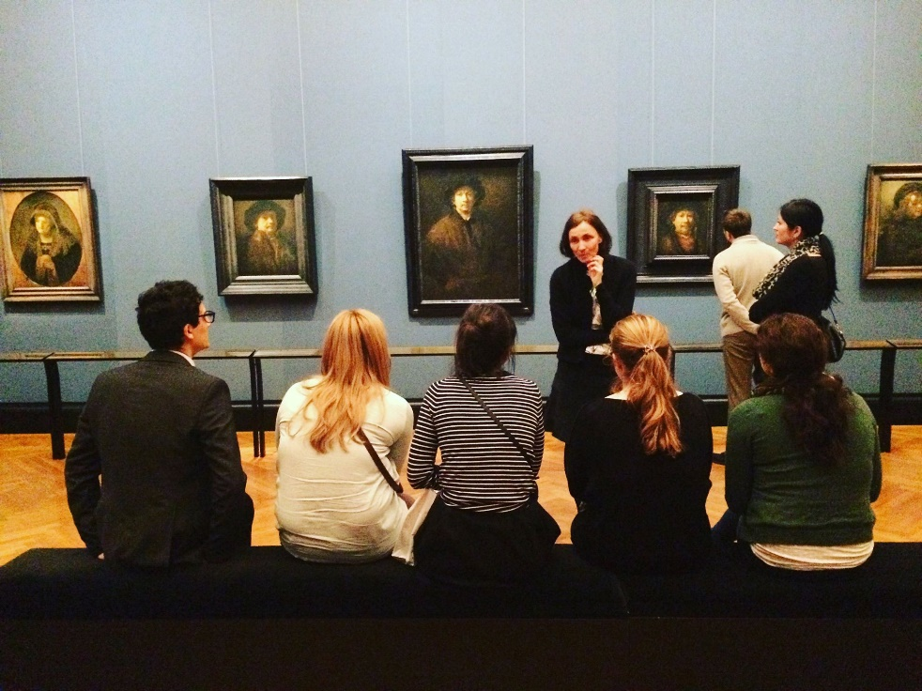

Slide 9
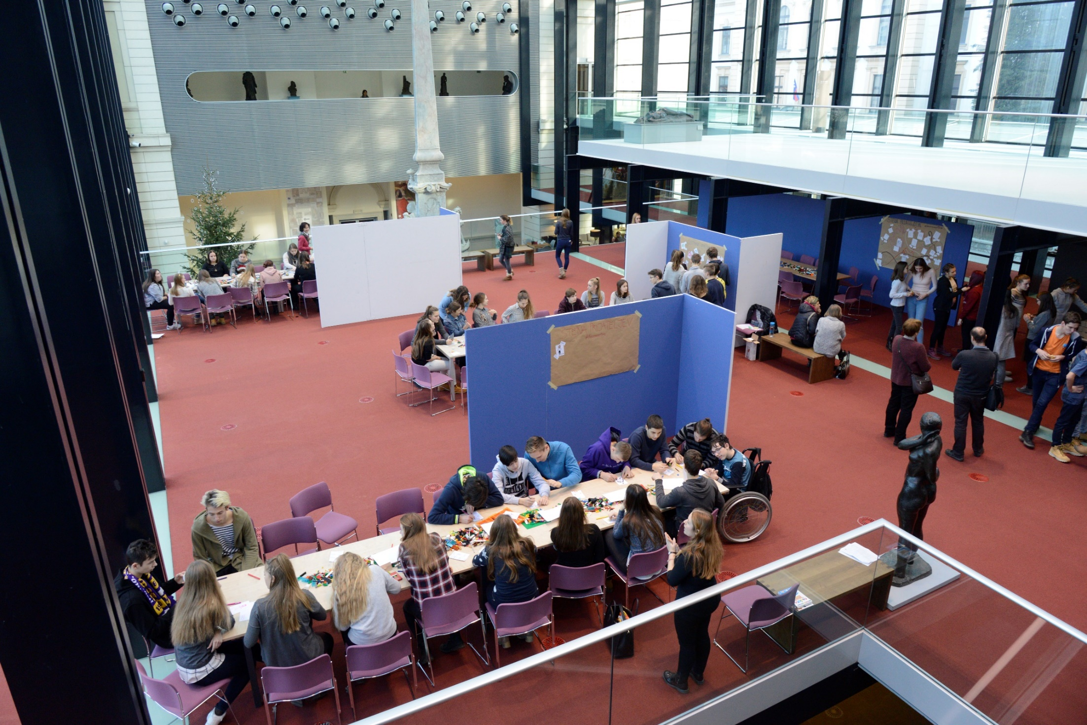
Challenges

Slide 10
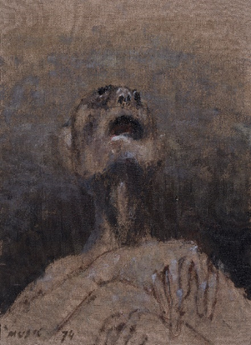
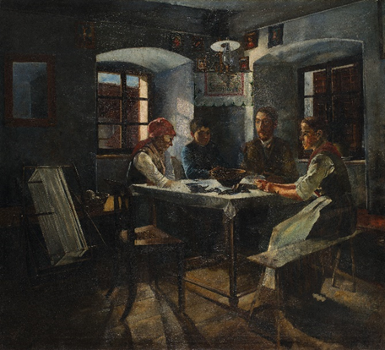
Structure of the National Gallery of Slovenia workshop
Ivana Kobilca, Summer, 1889-1890 Jožef Petkovšek, At home, 1889 Zoran Mušič, We Are Not The Last, 1972

Slide 11
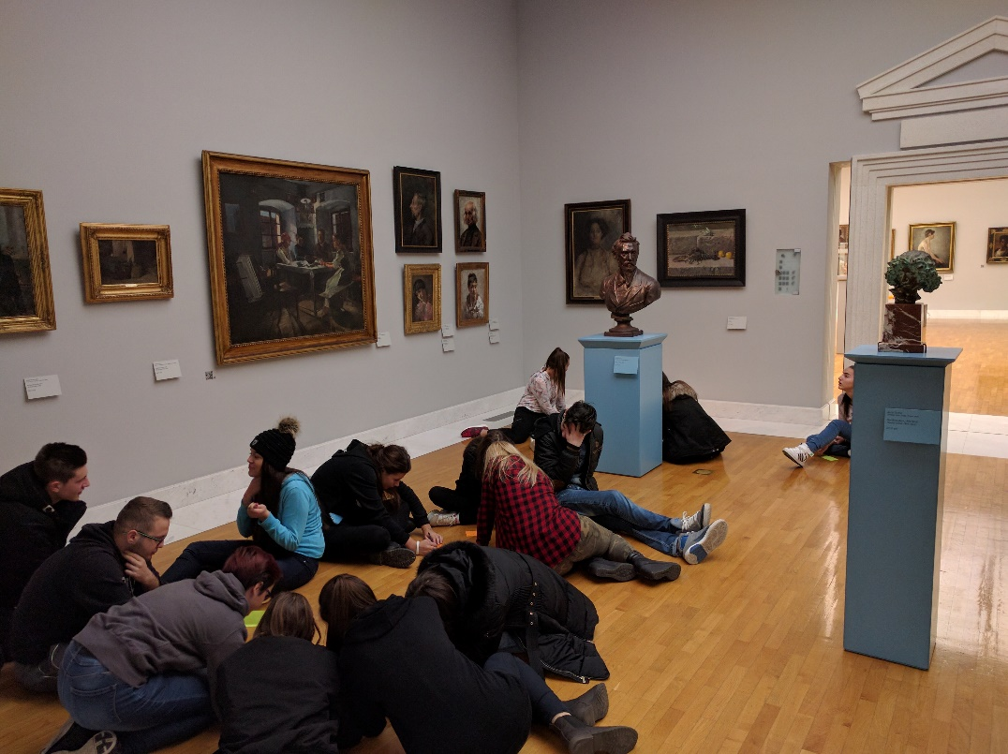
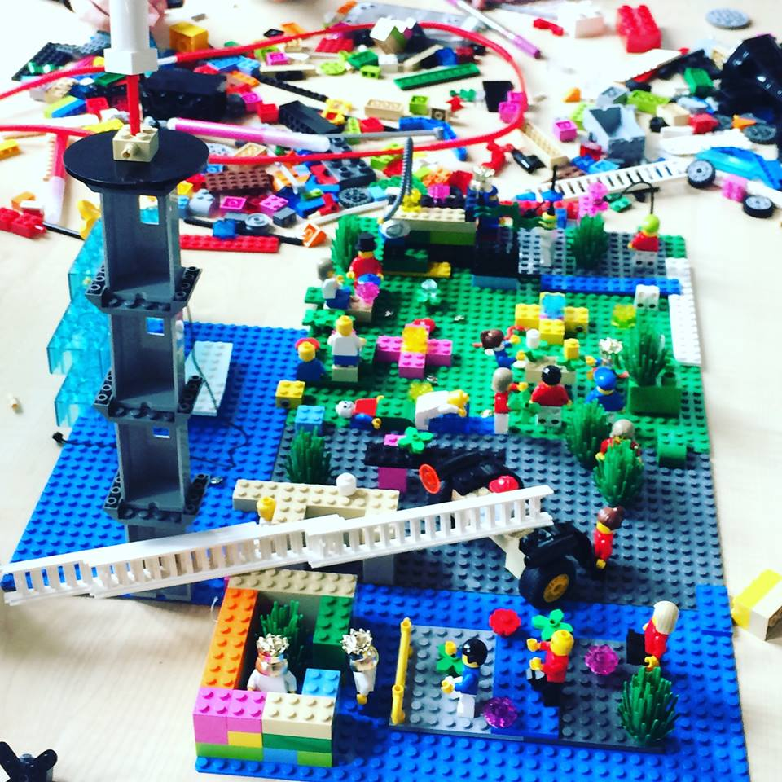
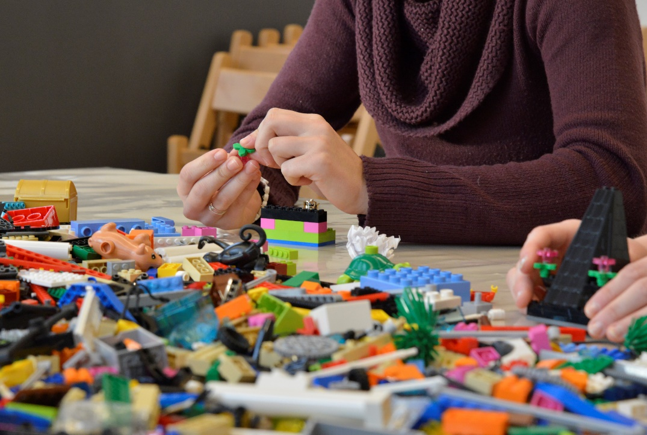

Slide 12
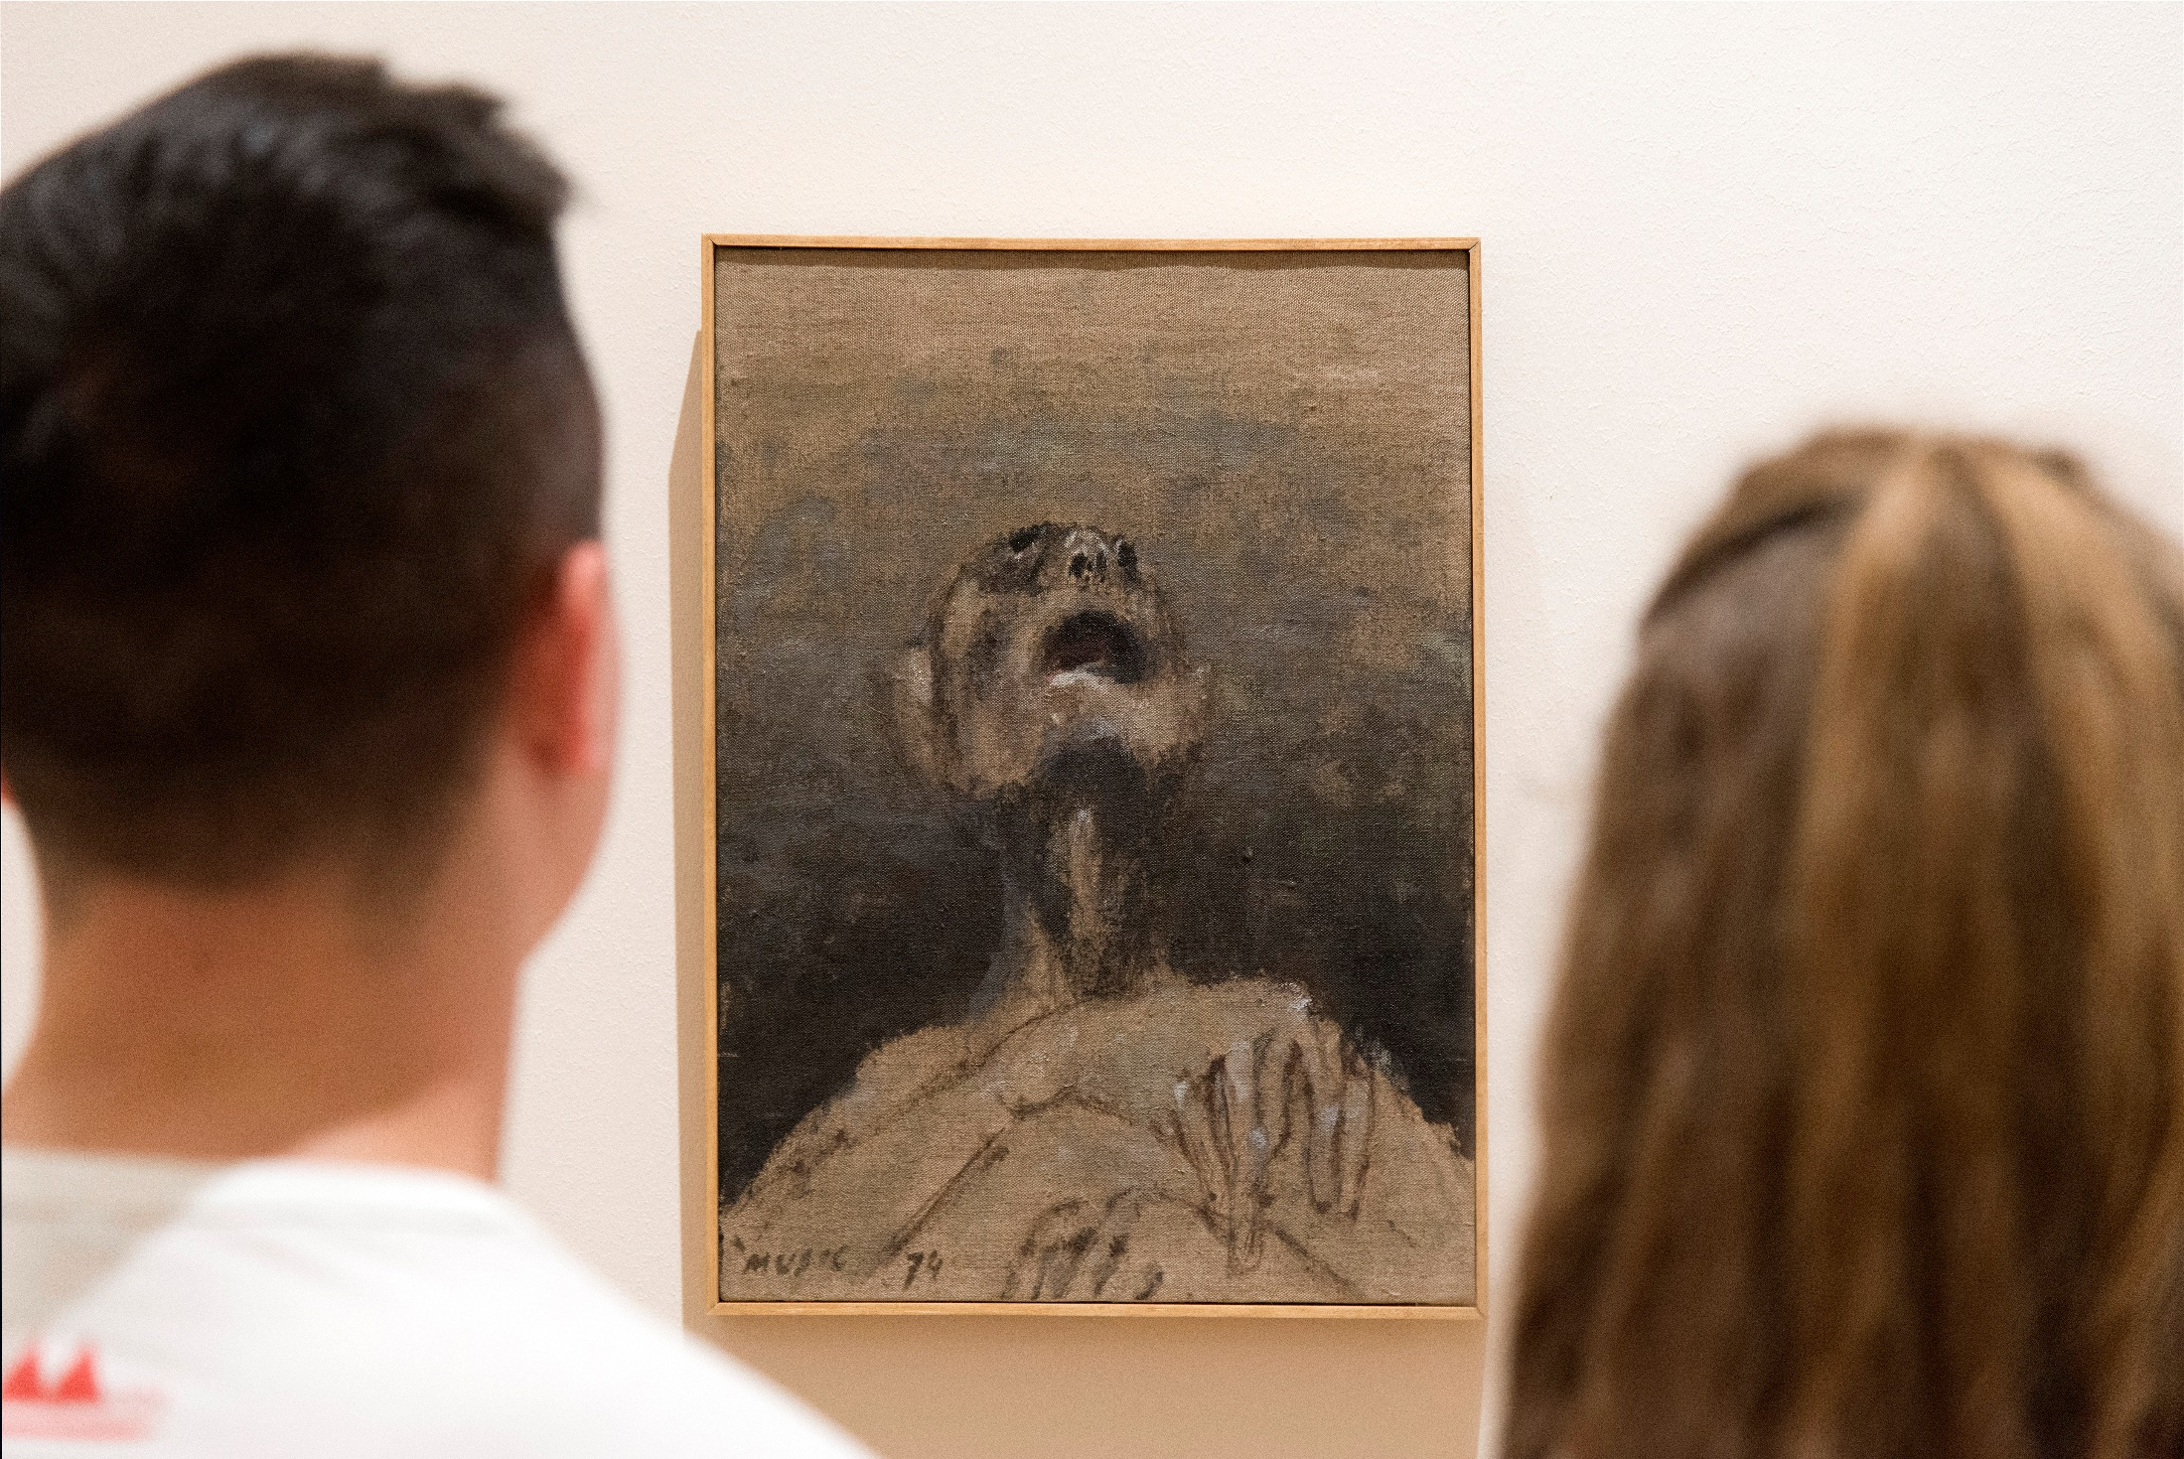
https://vimeo.com/215481816

Slide 13
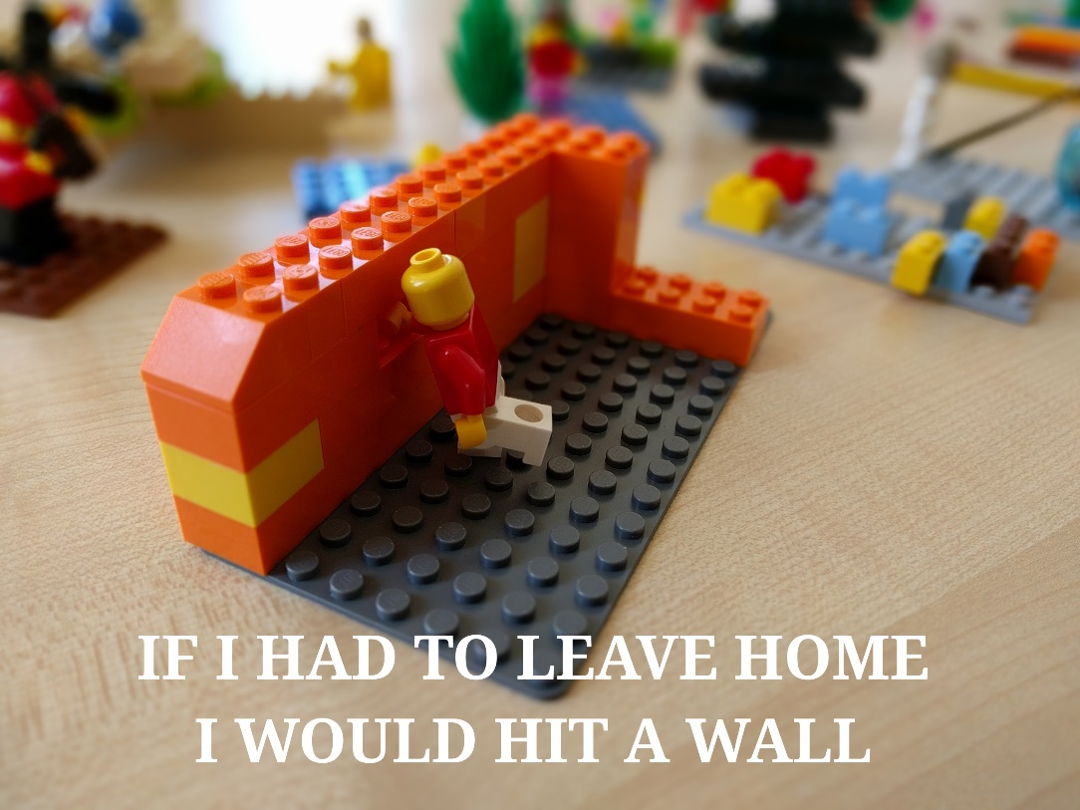
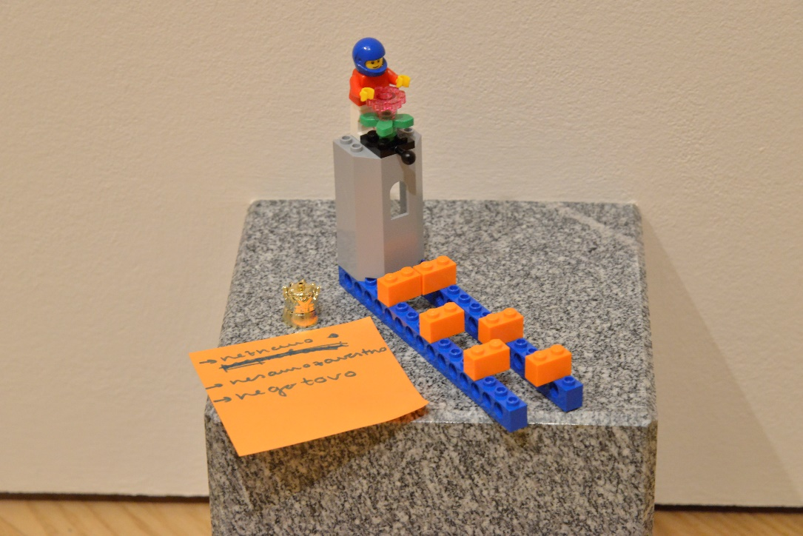
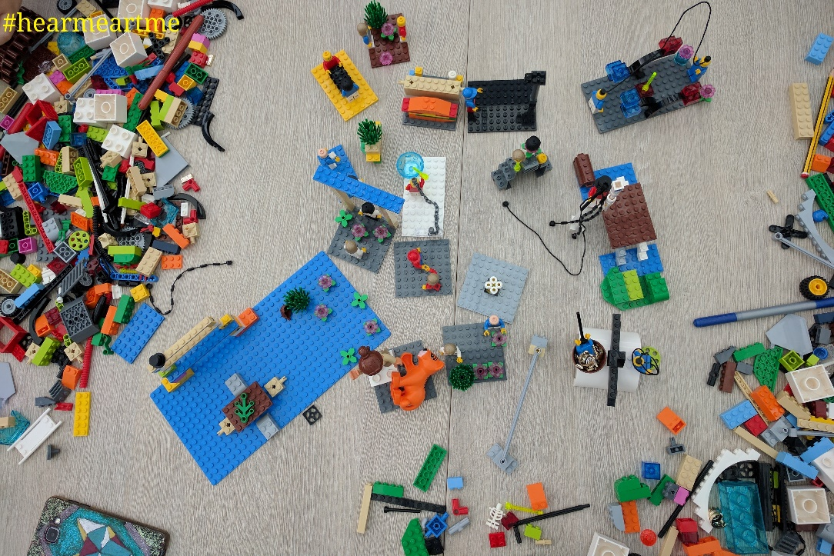
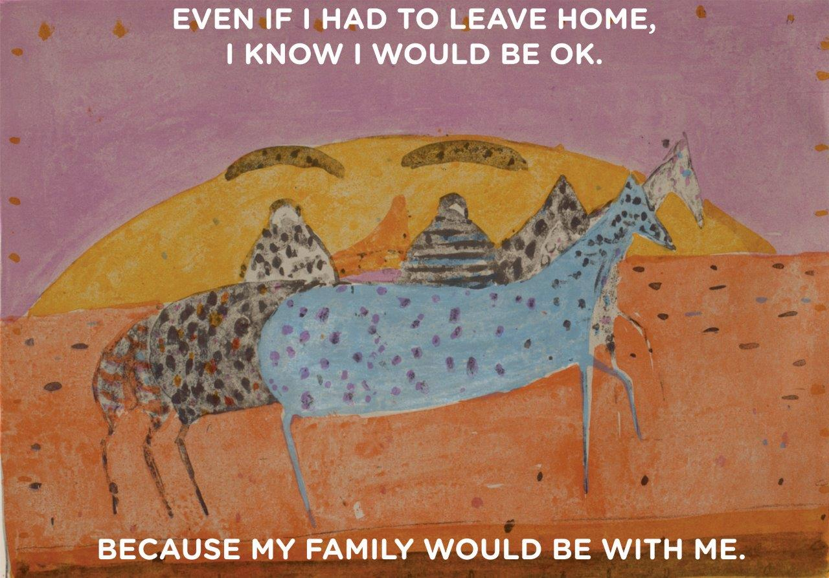

Slide 14
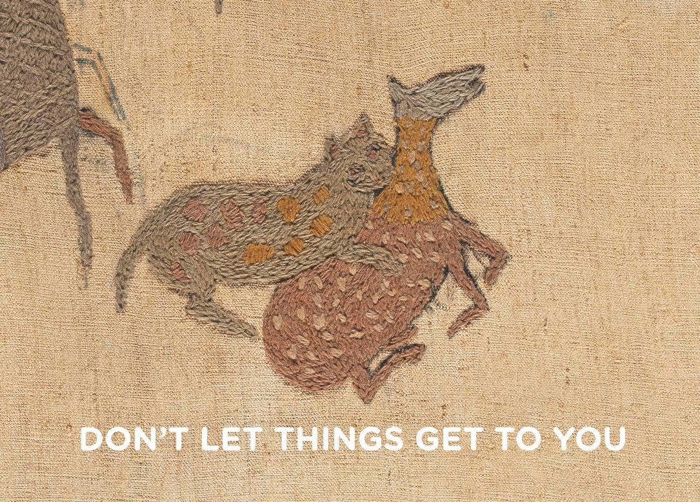
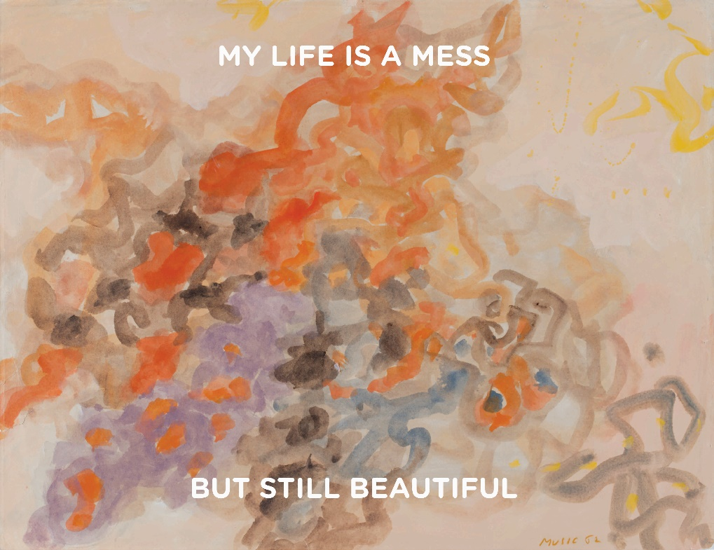
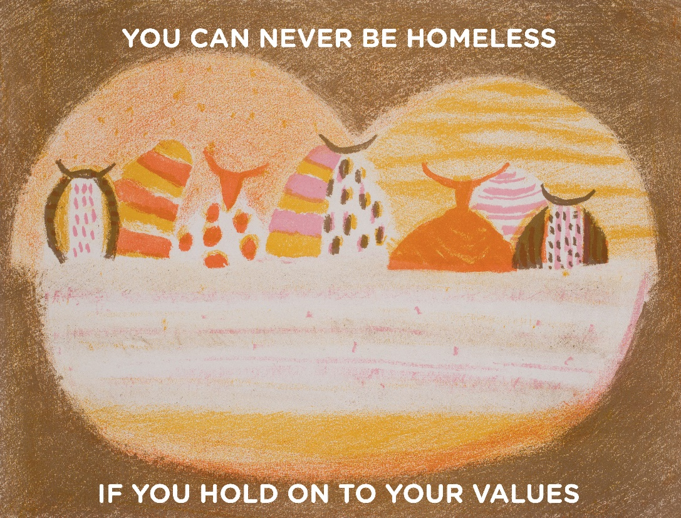
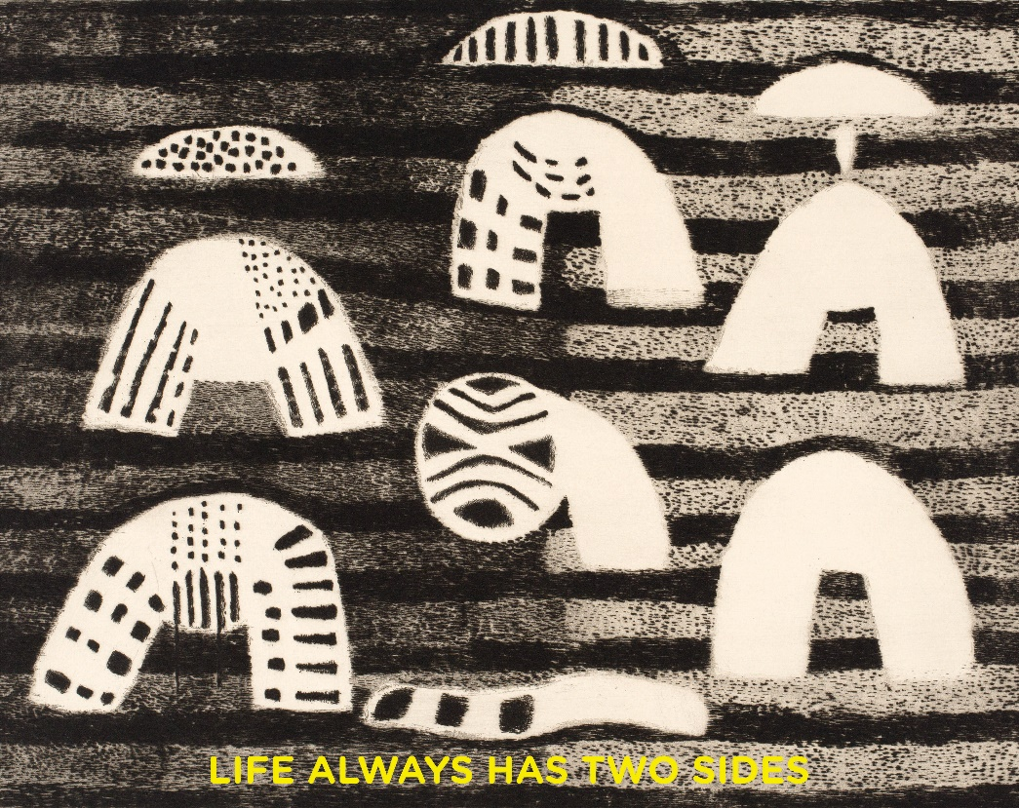

Slide 15
What did the youth like about the workshops?
“It wasn’t like in a typical museum.”
“Discovering how other people think.”
“Self-perception.”

Slide 16
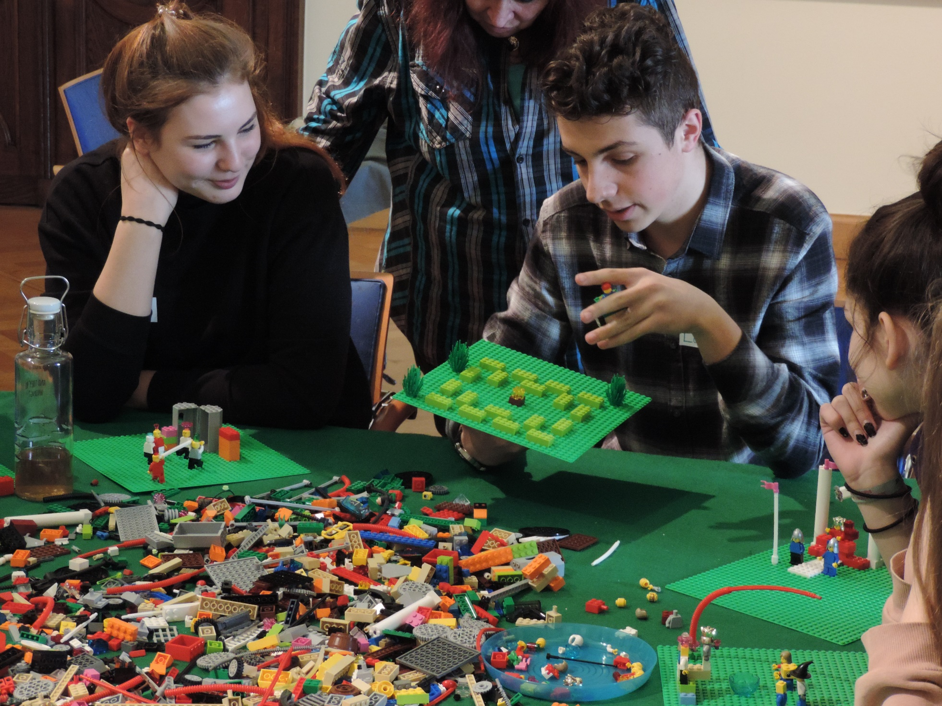
Were they interested in coming back?
“I would like to come back, but probably not right away.”
“Maybe in a few years.”
“When I’m older. Because you see the pictures differently at varying ages.”

Slide 17
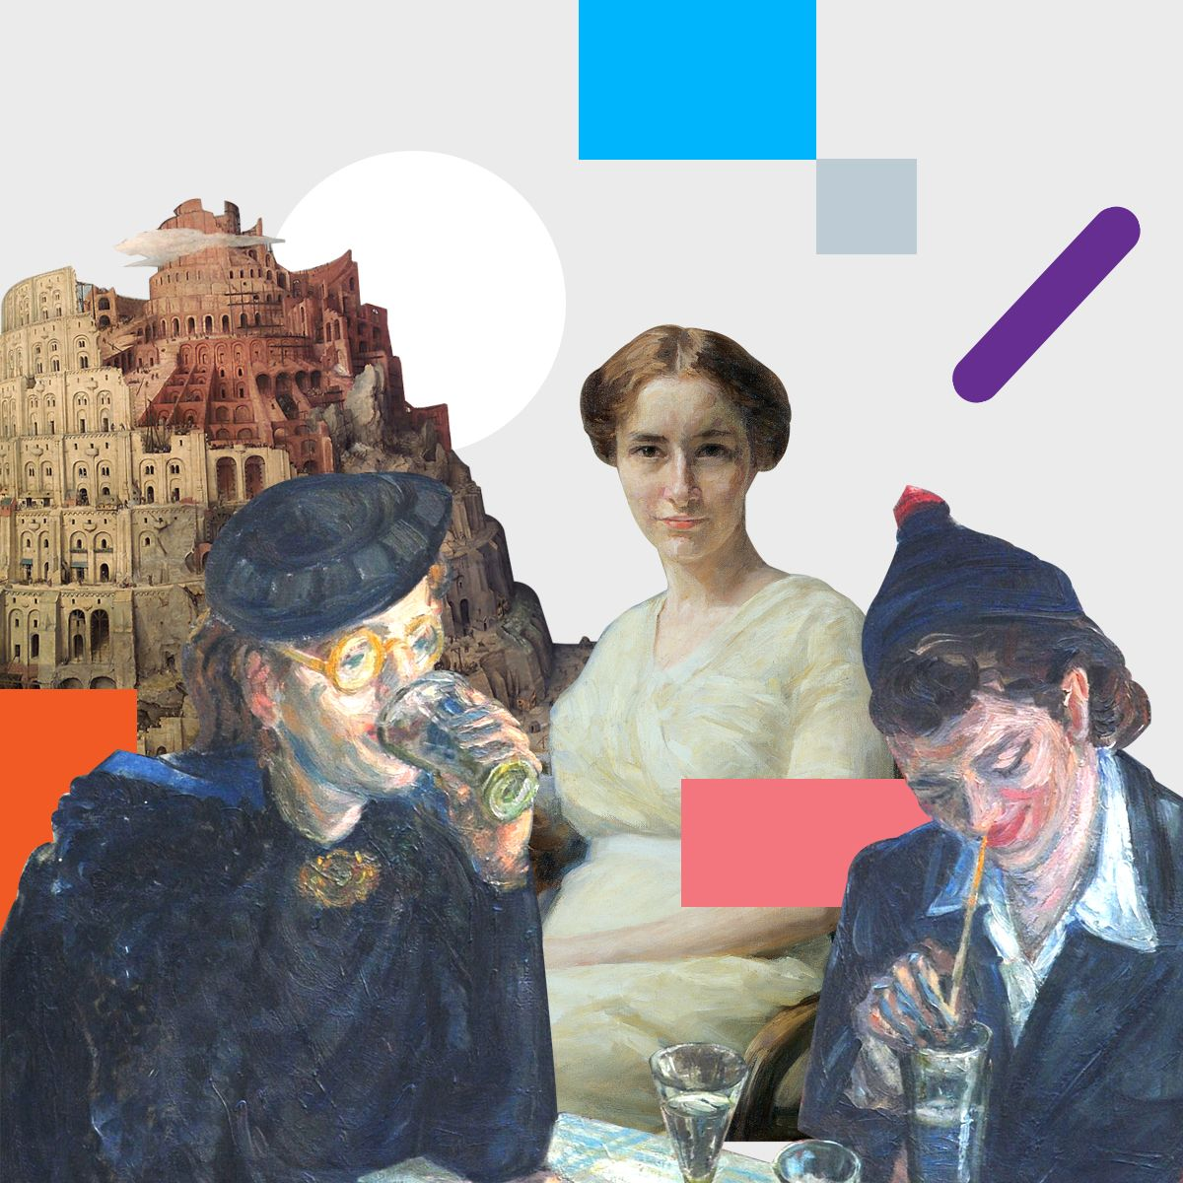
23 HearMe mentors
665 workshops
169 schools
8942 teenagers
630 teachers
150 students
119 culture specialists
41 cultural institutions
8 countries
21,000 engagements on social media
Project HearMe

Slide 18
Link to ProjectHearMe website:
http://projecthearme.org/
Link to manual (English, German, Serbian, Slovenian): http://projecthearme.org/2017/WW%20Manual%20English.pdf

