Slide 1

Les Contes de Fée 4
Title Slide
Name of presenter and contact details

Slide 2
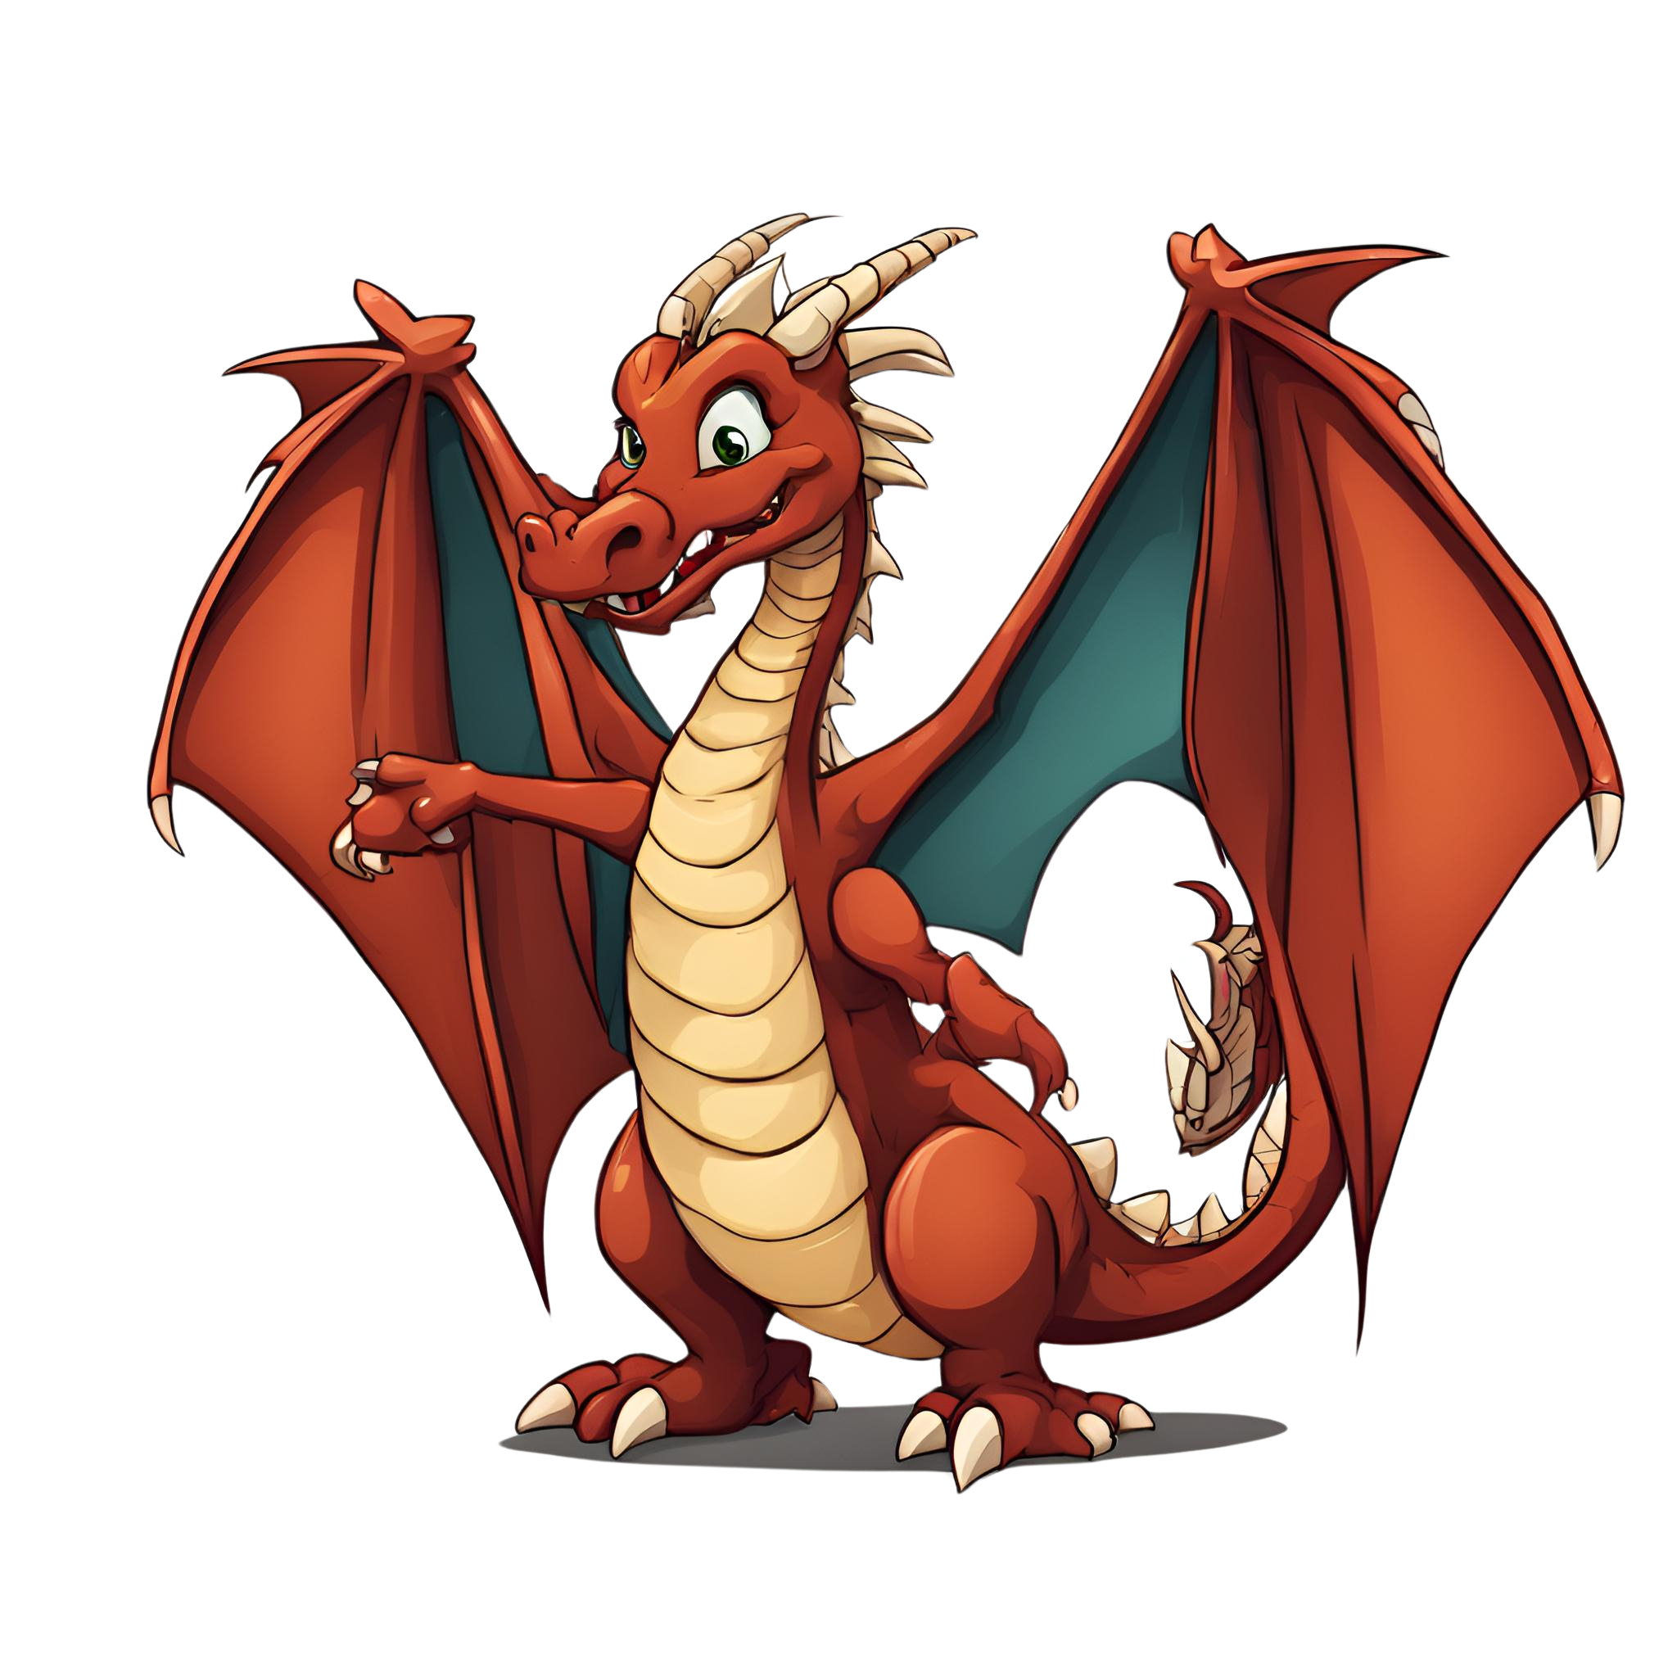

Bienvenue
Welcome Slide
Nous préparons les dialogues
Et les costumes!

Slide 3
Objectives
Objective Slide
Prepare the dialogues for the performance
Prepare the costumes for the performance
Rehearse in class for the performance

Slide 4

Write the script for the performance
Lesson Slide

Slide 5

Prepare the costumes
Lesson Slide

Slide 6

Rehearse the performance
Lesson Slide

Slide 7
JOIN OUR MAILING LIST

Slide 8

ευχαριστώ
Gracias
谢谢
Danke
Bedankt
Dziękuję
Diolch
Fa’afetai
Merci
Kiitos
Ласкаво просимо
Спасибо
Tak skal du have
Köszönjük
אדאנק
شكرًا لك
Teşekkürler
Thank you

