Slide 1
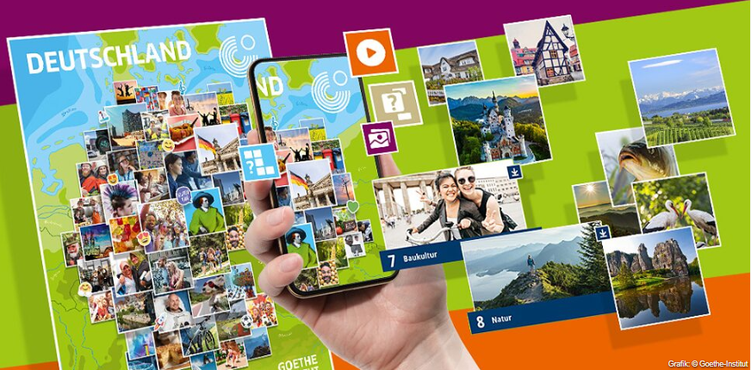
Deutschland. Kennen. Lernen.
Sprachniveau: A1

Slide 2
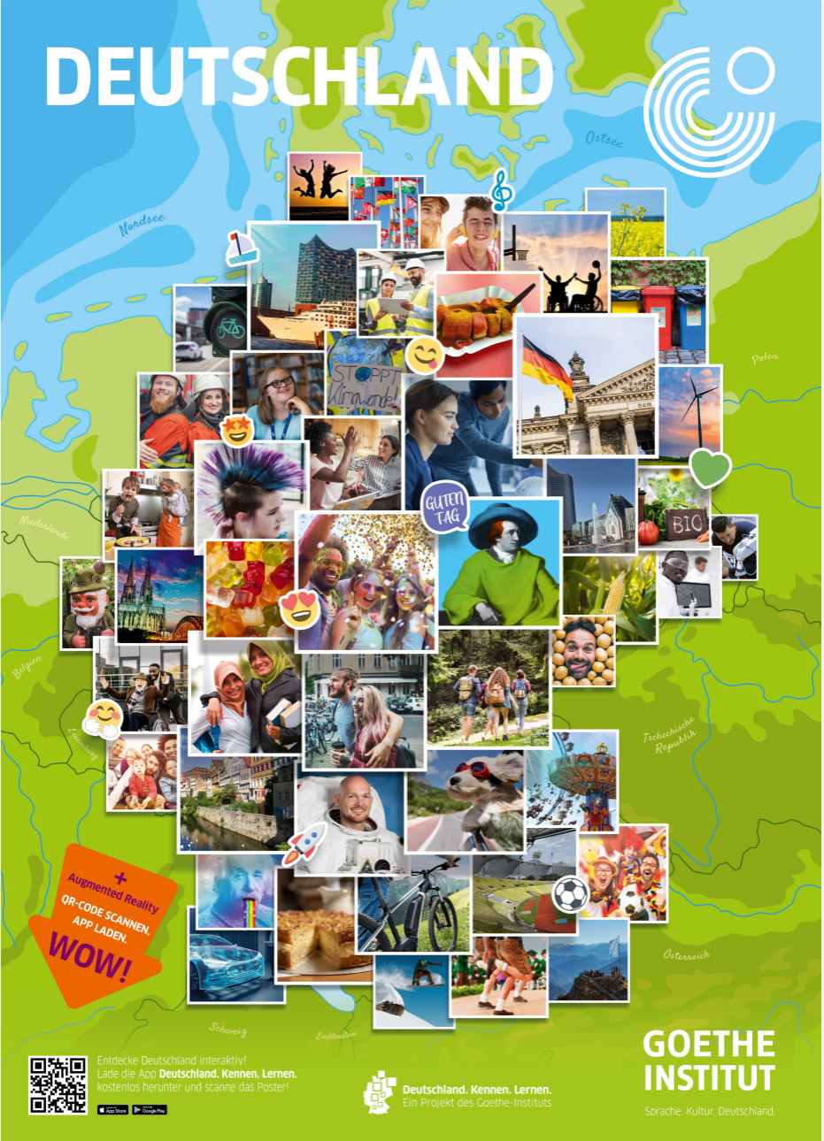

Vorbereitung
die App herunterladen mit Google Play Store (Android)
oder App Store (iOS)
das Poster herunterladen, ausdrucken oder bestellen
Notes:
Teachers and students can download the app from the Google Play Store (Android) or App Store (iOS) on to their smartphone or tablet. The app is called “Deutschland. Kennen. Lernen.”
Teachers can download, print or order the poster

Slide 3
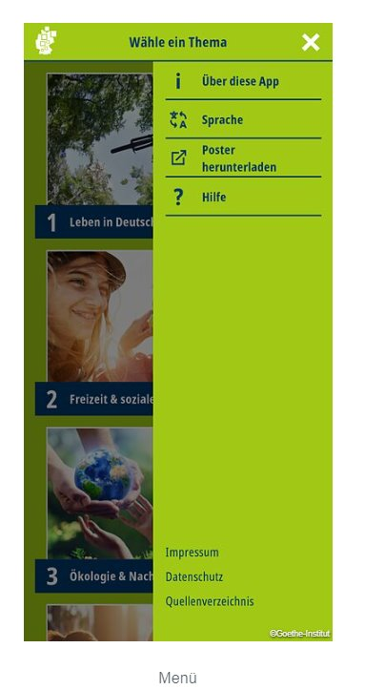
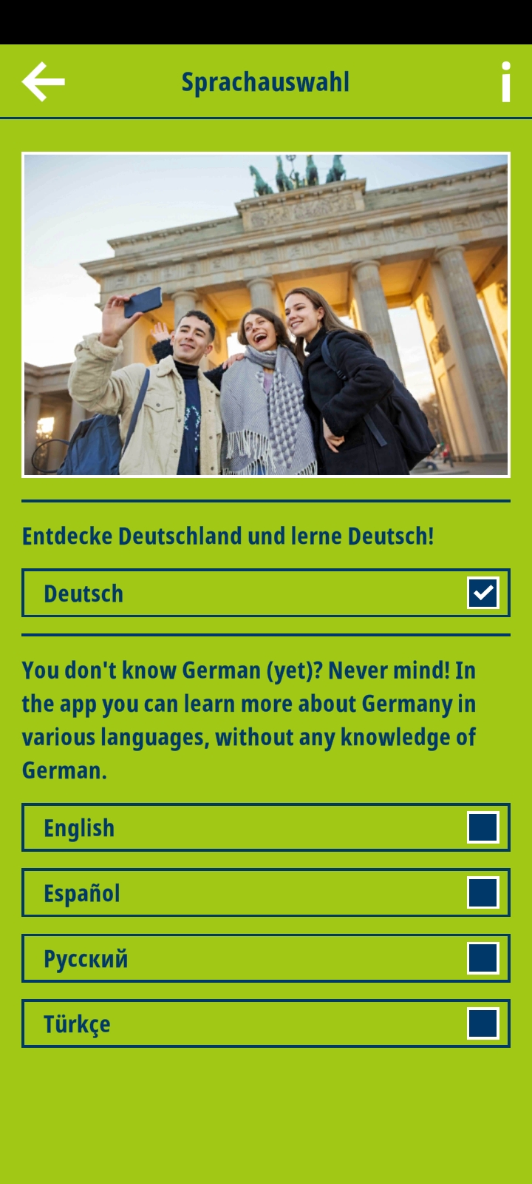
Anwendung der App
Du kannst die Sprache wählen, wenn du dich mit der deutschen Sprache nicht genug auskennst.
Notes:
Using the app
You can choose the language if you are not comfortable using it in German.

Slide 4
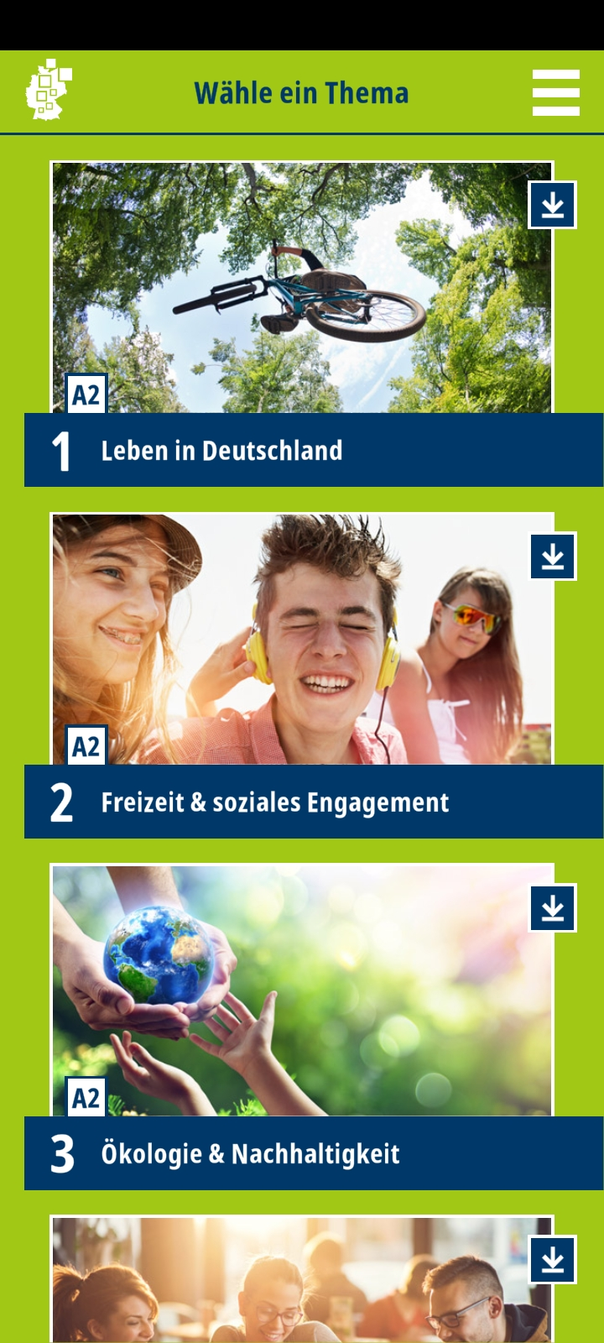
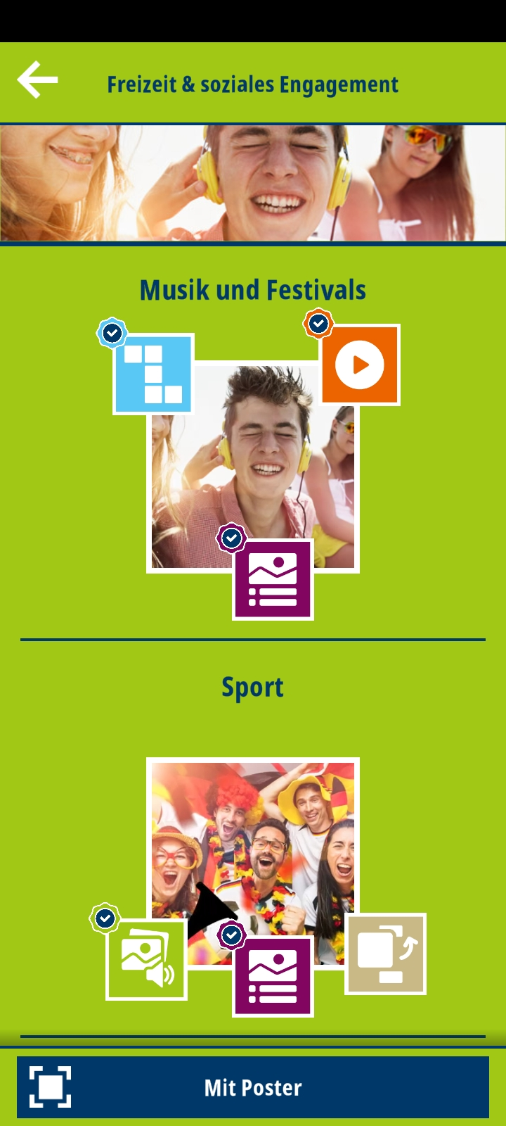
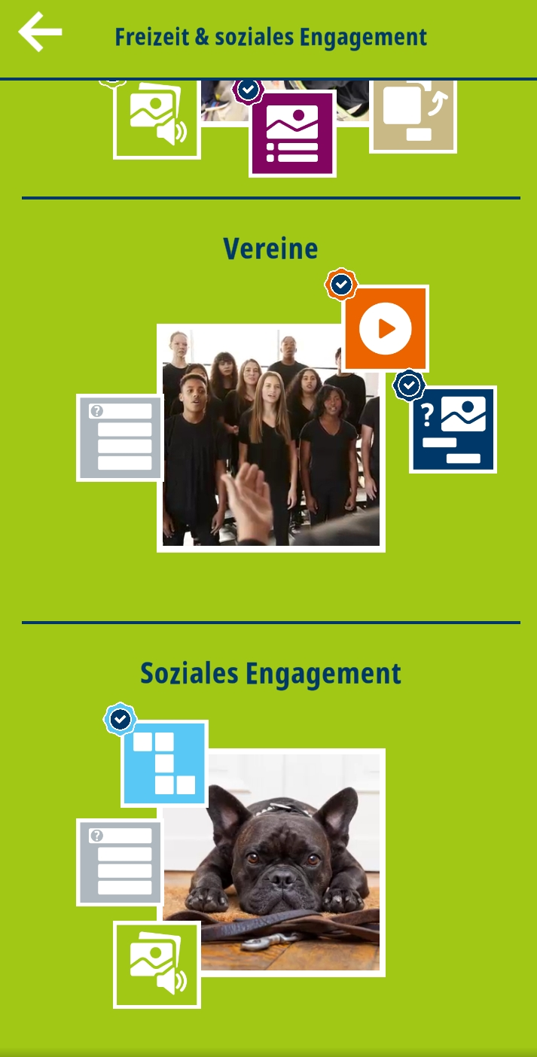
Wähle ein Thema- zb. 2. Freizeit & soziales Engagement
Jedes Thema hat 4 oder 5 Einheiten
und jede Einheit hat 3 Aktivitäten.
Notes:
Choose a Topic, for example: Topic 2. Leisure Timme & Voluntary Service
Each topic as you can see has 4 or 5 units and each unit has 3 activities.

Slide 5
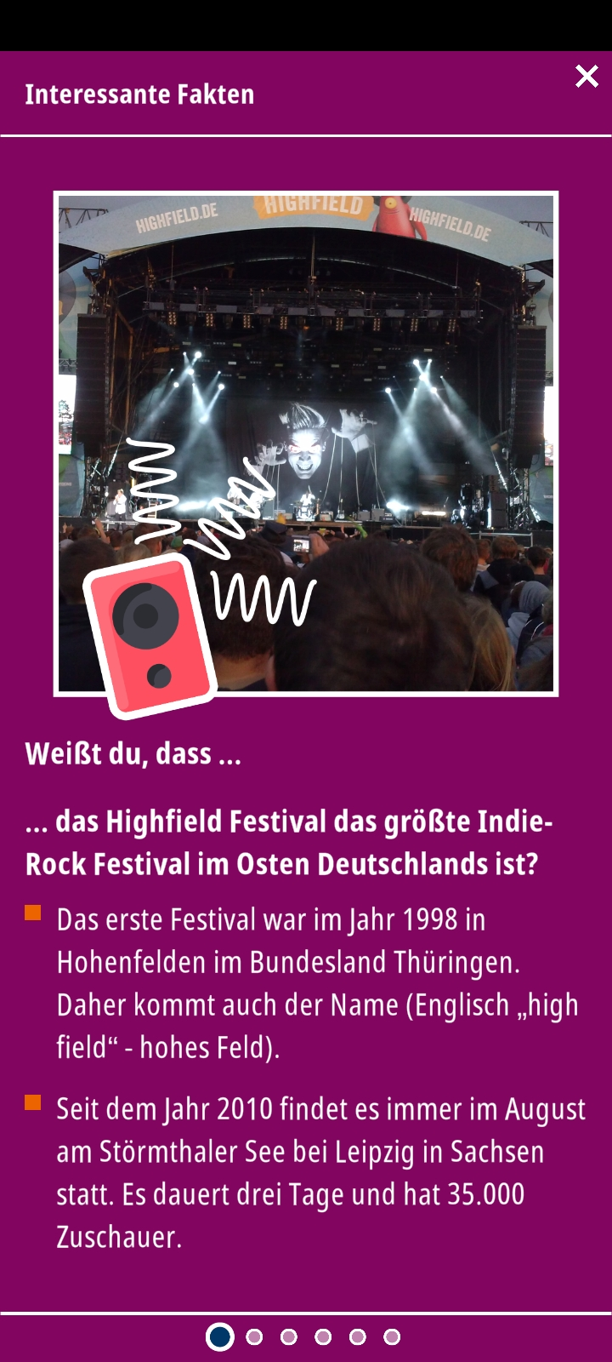
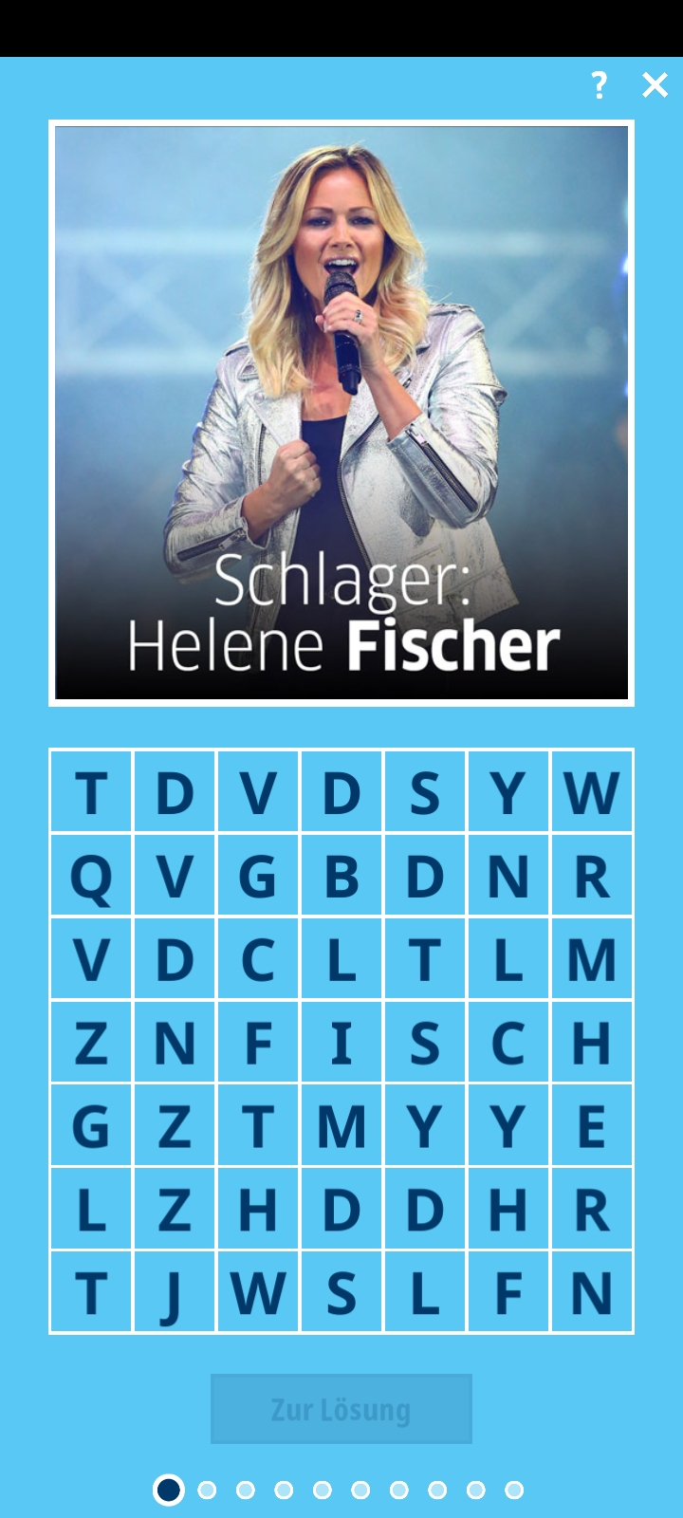
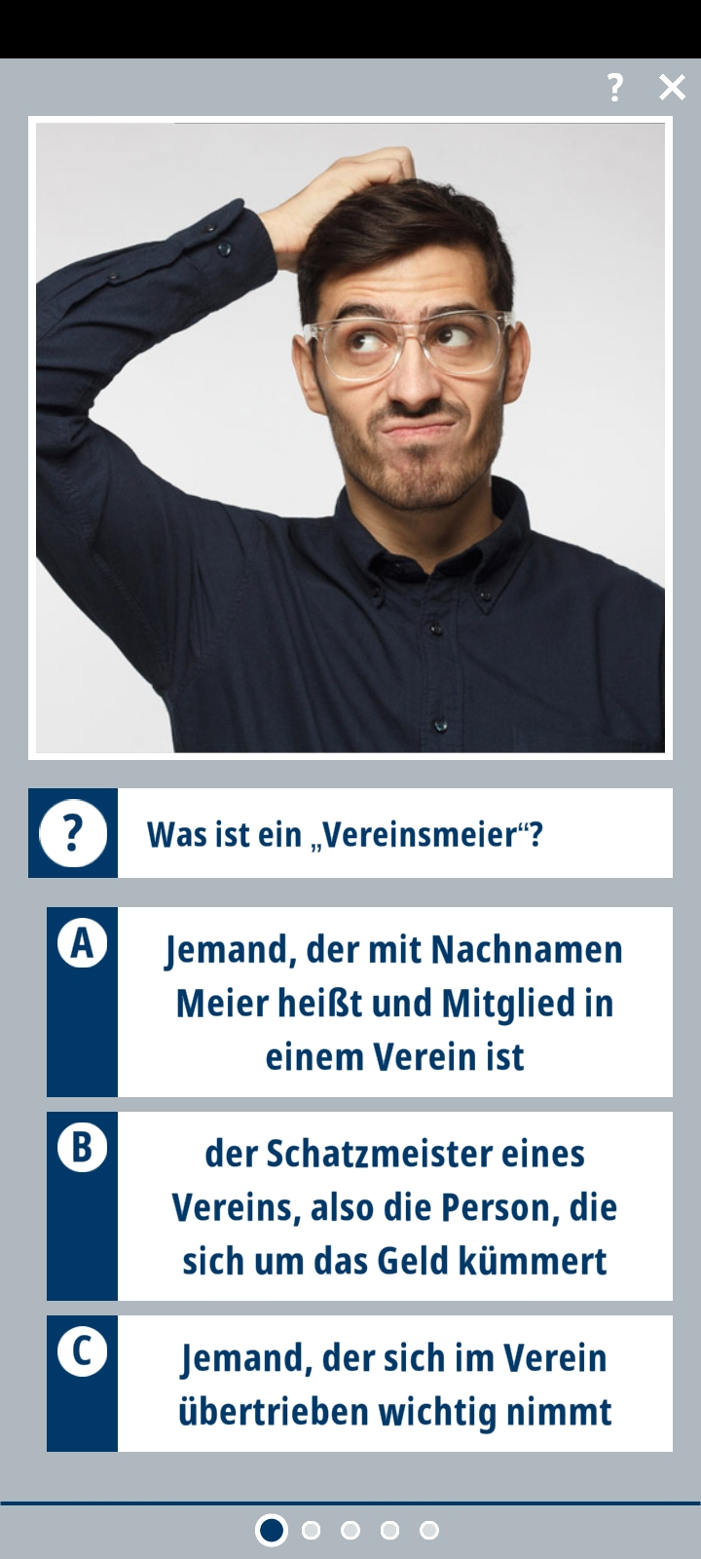
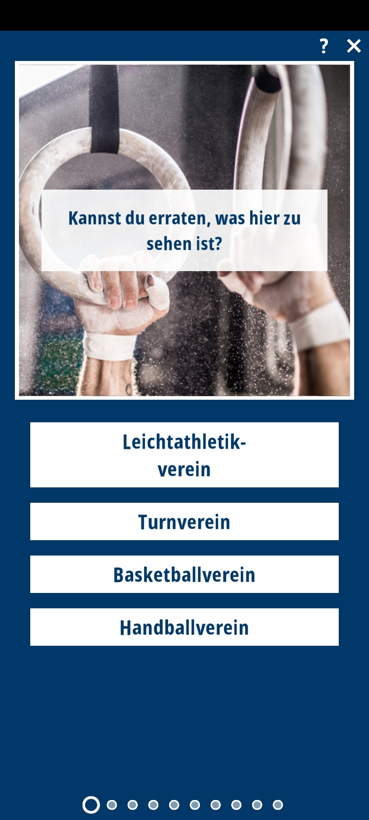
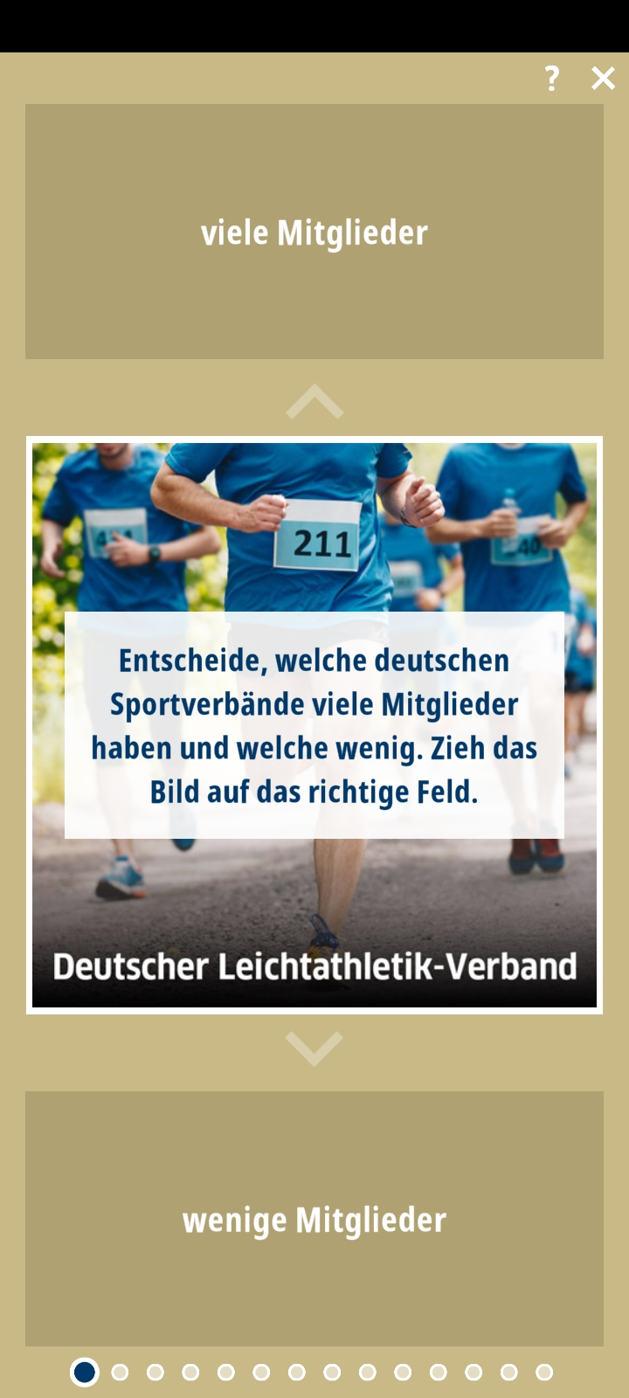
Unterschiedliche Aktivitäten
Quiz
Wörtersuchspiel
Video und Interessante Fakten
Notes:
Different types of activities

Slide 6
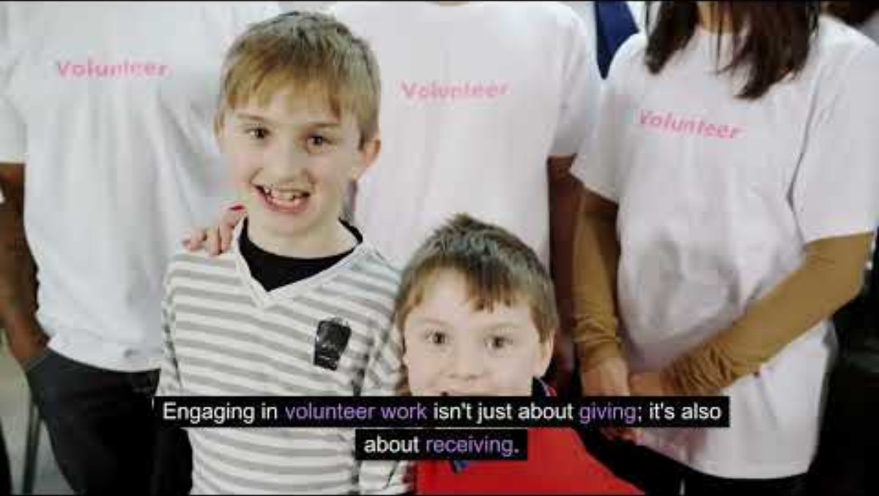
Final Cultural Exploration/Performance
Freizeit & soziales Engagement
Notes:
Teachers can introduce students to the notion of civic engagement in Germany by giving some statistics and facts. In order to do so, watch this short video in class: https://youtu.be/5SRARemjIrk

Slide 7
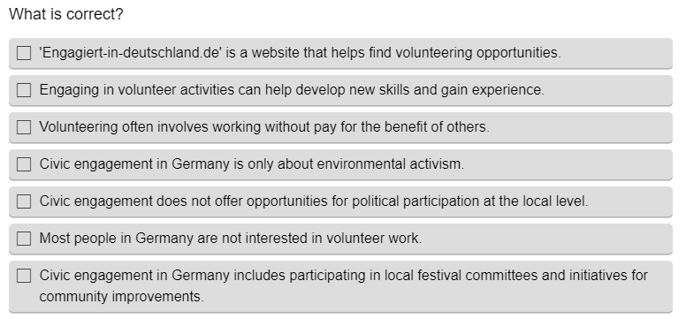
Quiz – Antworte die Fragen
Notes:
All together the students can answer the questions to the video.

Slide 8
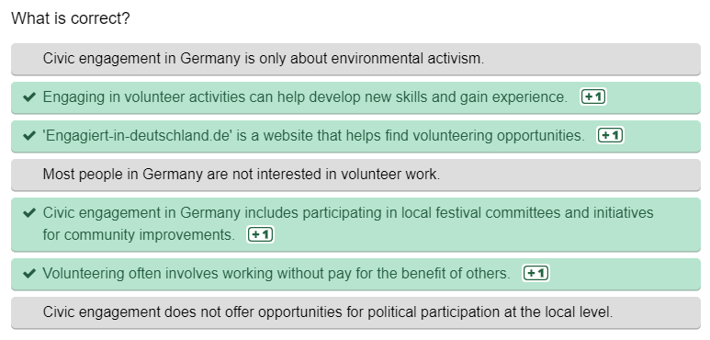
Antworten
Notes:
All together the students can answer the questions to the video.

Slide 9
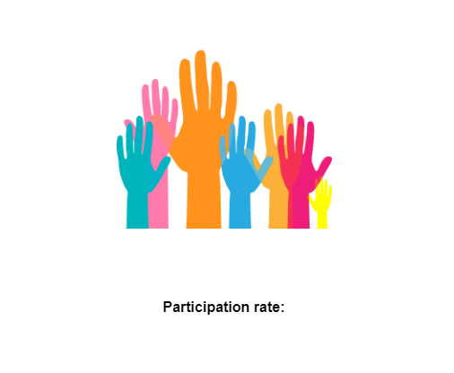
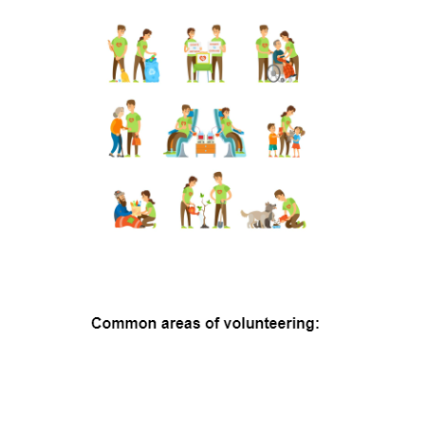
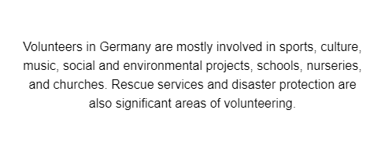
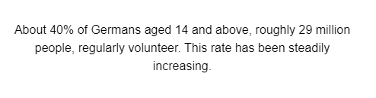
Statistiken und Fakten über zivilgesellschaftliches Engagement in Deutschland
Notes:
Together with the teacher, the students discover the statistics and facts concerning civic engagement in Germany.

Slide 10
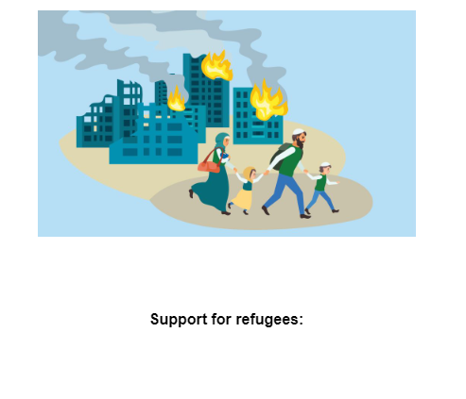

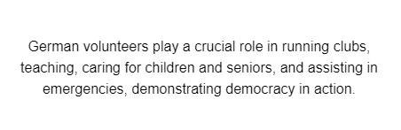
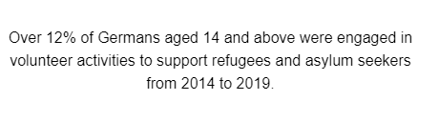
Notes:
Together with the teacher, the students discover the statistics and facts concerning civic engagement in Germany.

Slide 11
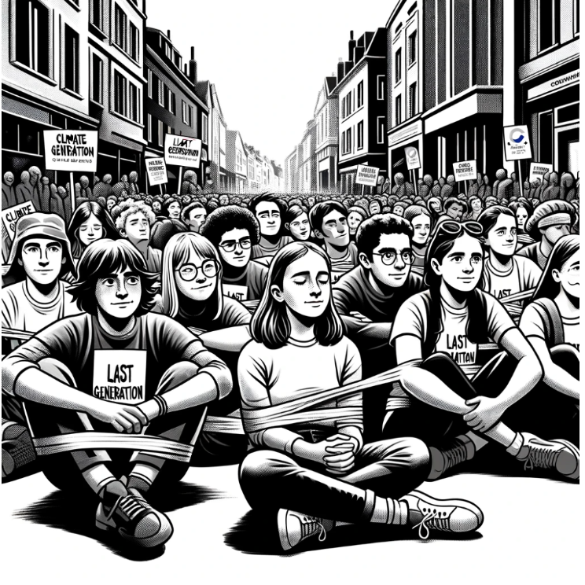
2. Maßnahmen ergreifen- Aktivismus
The Last Generation - Climate activists and 'Klima-Kleber' ('climate gluers')
For some time now, a movement of young people has formed worldwide, passionately advocating for climate protection. These young people, often referred to as the "Last Generation", are determined to raise awareness about the urgency of climate change and demand changes.
Fridays for Future - A global wake-up call
Origin: In 2018, Greta Thunberg, a student from Sweden, started to skip school on Fridays to protest for climate protection in front of the Swedish Parliament.
Global Movement: Her solo protest inspired young people worldwide. Soon, "Fridays for Future" protests were organised in many countries, including Germany. Prominent figures in Germany include Luisa Neubauer and Jakob Blasel.
Reactions: The movement received both approval and criticism for its commitment, especially for skipping school. Recently, Greta Thunberg faced criticism for her social media posts regarding the Israel-Palestine conflict, leading to the German "Fridays for Future" movement distancing itself from her statements and any form of antisemitism, highlighting the importance of balanced and sensitive political discourse in activism.
Notes:
The students split into groups of 3 or 4 and ask each other: What would they like to demonstrate for or against?
Students design a protest sign for their cause in German.

Slide 12
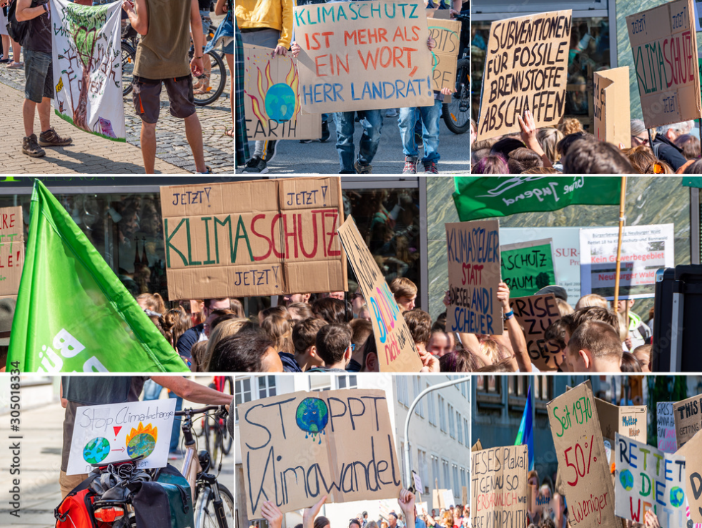
Maßnahmen ergreifen- Aktivismus
Option 1
Entwerfe ein Protestzeichen auf Deutsch für die Sache, für die du dich einsetzt.
Notes:
The students split into groups of 3 or 4 and ask each other: What would they like to demonstrate for or against?
Students design a protest sign for their cause in German.

Slide 13
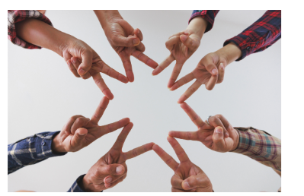
Stelle dich vor, dass du einen Verein oder Club aufbauen, und entwerfe einen Flyer, der erklärt, worum es in dem Verein geht.
Maßnahmen ergreifen- Aktivismus
Option 2
Notes:
Alternatively, students split into groups of 3 or 4 and ask each other:
They imagine that they are setting up an association or club and design a flyer explaining what the organisation is all about.

Slide 14
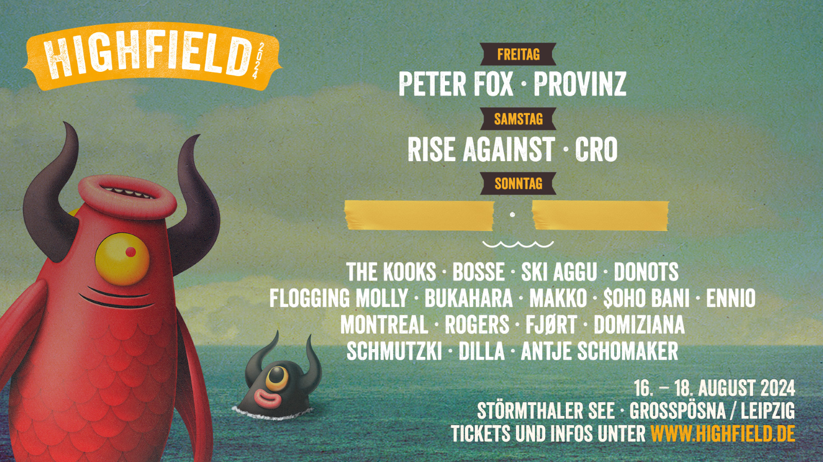

Final Cultural Exploration/Performance
Musik Festival
Beschreibe die Plakate
Notes:
A whole range of visual and creative work can be done afterwards. 1. Students can start by describing posters from German festivals of their choice to familiarise themselves with the following expressions:

Slide 15
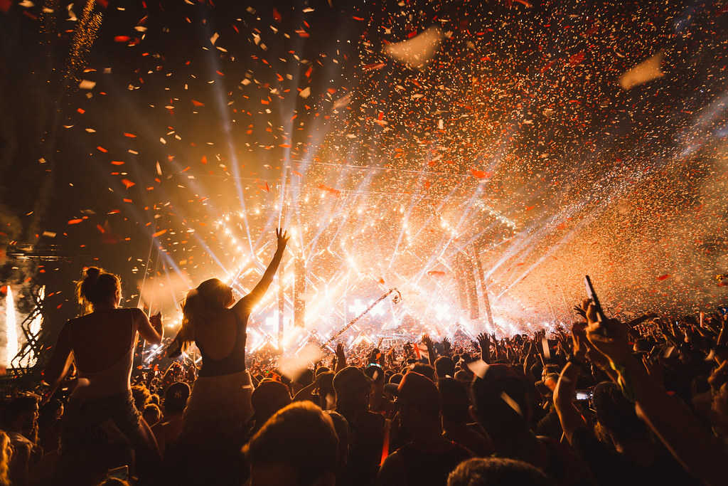
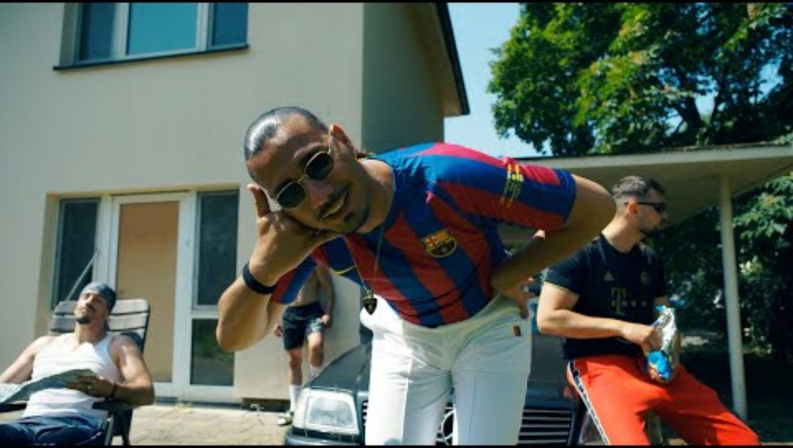
Final Cultural Exploration/Performance
Musik Festival – Option 1
Gestalte dein eigenes Festivalschild und lass dich von deutscher Musik inspirieren:
German Charts - Summer 2024 - Step into German - Goethe-Institut
ThePhoto von PhotoAuthor ist unter CCYYSA lizenziert.
Notes:
In groups of 3 or 4, students can prepare a sign for a fictional or existing festival highlighting at least one German group/artist that they liked, with a bit of text (biography, genre of music, location). In order to do so, Students can listen again to a selection of German songs here: German Charts - Summer 2024 - Step into German - Goethe-Institut

Slide 16
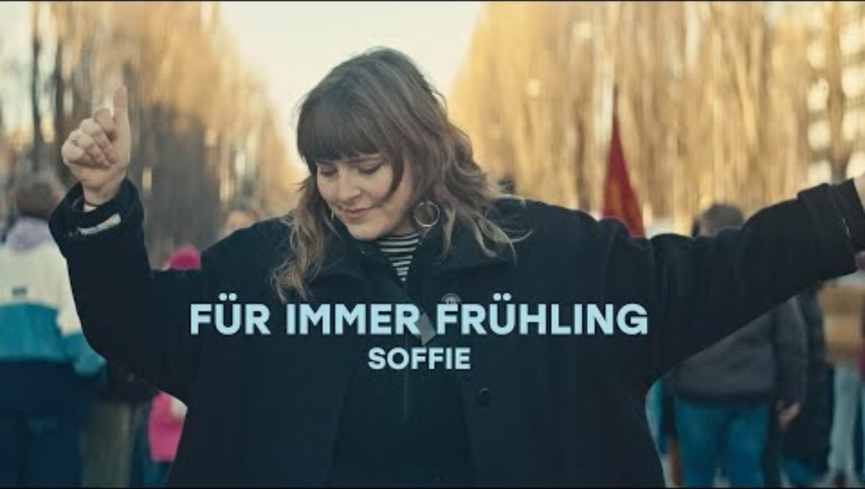
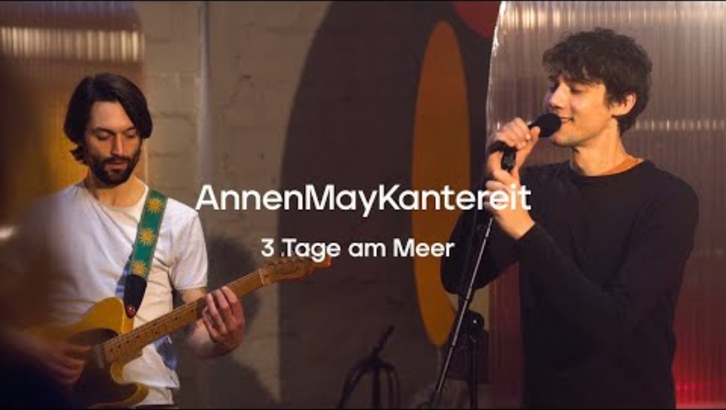

Final Cultural Exploration/Performance
Musik Festival – Option 2
Schreibe dein eigenes Lied oder Gedicht
Notes:
Alternatively, in groups of 3 or 4, they can choose a German song or slam that appeals to them and learn the lyrics, translate the chorus and/or explain why they chose the song in English. If they prefer they can invent their own lyrics and write a slam or poem with both verses in ENglish and German.This performance can be presented at the end of the year.

Slide 17
Slide Title
Q&A

Slide 18
JOIN OUR MAILING LIST

Slide 19

ευχαριστώ
Gracias
谢谢
Danke
Bedankt
Dziękuję
Diolch
Fa’afetai
Merci
Kiitos
Ласкаво просимо
Спасибо
Tak skal du have
Köszönjük
אדאנק
شكرًا لك
Teşekkürler
Thank you

