Slide 1
Spanish Cultural Performance 2
Spanish cultural performance
Primary

Slide 2
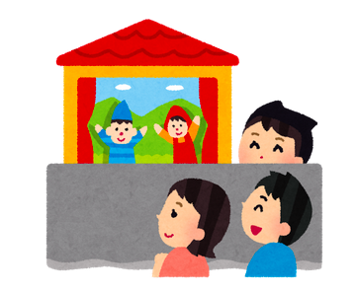
Spanish cultural performance
Don Quijote y la aventura de los gigantes
Let’s perform a puppet show!
2

Slide 3
Spanish cultural performance
Contenidos – Contents
1. Characters and scene of Don Quijote de la Mancha
Suggested activities
2. Creation and performance of a little puppet theatre
Suggestions for the creation of a Spanish children’s puppet show in Spanish

Slide 4
Spanish cultural performance
Objetivos de aprendizaje – Learning objectives
Prepare a puppet show based on one of the most famous scenes from Cervantes’s Don Quijote…
… and perform it in front of an audience!

Slide 5
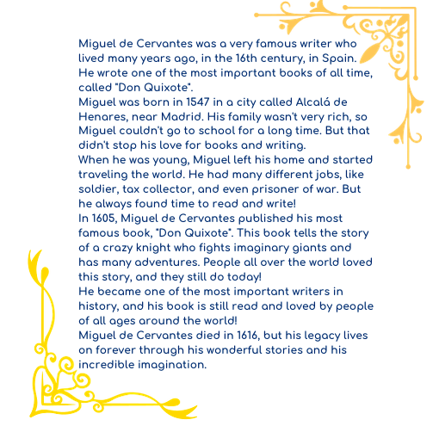
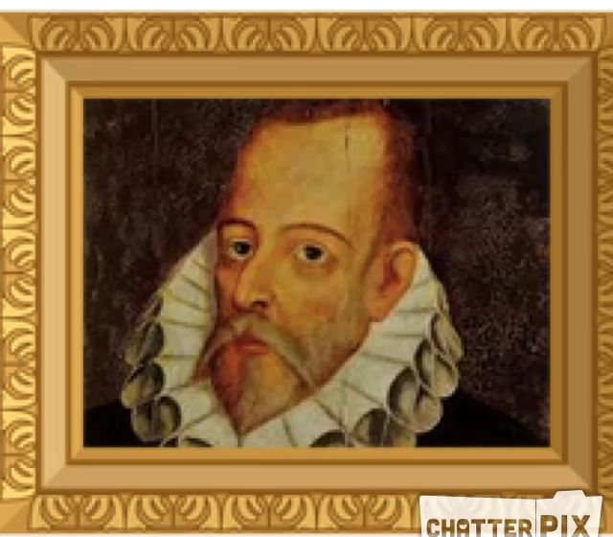

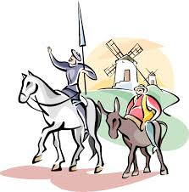
Spanish cultural performance
Don Quijote: El autor – The author
1.Who is this historic character?
2.Click on the picture and listen to Cervantes
5

Slide 6
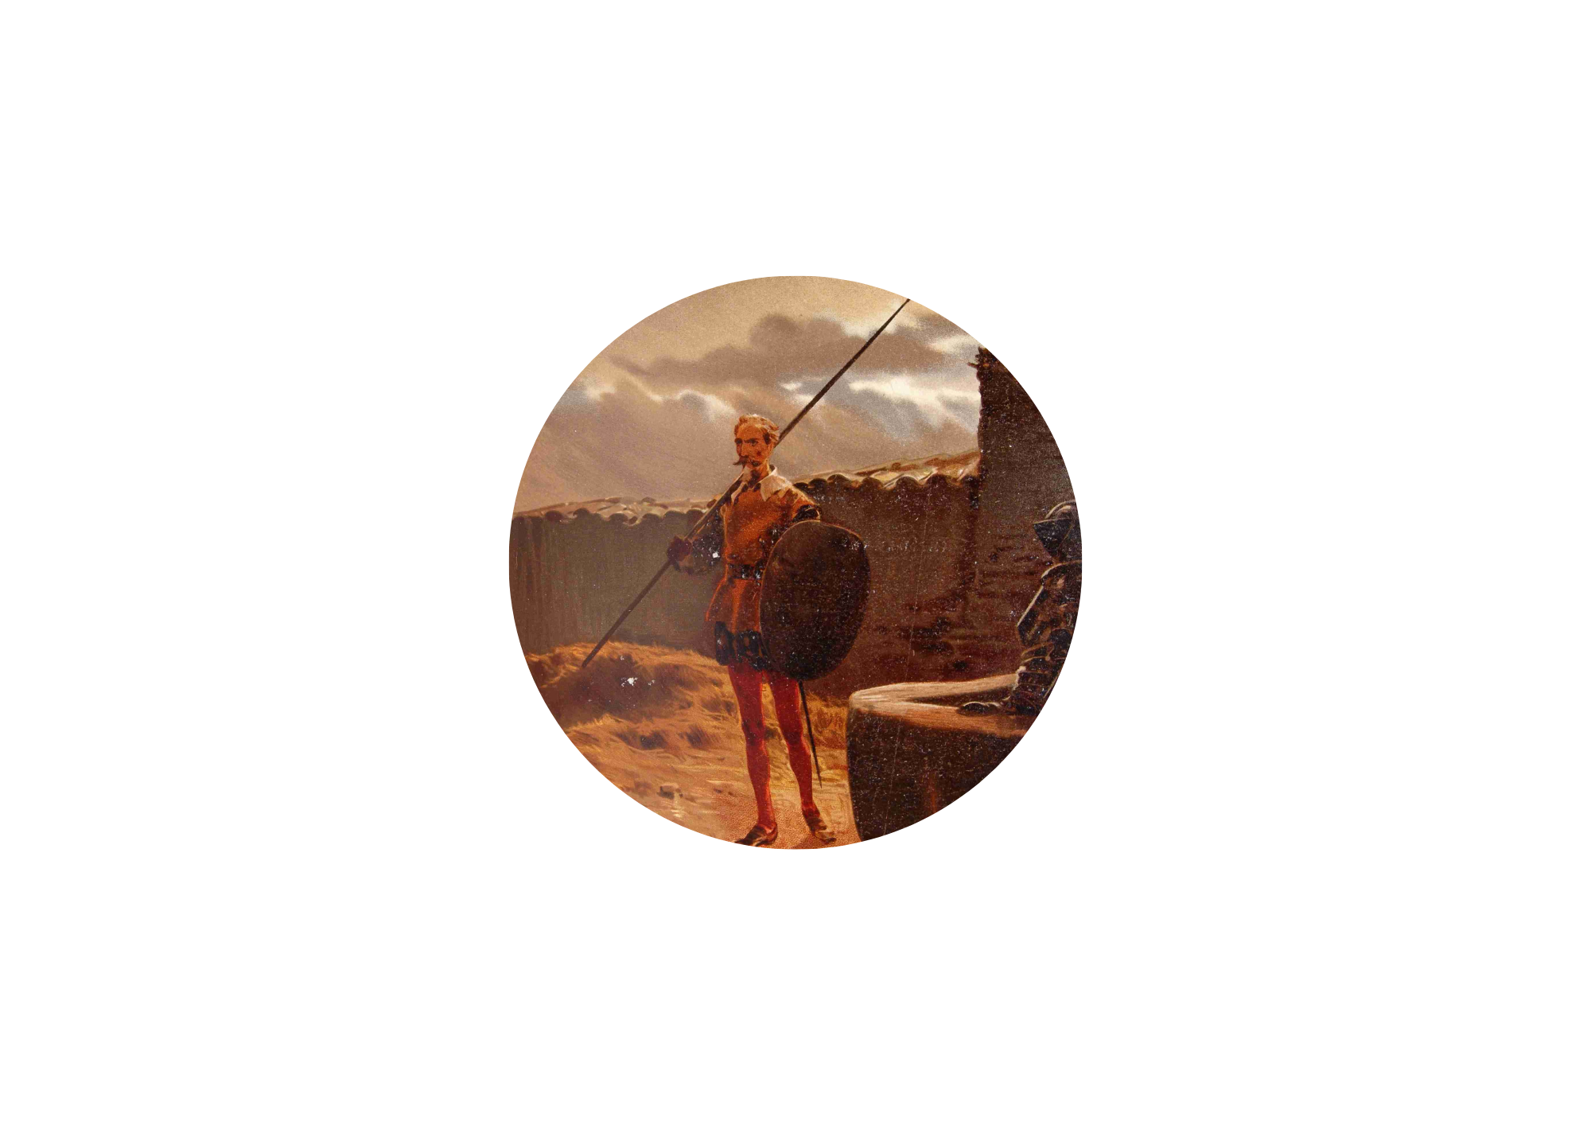
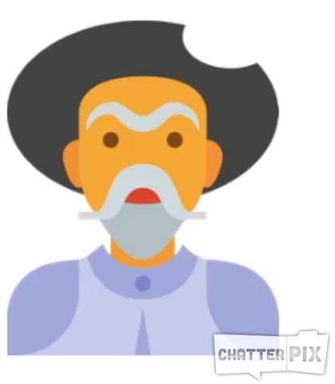




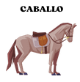
Spanish cultural performance
DON QUIJOTE
Don Quijote: Los personajes – The characters
Click on the picture and listen to Don Quijote
6

Slide 7
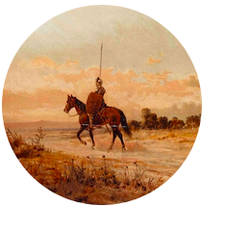
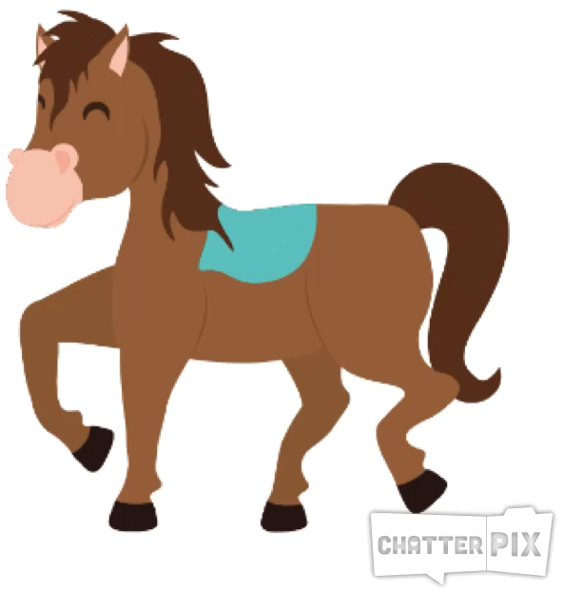
Spanish cultural performance
Don Quijote: Los personajes – The characters
ROCINANTE
Click on the picture and listen to Rocinante
7

Slide 8
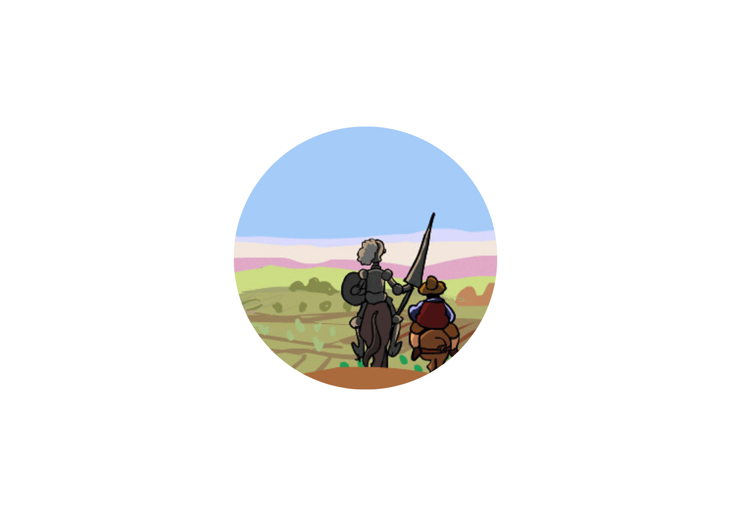


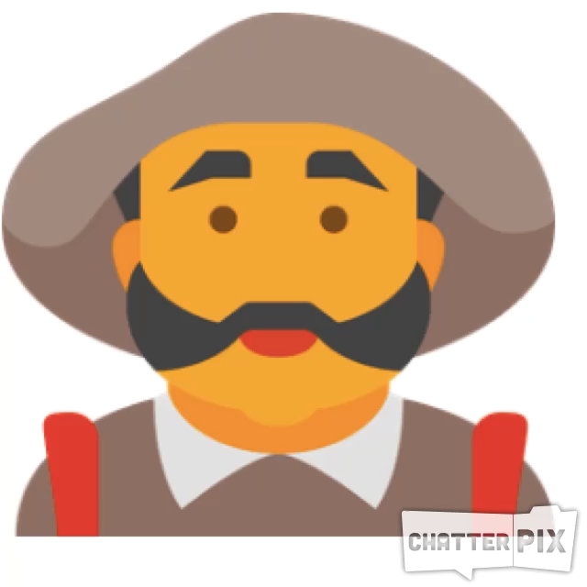



Spanish cultural performance
SANCHO PANZA
Don Quijote: Los personajes – The characters
Click on the picture and listen to Sancho Panza
8

Slide 9
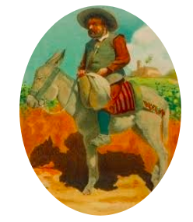
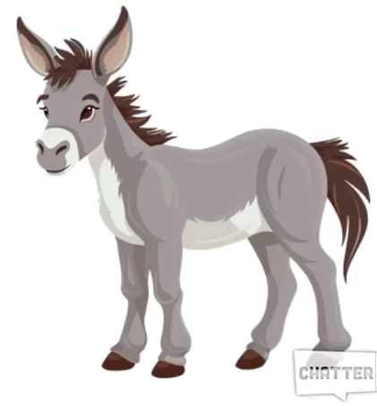
Spanish cultural performance
Don Quijote: Los personajes – The characters
RUCIO
Click on the picture and listen to Rucio
9

Slide 10
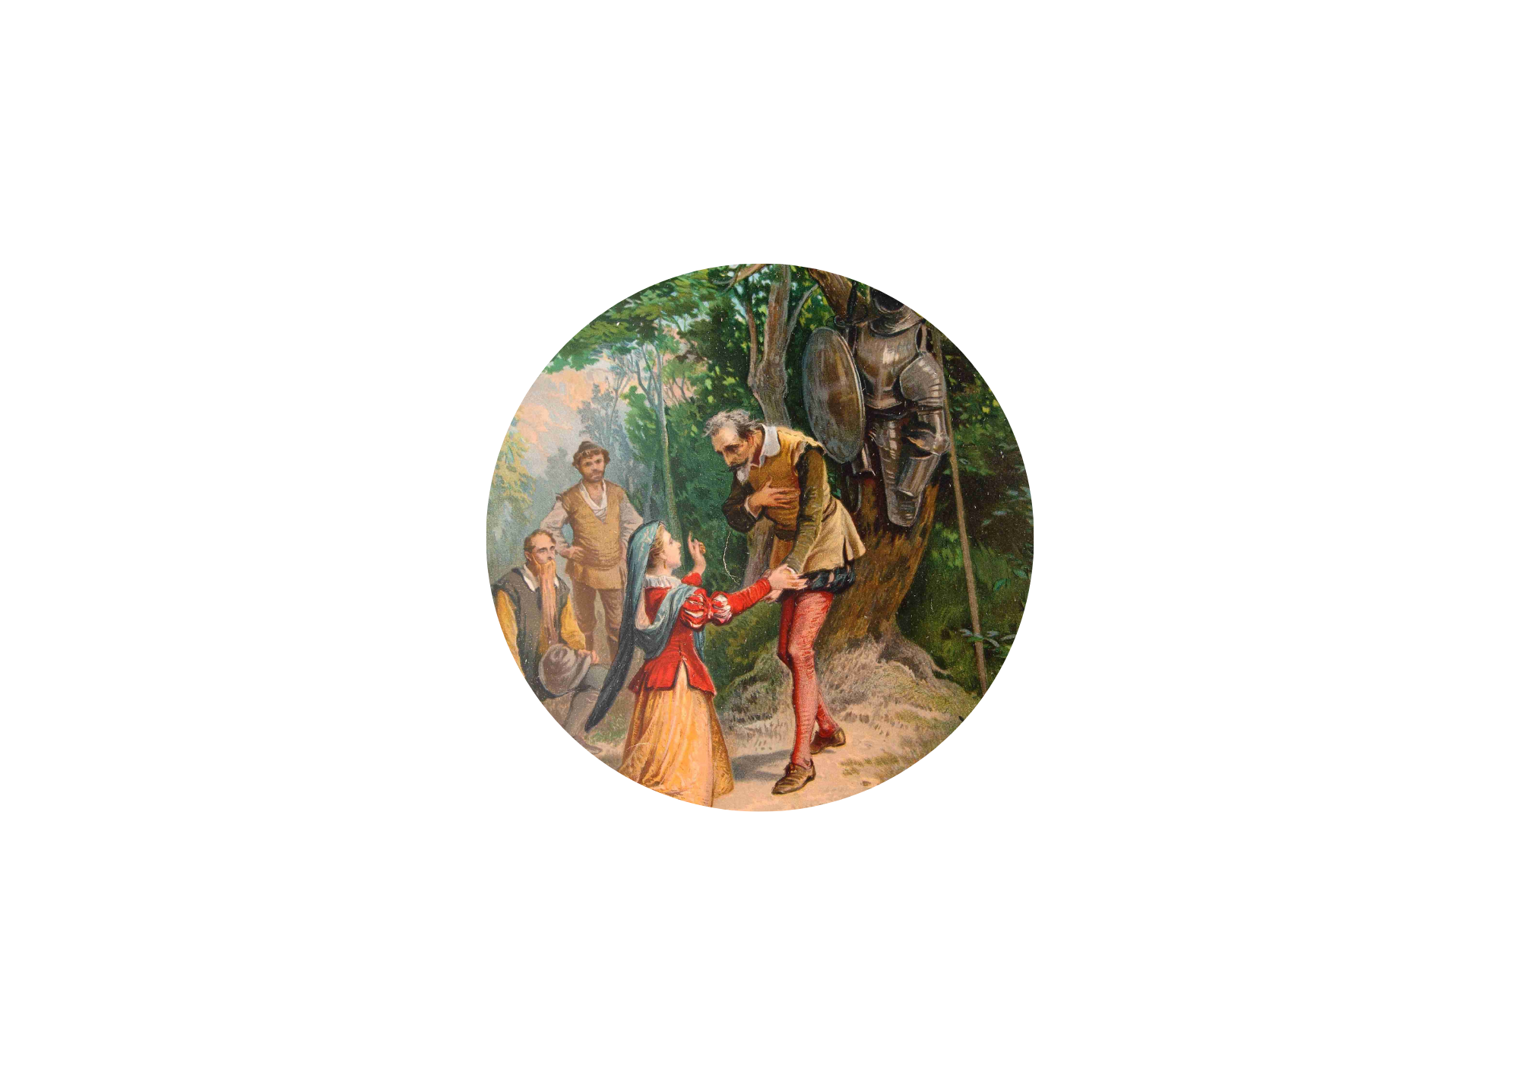

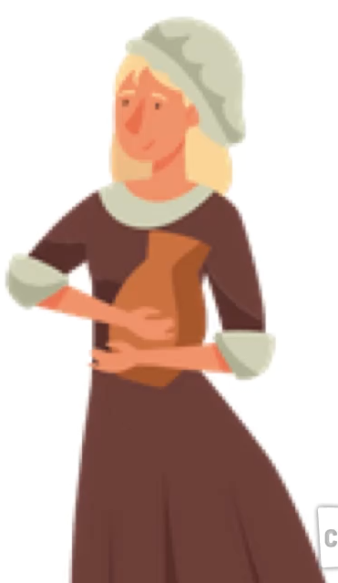


Spanish cultural performance
DULCINEA
Don Quijote: Los personajes – The characters
Click on the picture and listen to Dulcinea
10

Slide 11

Spanish cultural performance
¡Don Quijote y los gigantes! – Don Quixote and the Giants!
Click on the picture and watch this audio book about the windmill adventure!
11

Slide 12
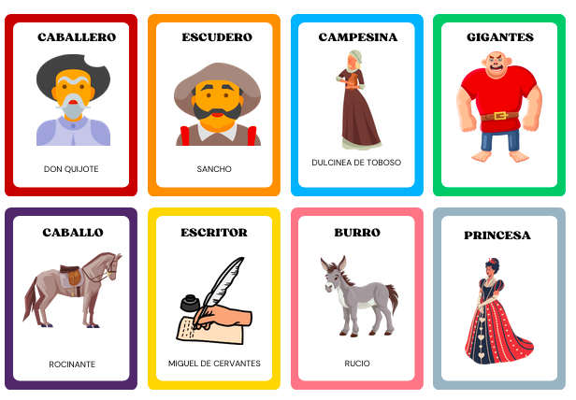
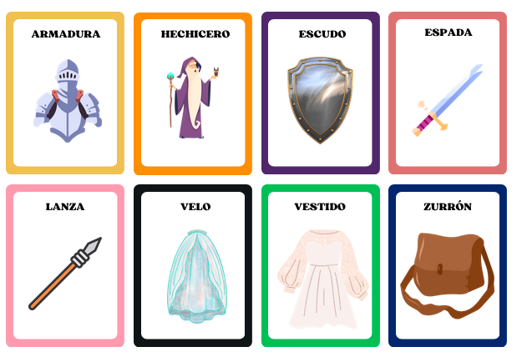
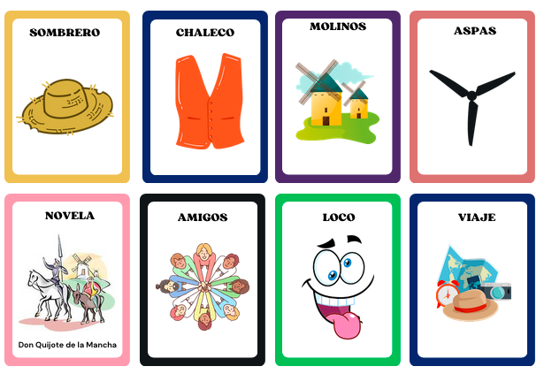
Spanish cultural performance
Don Quijote: ¡Juega con las tarjetas de Don Quijote! – Play with Don Quijote flash cards!
12

Slide 13
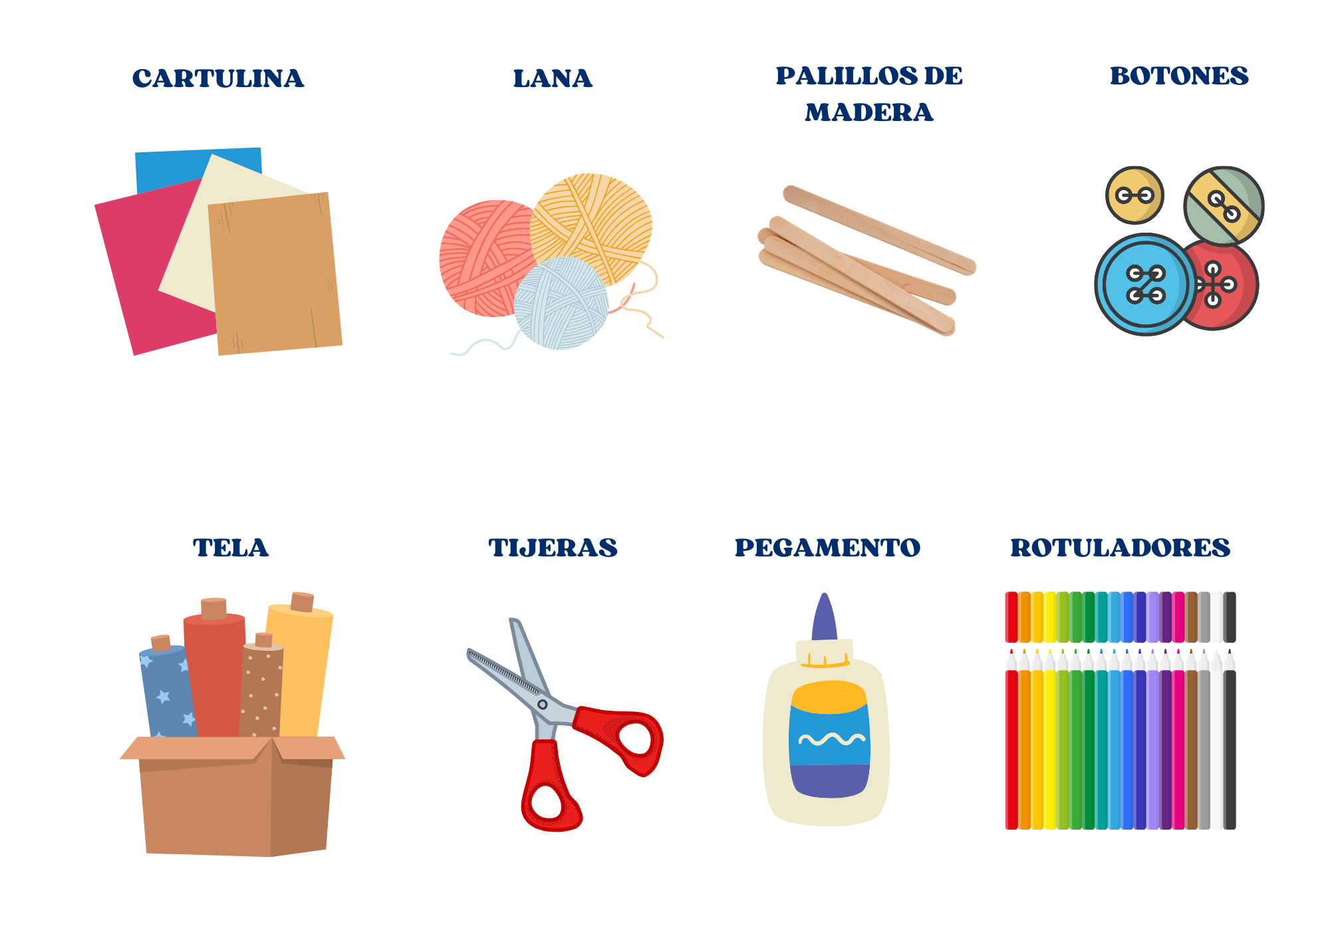
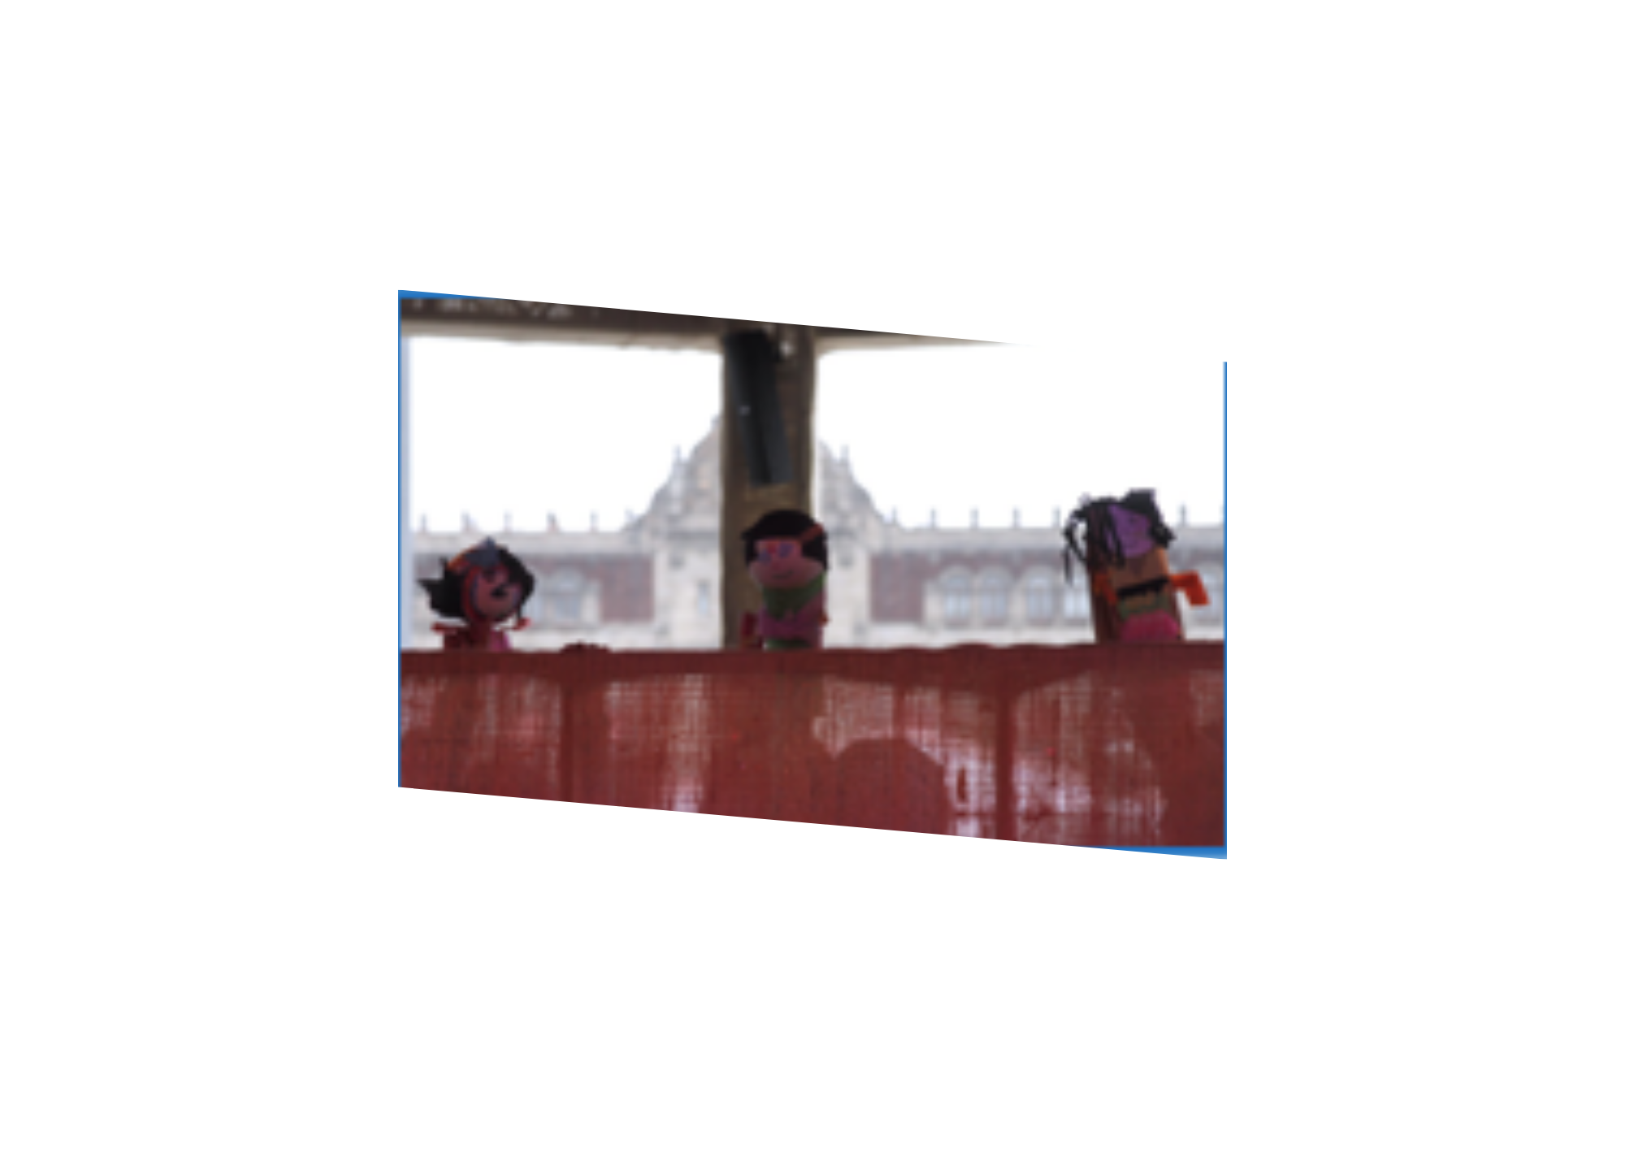
Spanish cultural performance
Don Quijote: El teatro de marionetas – The puppet show
1.Create the puppets of Don Quijote!
13

Slide 14
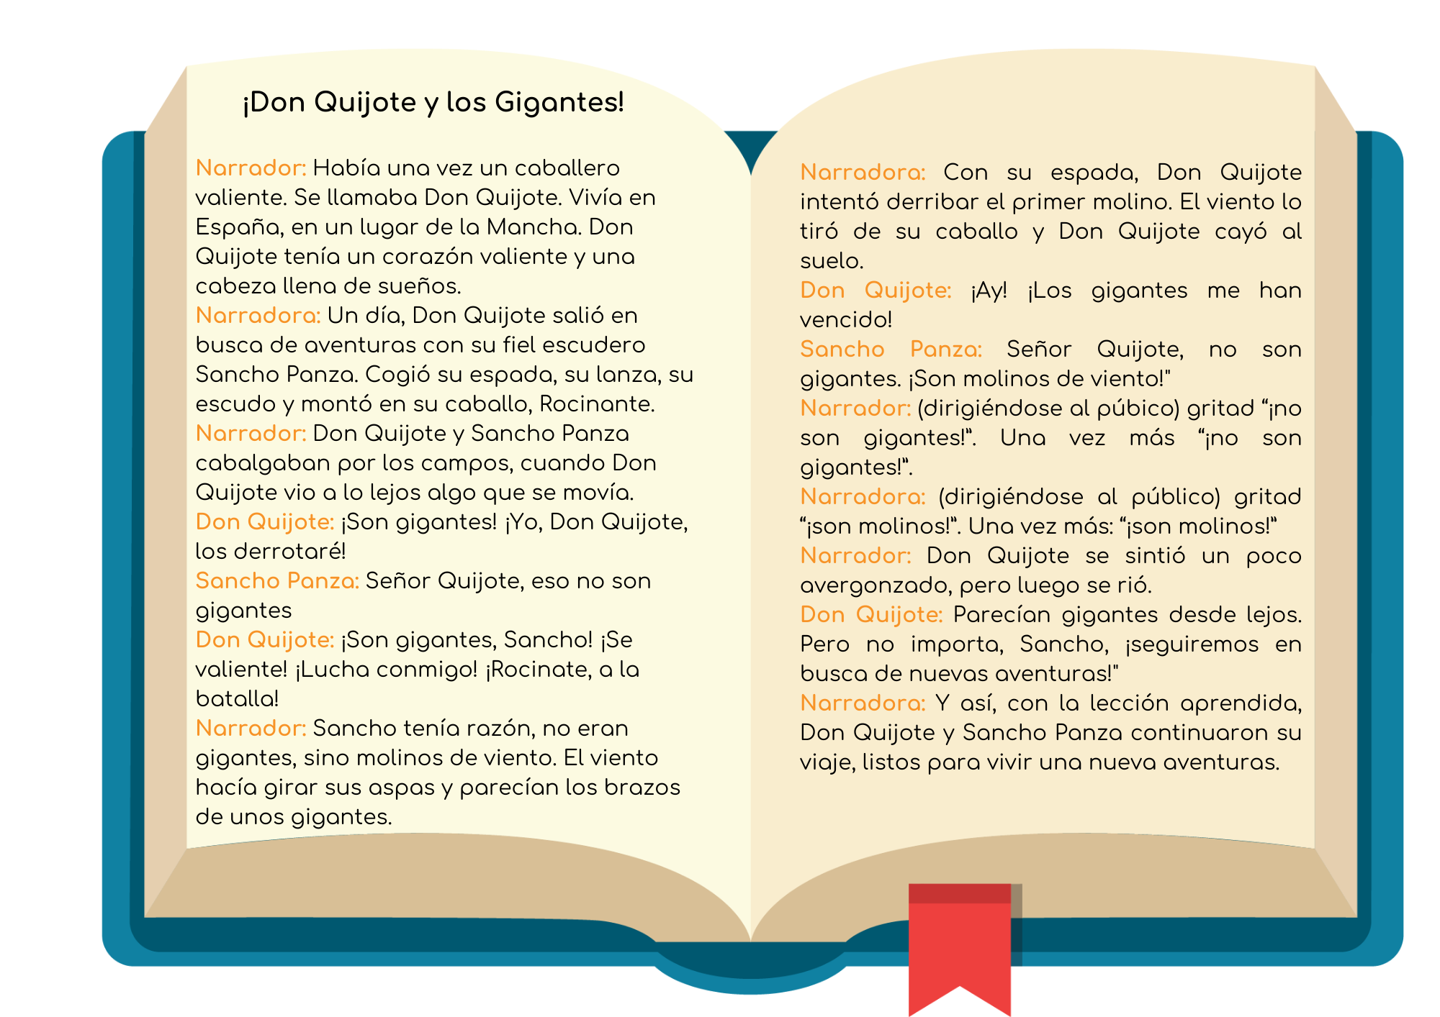
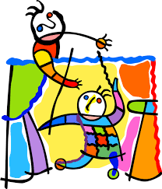
Spanish cultural performance
Don Quijote: El teatro de marionetas – The puppet show
2.Learn the script and rehearse!

Slide 15
¡Ya estáis preparados para representar un teatro de marionetas en español!
You are now ready to perform a Spanish puppet show for children!
15

Slide 16
Slide Title
Q&A

Slide 17
JOIN OUR MAILING LIST

Slide 18

ευχαριστώ
Gracias
谢谢
Danke
Bedankt
Dziękuję
Diolch
Fa’afetai
Merci
Kiitos
Ласкаво просимо
Спасибо
Tak skal du have
Köszönjük
אדאנק
شكرًا لك
Teşekkürler
Thank you

