Slide 1
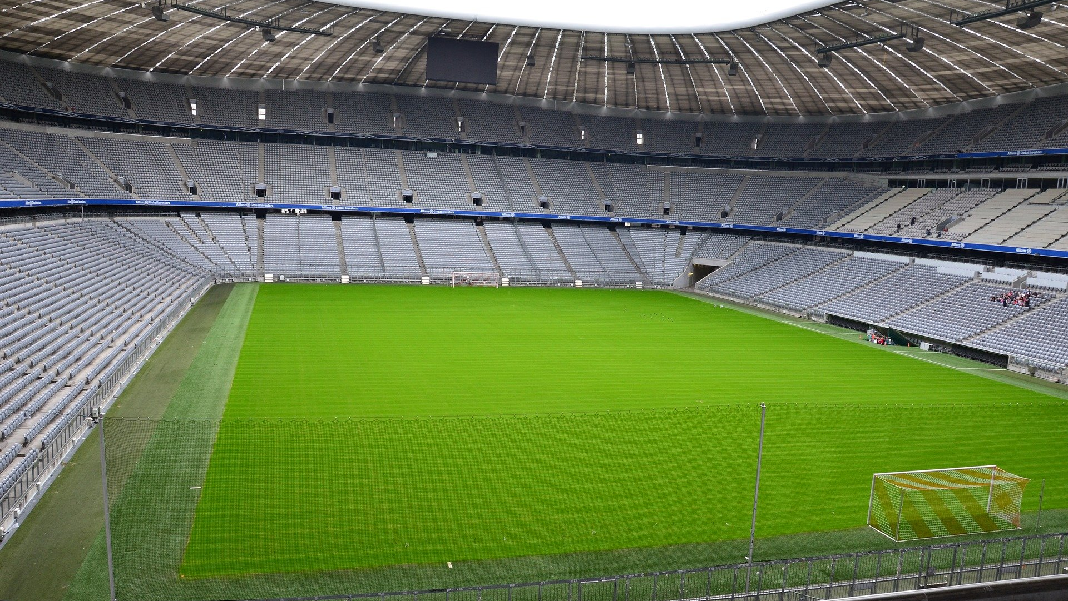
EURO 2020:
FANTASY FOOTBALL - AUF DEUTSCH!
PUPIL RULES

Slide 2
BUILDING YOUR TEAM
Each team must have 5 players
A team must consist of 1 goalkeeper, 1 defender, 1 midfielder, 1 striker; plus 1 extra defender, midfielder or striker
The selected players must be from 5 different countries
The overall cost of the team must not exceed €20 million
Players must be selected from the Player List provided

Slide 3
SCORING SYSTEM
(ENGLISH)
 | GOAL | ASSIST | CLEAN SHEET | 1-3 GOALS CONCEDED | 4+ GOALS CONCEDED | OWN GOAL | YELLOW CARD | RED CARD
GOALKEEPER | 6 | 2 | 3 | -1 | -3 | -2 | -1 | -3
DEFENDER | 5 | 2 | 3 | -1 | -3 | -2 | -1 | -3
MIDFIELDER | 4 | 2 | N/A | N/A | N/A | -2 | -1 | -3
STRIKER | 3 | 2 | N/A | N/A | N/A | -2 | -1 | -3

Slide 4
SCORING SYSTEM
(DEUTSCH)
 | TOR | TOR-VORLAGE | ZU NULL | 1-3 GEGENTORE | 4+ GEGENTORE | EIGEN-TOR | GELBE KARTE | ROTE KARTE
TORWART | 6 | 2 | 3 | -1 | -3 | -2 | -1 | -3
VERTEIDIGER | 5 | 2 | 3 | -1 | -3 | -2 | -1 | -3
MITTELFELD-SPIELER | 4 | 2 | N/A | N/A | N/A | -2 | -1 | -3
STÜRMER | 3 | 2 | N/A | N/A | N/A | -2 | -1 | -3

