Slide 1
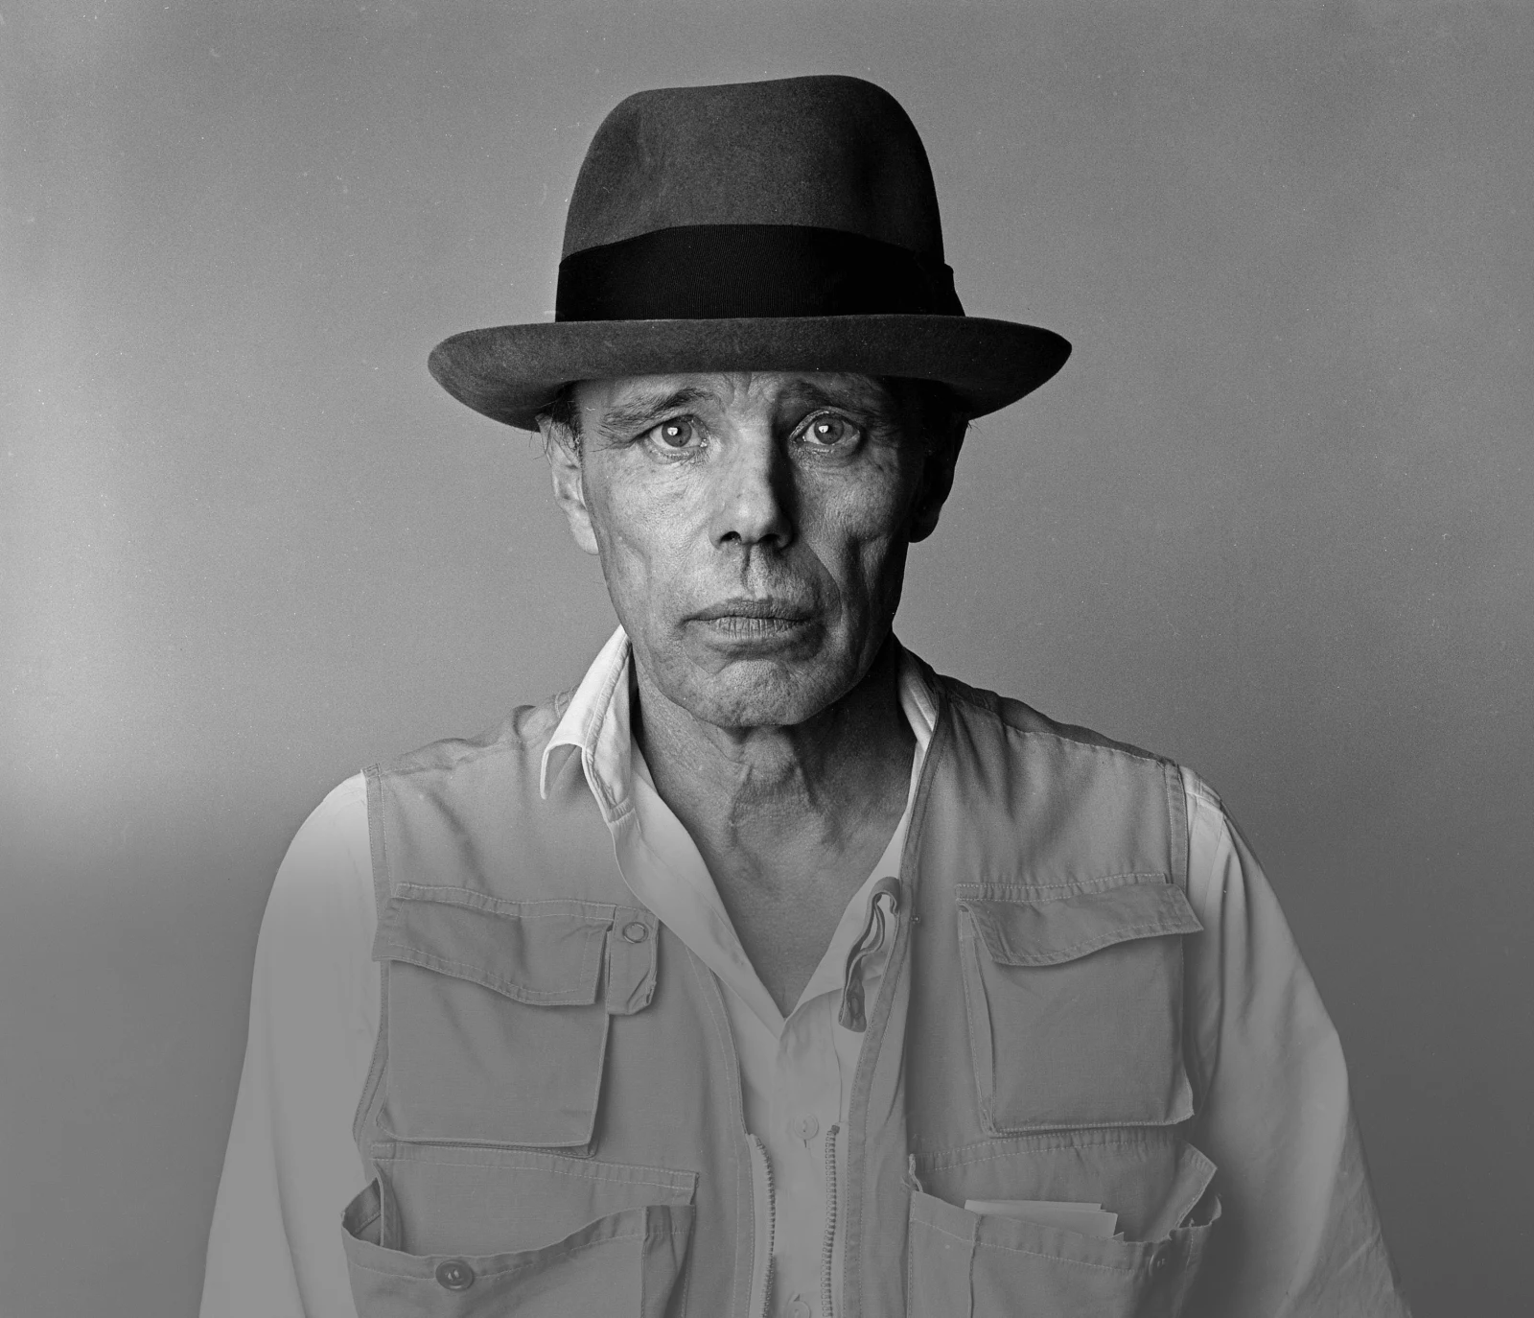
AFTERSCHOOL PROGRAM: BE BEUYS
Session 1 - Datum

Slide 2
WELCOME TO SESSION 1
My name is...
What’s your name?

Slide 3
WILLKOMMEN ZU SITZUNG 1
Mein Name ist...
Wie heißt du?

Slide 4
GOALS FOR TODAY YOU GET TO KNOW EACH OTHER. YOU REFLECT ON OUR ART
PREFERENCES.
→
→

Slide 5
AGENDA
STEPS | TIME | GAME
Step 1 | 7 Minutes | Arrival
Step 2 | 15 Minutes | Getting to Know Each Other
Step 3 | 9 Minutes | Introduction to the Project Goals and to Miro
Step 4 | 38 Minutes | Group Discussion: Art Preferences
Step 5 | 7 Minutes | Reflection, Preview & Goodbye

Slide 6
GETTING TO KNOW EACH OTHER
10 MIN INTRODUCE YOURSELF TO YOUR PARTNERS.
Round I – 2 Min
Round II – 2 Min
Round III – 2 Min
Round IV – 2 Min
Where do you live? What are your hobbies?
Why did you join this afterschool program?

Slide 7
KENNENLERNEN
10 MIN STELL DICH DEINEN PARTNER*INNEN VOR.
Runde I – 2 Min
Runde II – 2 Min
Runde III – 2 Min
Runde IV - 2 Min
Wo wohnst du? Was sind deine Hobbys?
Warum bist du hier?

Slide 8
GETTING TO KNOW EACH OTHER
4 MIN PRESENT ONE INTERESTING FACT ABOUT YOUR LAST PARTNER.
I talked to __________ . S/he …

Slide 9
KENNENLERNEN
4 MIN PRÄSENTIERT EINE INTERESSANTE INFORMATION ÜBER
DEINE LETZTE PARTNERIN/ DEINEN LETZTEN PARTNER.
Ich habe mit ____________ gesprochen. Er/Sie …

Slide 10
OVERVIEW: PROGRAM OBJECTIVES 3 Min Listen to our program‘s objectives.
Get to know the German artist Joseph Beuys and his art.
Follow in Beuys’ steps and plan a socially relevant art project.
Present your project plan at the end of our program.

Slide 11
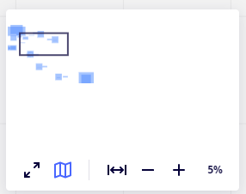
INTRODUCTION TO MIRO
LK muss den individuellen Miro Link/ QR Code hier einfügen
7 MIN GET TO KNOW THE MAIN FUNCTIONS OF MIRO.
Arrow: Select.
Klick on the arrow to activate the hand function:
Hand: Move the board
Textbox: Write on the board.
Zoom: Zoom in and out.

Slide 12
INTRODUCTION TO MIRO
7 MIN GET TO KNOW THE MAIN FUNCTIONS OF MIRO.
Insert a picture on the Miro Board:
Search a picture or link on google.
Copy the picture or link (CtrC).
Paste it on the Miro Board (CtrV).

Slide 13
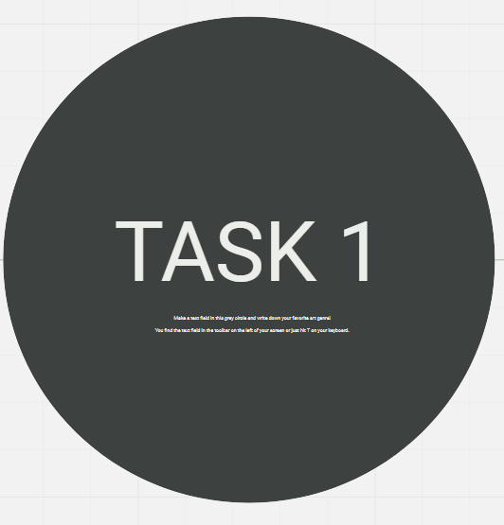
GROUP ACTIVITY 1: ART GENRES
12 MIN DISCUSS THE QUESTION IN YOUR GROUP.
What is your favorite art genre?

Slide 14
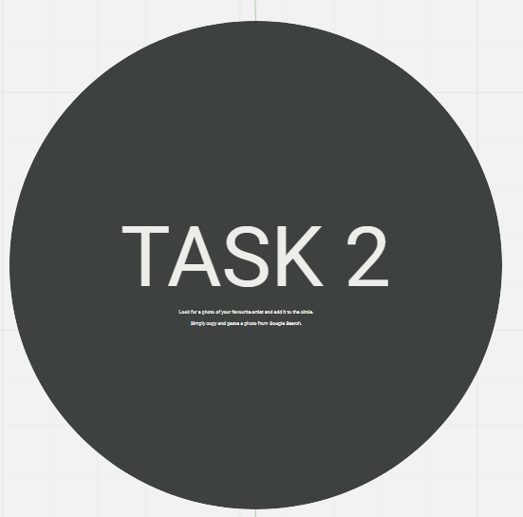
GROUP ACTIVITY 2: ARTISTS
12 MIN DISCUSS THE QUESTION IN YOUR GROUP.
Who is your favorite artist?

Slide 15
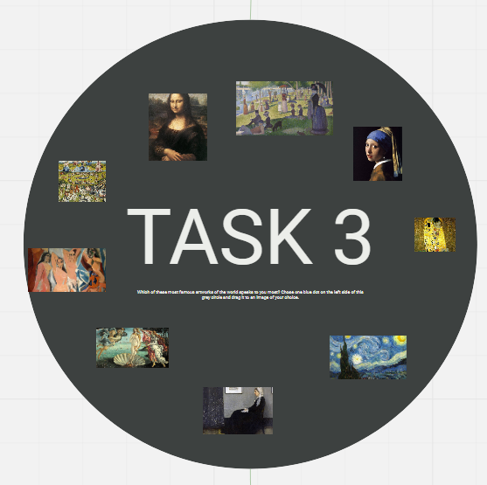
GROUP ACTIVITY 3: ART WORKS
12 MIN DISCUSS THE QUESTION IN YOUR GROUP.
Which of these famous art works speaks to you most?

Slide 16
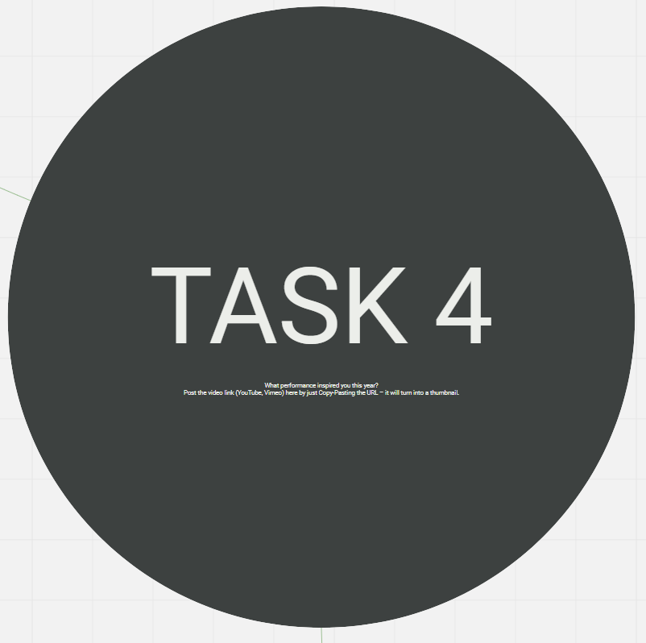
OPTIONAL: TASK 4
10 MIN COMPLETE TASK 4 AT HOME.
What performance inspired you this year?

Slide 17
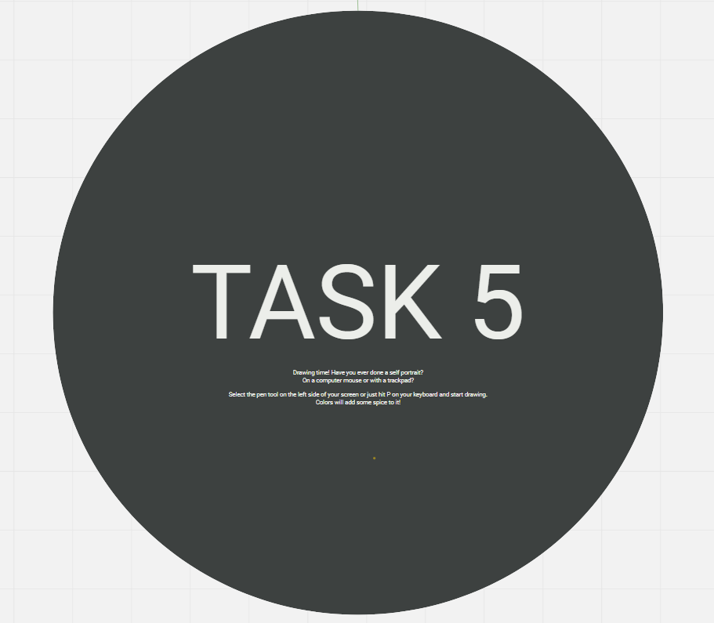
OPTIONAL: TASK 5
10 MIN COMPLETE TASK 5 AT HOME.
Have you ever done your own self portrait? On a computer mouse or on a trackpad? Draw your own self portrait and post it in the gray circle.

Slide 18
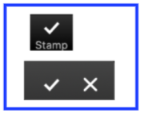
GOALS FOR TODAY WE GOT TO KNOW EACH OTHER. WE REFLECTED ON OUR ART
PREFERENCES.

Slide 19
REFLECTION
3 MIN ANSWER THE QUESTION.
Which activity did you like most today? Why?

Slide 20
PREVIEW: Session 2
Who was Joseph Beuys?
You will learn about the artist and his art.

Slide 21
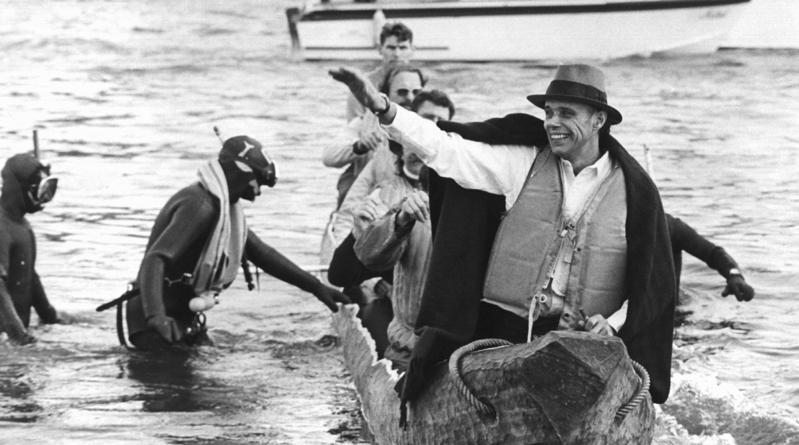
SEE YOU NEXT WEEK!

Slide 22
Schneidermann, R. (1973, OCTOBER 20). JOSEPH BEUYS ARTIST 01[PHOTOGRAPH]. DPA. Müller, B. (1972, November 23). Joseph Beuys Maschendrahtzaun[Photograph]. DPA, Düsseldorf.
CITATIONS

