Slide 1
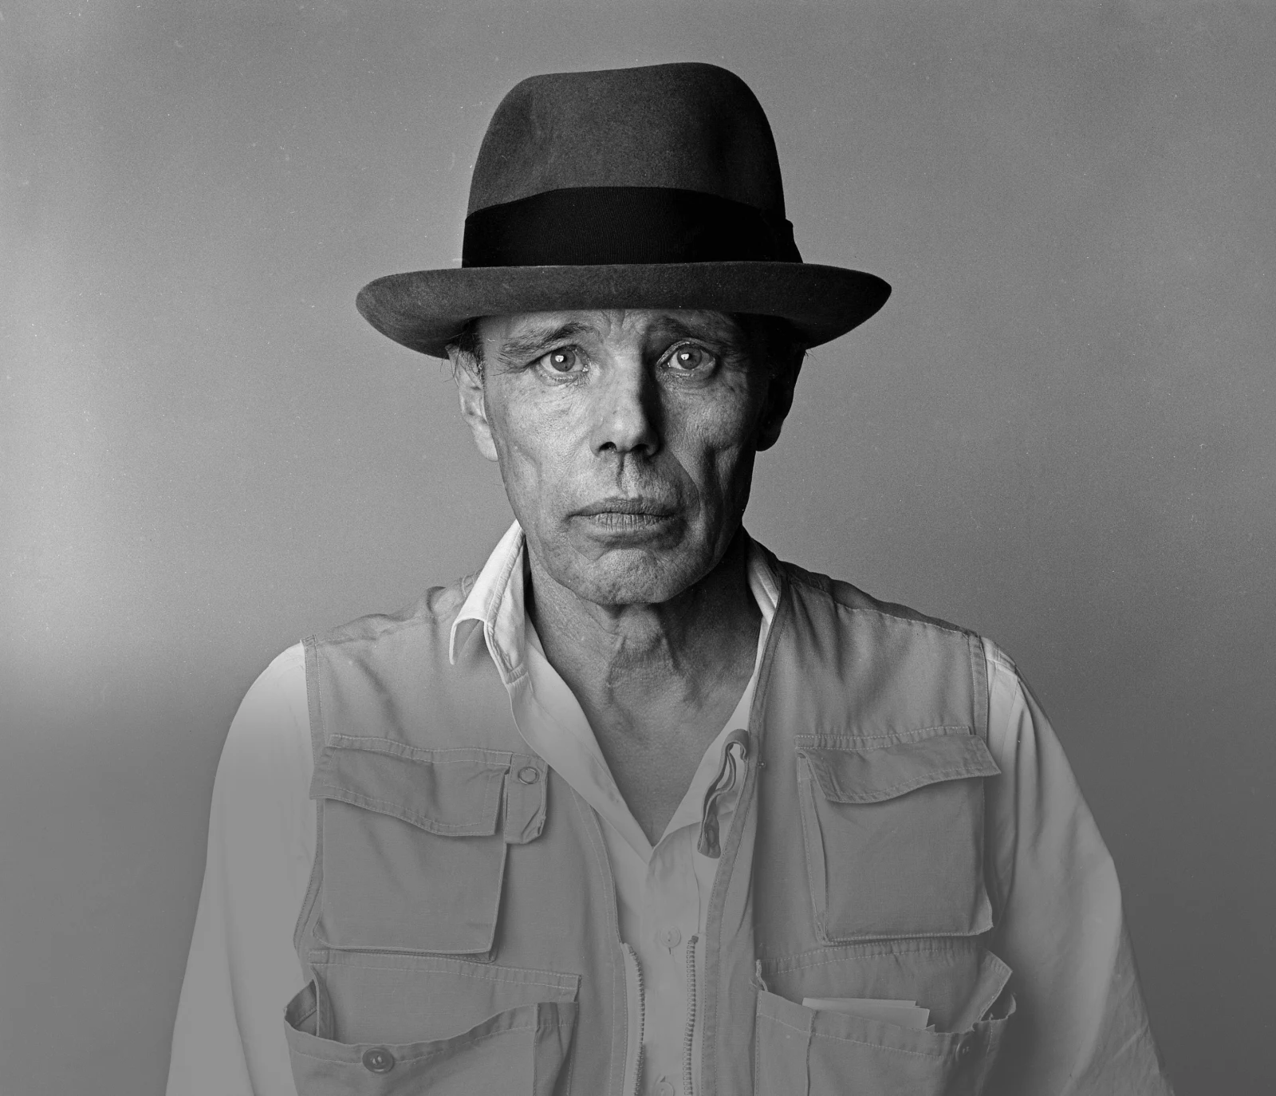
Afterschool Program: Be Beuys
Session 2 - Datum

Slide 2
Welcome to Session 2
Which art genre do you not like at all?

Slide 3
Willkommen zu Sitzung 2
Welches Kunstgenre gefällt dir gar nicht?

Slide 4
Goals for today → You learn important facts about the artist Josep beuys. → You get to know some of beuys’ most significant works of art → You present one of Beuys’ Artworks

Slide 5
Agenda
Steps | Time | Goal
Step 1 | 7 Minutes | Arrival
Step 2 | 8 Minutes | Warm-Up: Getting to Know Each Other
Step 3 | 25 Minutes | The Life of Joseph Beuys
Step 5 | 30 Minutes | Expert groups: Beuys‘ works of art
Step 6 | 5 Minutes | Reflection, Preview und Goodbye

Slide 6
Warm-up: Getting to know each other 5 Min CHOOSE one of the questions AND DISCUSS IT in your group.
What role does art play in your everyday life? Is it important to you or are you new to the field?
Which art performance inspired you this year (concert, art show, museum …)?
Did you draw a self—portrait after last class? What was the process/result like?
Hinweis an LK: Hier könnte ein QR-Code für das Intro Miro Board eingefügt warden.

Slide 7
Warm-up: Getting to know each other 3 Min What did your group discuss? Present.
Our Group discussed question ___ …
(JOSEPH BEUYS)

Slide 8
The Life of Joseph Beuys 1 Min HAVE YOU HEARD OF JOSEPH BEUYS BEFORE? MARK ON THE WHITEBOARD.
(JOSEPH BEUYS)

Slide 9
The Life of Joseph Beuys 5 Min What do you know about joseph beuys? Write down your ideas.
artist

Slide 10
Das Leben von Joseph Beuys 5 Min Was wisst ihr über joseph beuys? Notiert eure Ideen.
der Künstler

Slide 11
The Life of Joseph Beuys 8 Min watch the video and take notes on the worksheet.
Watch out for bonus questions:
You may not find all relevant information in the video.

Slide 12
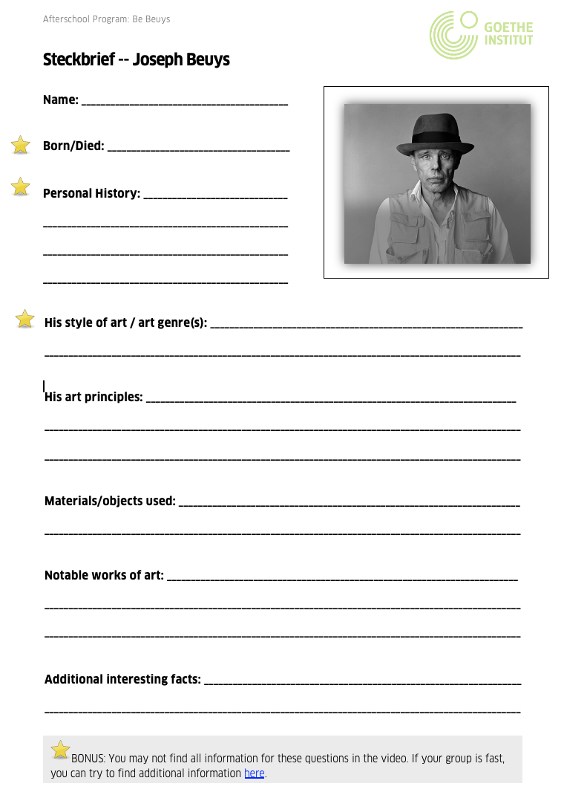
The Life of Joseph Beuys 8 Min discuss your notes with a partner & complete the worksheet.
You can research the bonus questions if your team is fast!

Slide 13
The Life of Joseph Beuys 3 Min Briefly respond to the questions.
Which bonus information did you find out about Beuys?
Did your team
still have any
questions?

Slide 14
Expert groups: Beuys’ works of art 15 Min Choose one of the stations. explore one of Beuys‘ artworks together.
Station 3:
7000 Oaks.
Station 1:
How to Explain Pictures to a Dead Hare.
Station 4:
I Like America and America Likes me.
Station 2:
The Fat Corner.
(JOSEPH BEUYS)
(JOSEPH BEUYS)

Slide 15
Expert groups: Beuys’ works of art 12 Min Present the artwork you researched in your new group.
Each person has 3 Minutes to present.
(JOSEPH BEUYS)

Slide 16
Expert groups: Beuys’ works of art 3 Min Which one did you like best? Go to the station of your favorite.
Station 3:
7000 Oaks.
Station 1:
How to Explain Pictures to a Dead Hare.
Station 4:
I Like America and America Likes me.
Station 2:
The Fat Corner.
(JOSEPH BEUYS)
(JOSEPH BEUYS)

Slide 17
Goals for today You know important facts about the artist Joseph beuys. You know some of beuys’ most significant works of art You can present one of Beuys’ Artworks

Slide 18
I pack my suitcase and take with me… 3 Min What did you learn today?

Slide 19
Preview: Session 3
What were Beuys’ art principles?
You are going to learn about the social and political causes, which informed Beuys’ work.
You will also take the first step in your group projects ☺.
(JOSEPH BEUYS)

Slide 20
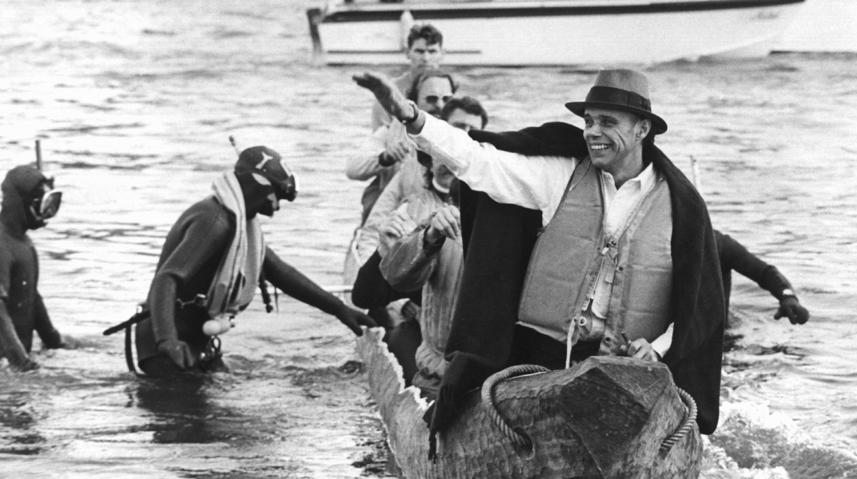
See you next week!
ČTK/DPA/Roland Scheidemann

Slide 21
Evans, M. (1985, May 01). Joseph Beuys Artist 01[Photograph]. AF Archive. National Galleries (Producer). (2016, August 12). Who is Joseph Beuys? [Video file]. Retrieved September 29, 2021, from https://www.youtube.com/watch?v=e7pIGGcIoLk Scheidemann, R. (1973, October 20). Joseph Beuys in a log-boat.[Photograph]. ČTK/DPA, Düsseldorf.
Citations

