Slide 1
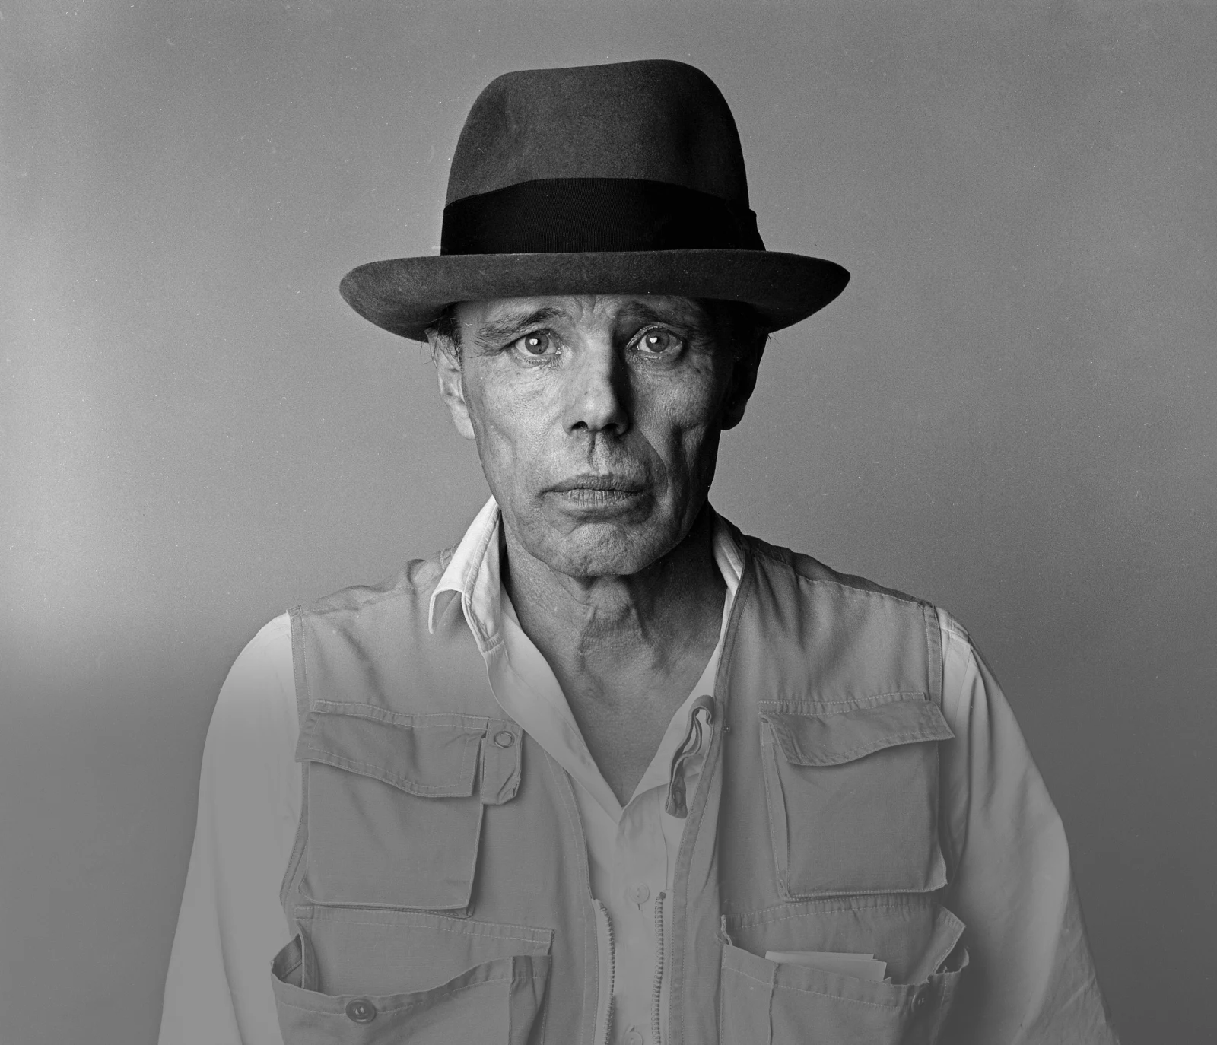
AFTERSCHOOL
PROGRAM:
BE BEUYS
Session 4 - Datum

Slide 2
WELCOME TO SESSION 4
PLEASE ACTIVATE
MICROPHONE
WEBCAM

Slide 3
WELCOME TO SESSION 4
MICROPHONE TEST
What is your favorite color?
WE CAN HEAR YOU.
WE CANNOT HEAR YOU.

Slide 4

Willkommen zu Sitzung 4
Mikrofon TEST
Was ist deine Lieblingsfarbe?
WIR KÖNNEN DICH HÖREN.
WIR KÖNNEN DICH NICHT HÖREN.

Slide 5
GOALS FOR TODAY
You find a video that represents your topic.
You argue why others should care for your project.
You write a slogan that communicates the message of your topic.
→
→
→

Slide 6






PROGRAM OVERVIEW
1 MIN
FIND OUT WHERE WE ARE IN OUR PROGRAM.
Find a Cause you’re Passionate About!
Choose Materials and Places that Matter to you!
Create your Brand and Art Persona!
Finalize and Present your Project Plan!
Share your Project in a Social Media Post!

Slide 7
AGENDA
STEPS | TIME | CONTENT
Step 1 | 7 Minutes | Arrival
Step 2 | 10 Minutes | Warm-Up: Speed Dating
Step 3 | 15 Minutes | Group Task I: Video Search
Step 4 | 27 Minutes | Group Task II: Slogan Writing
Step 5 | 8 Minutes | Voting
Step 6 | 8 Minutes | Reflection, Preview & Goodbye

Slide 8

WARM-UP: SPEED DATING
Round I – 2 Min
Round II – 2 Min
Round III – 2 Min
7 MIN
TALK TO YOUR PARTNER ABOUT THE QUESTION.
A question will be broadcasted in your breakout rooms.
Discuss the question with your partner.
After two minutes, you will get a new partner AND a new question.
Discuss the new question with your partner.

Slide 9
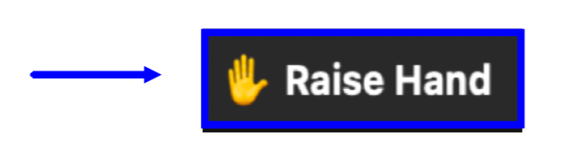
SPEED DATING
3 MIN
PRESENT ONE INTERESTING FACT ABOUT ONE OF YOUR PARTNERS.
I talked to __________ . S/he …

Slide 10


GROUP TASK I: VIDEO SEARCH
15 MIN
FIND A VIDEO THAT REPRESENTS YOUR TOPIC.
Open our Miro Board and add the names of all of your team member to one of the boxes for task 1.
2. Find a video online that represents your topic.
3. Post your link on the Miro Board.

Slide 11


GROUP TASK I: VIDEO SEARCH
10 MIN
REFLECT ON YOUR VIDEO CHOICE IN YOUR NEW GROUPS.
Screenshot
What video did you choose?
How does it represent your project?
In which ways did the video inspire you?
2 MIN PER PROJECT

Slide 12
GRUPPENAUFGABE I: VIDEO SUCHE
10 MIN
REFLEKTIERT IN EUREN NEUEN GRUPPEN ÜBER EURE AUSWAHL.
Screenshot
Welches Video habt ihr ausgewählt?
Wie repräsentiert dieses Video euer Projekt?
Welche neue Inspirationen habt ihr durch euer Video bekommen?
2 MIN PRO PROJEKT

Slide 13


GROUP TASK II: SLOGAN WRITING
15 MIN
DISCUSS THE QUESTION AND WRITE A SLOGAN.
Screenshot
Reflect on the following question: Why should others care about your project?
2. Write a slogan that communicates the message of your project.
3. Post your slogan on the Miro Board.

Slide 14
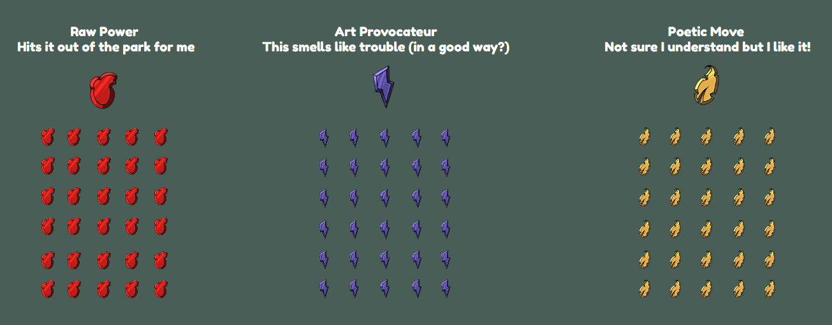
INTRODUCTION TO THE AWARD SYSTEM
THE DIFFERENT BADGES
2 MIN

Slide 15

INTRODUCTION TO THE AWARD SYSTEM
INSTRUCTIONS
2 MIN
You can award one badge of each category to a team of your choice.
Do not award your own project.
Place the badge in the area marked with the dotted line.

Slide 16

VOTING
5 MIN
READ THE SLOGANS OF THE OTHER GROUPS. AWARD THREE GROUPS. TALK TO YOUR GROUP ABOUT YOUR CHOICES.

Slide 17
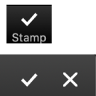
GOALS FOR TODAY
You found a video that represents your topic.
You argued why others should care for your project.
You wrote a slogan that communicates the message of your topic.

Slide 18

REFLECTION
3 MIN
REFLECT ON THE QUESTION.
What are
you particularly proud of in your project or group collaboration?

Slide 19
PREVIEW: SESSION 5
You will continue to work
on your project and…
… decide where to locate your project.

Slide 20
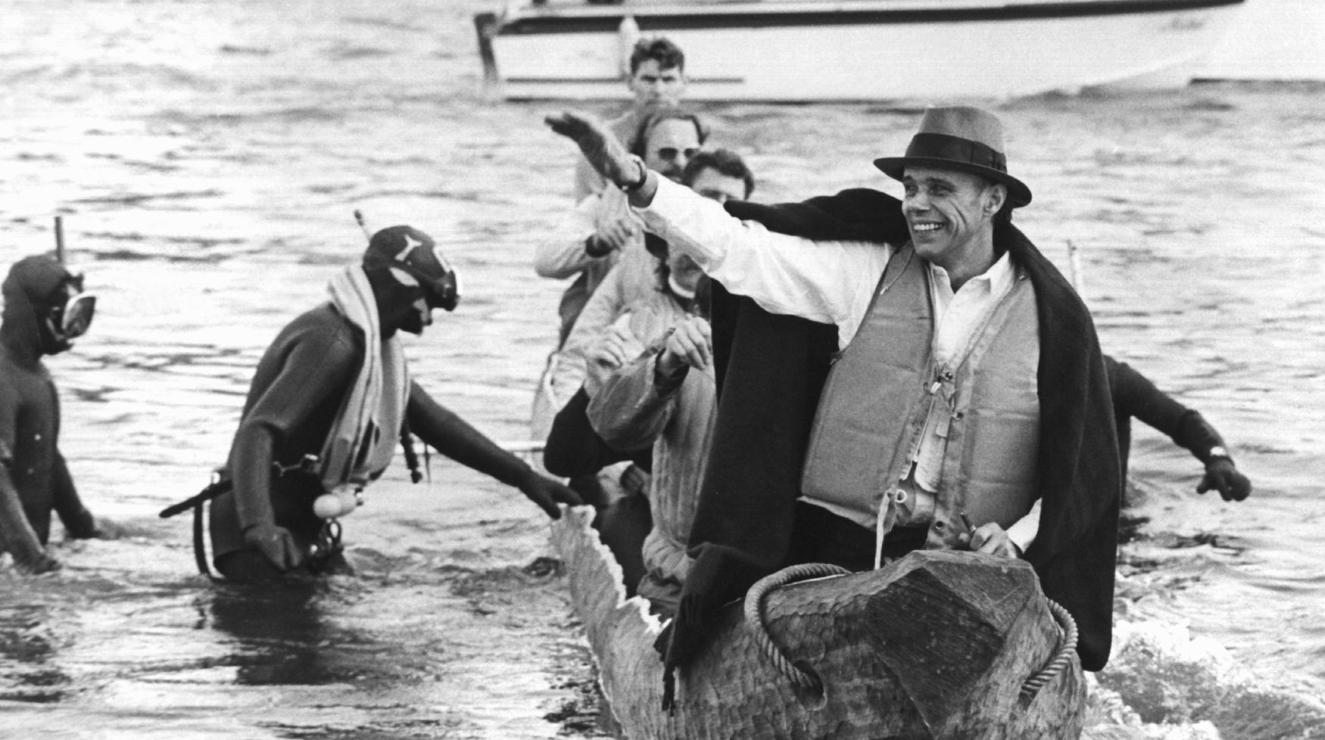
SEE YOU NEXT WEEK!

Slide 21
SCHEIDEMANN, R. (1973, OCTOBER 20). JOSEPH BEUYS IN A LOG-BOAT.[PHOTOGRAPH]. ČTK/DPA, DÜSSELDORF.
Citations

