Slide 1
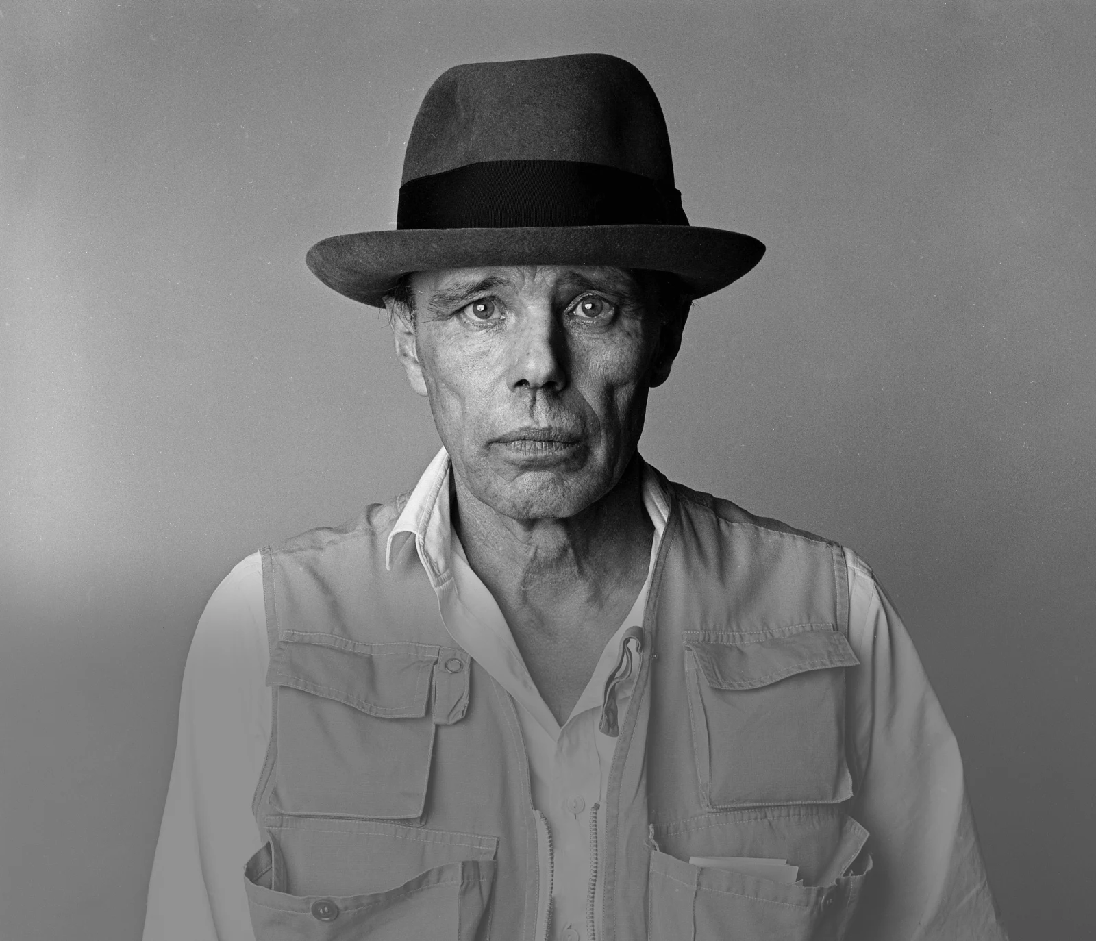
Afterschool
Program:
Be Beuys
Session 8 - Datum

Slide 2
Welcome to Session 8
What‘s one thing you did last weekend?

Slide 3

Willkommen zu Sitzung 8
Welche Aktivität hast du am Wochenende gemacht?

Slide 4
Goals for today
→ you Choose a name for your art project group.
→ You finalize your project plan.
→ you decide on a way to visualize
Your Project plan.

Slide 5






PROGRAM OVERVIEW
1 MIN
FIND OUT WHERE WE ARE IN OUR PROGRAM.
Find a Cause you’re Passionate About!
Choose Materials and Places that Matter to you!
Create your Brand and Art Persona!
Finalize and Present your Project Plan!
Share your Project in a Social Media Post!

Slide 6
Agenda
Steps | Time | Goal
Step 1 | 5 Minutes | Arrival
Step 2 | 12 Minutes | Warm-Up: Two Truths and a Lie
Step 3 | 12 Minutes | Choosing a Group Name
Step 4 | 5 Minutes | Recap: Course Achievements
Step 5 | 33 Minutes | Finalizing your Project Plan
Step 6 | 8 Minutes | Reflection, Preview & Goodbye

Slide 7


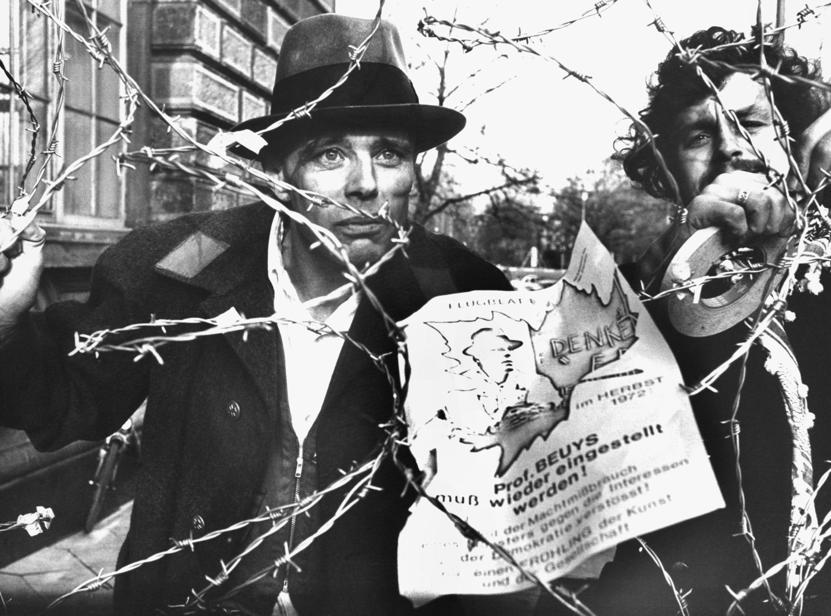
Warm-Up: Two truths and a lie
3 Min
WHICH STATEMENT ABOUT JOSEPH BEUYS IS A LIE?
Beuys survived a plane crash.
He was fired from his job as professor at
the art academy in Düsseldorf.
DPA/ Bernd Müller (1972)
He was one of the first members of the Christian political party CDU.

Slide 8



Warm-Up: Two truths and a lie
2 Min
WRITE DOWN TWO TRUTHS AND A LIE ABOUT YOURSELF.

Slide 9


Warm-Up: Two truths and a lie
5 Min
PRESENT YOUR STATEMENTS AND FIND OUT THE LIES
OF YOUR CLASS COLLEAGUES.
I believe your
second statement
is a lie, because …

Slide 10

Warm-Up: Two truths and a lie
2 Min
WHICH LIES DID YOU DISCOVER? PRESENT.
I discovered a lie
about _________ .
S/he said that …

Slide 11
Warm-Up: Zwei Wahrheiten und eine Lüge
3 Min
WELCHES STATEMENT ÜBER BEUYS IST EINE LÜGE?
Beuys hat einen Flugzeugabsturz überlebt.
Er wurde von von der Kunstakademie in
Düsseldorf gefeuert. Dort war er Professor.
DPA/ Bernd Müller (1972)
Er war einer der ersten Mitglieder der christlichen Partei CDU.

Slide 12
Warm-Up: Zwei wahrheiten und eine Lüge
2 Min
NOTIERT JEWEILS ZWEI WAHRHEITEN UND EINE LÜGE ÜBER EUCH SELBST.

Slide 13
Warm-Up: ZWEI WAHRHEITEN UND EINE LÜGE
5 Min
PRÄSENTIERT EURE STATEMENTS UND FINDET DIE LÜGEN VON
DEN ANDEREN PERSONEN IM KURS HERAUS.
Ich glaube, dein
zweites Statement
ist eine Lüge, weil…

Slide 14
Warm-Up: Zwei wahrheiten und eine lüge
2 Min
WELCHE LÜGEN HABT IHR HERAUSGEFUNDEN? PRÄSENTIERT.
Ich habe eine Lüge über
______ herausgefunden .
Er/Sie sagt, dass…

Slide 15


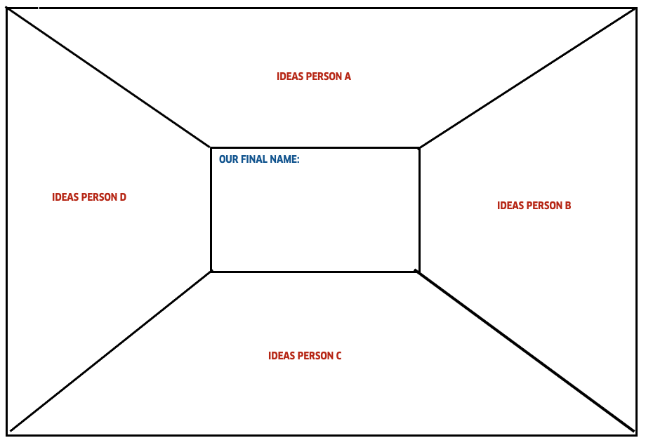


Choosing a group name
10 Min
DECIDE ON A GROUP NAME THAT BEST REFLECTS YOUR ART PROJECT.
Think of 2-3 names for your team and write them in your section of the worksheet.
Present your ideas to your fellow team members.
Discuss all ideas and decide on one name for your team.
3 Min
5 Min

Slide 16

Choosing a group name
2 Min
BRIEFLY PRESENT YOUR GROUP NAME.
We chose the group
name __________
because …

Slide 17

RECAP: COURSE ACHIEVEMENTS
5 Min
THINK BACK TO OUR PREVIOUS SEVEN SESSIONS. WHAT DID WE
ACHIEVE FOR OUR ART PROJECTS SO FAR? WRITE DOWN YOUR IDEAS.
Choose a group name

Slide 18
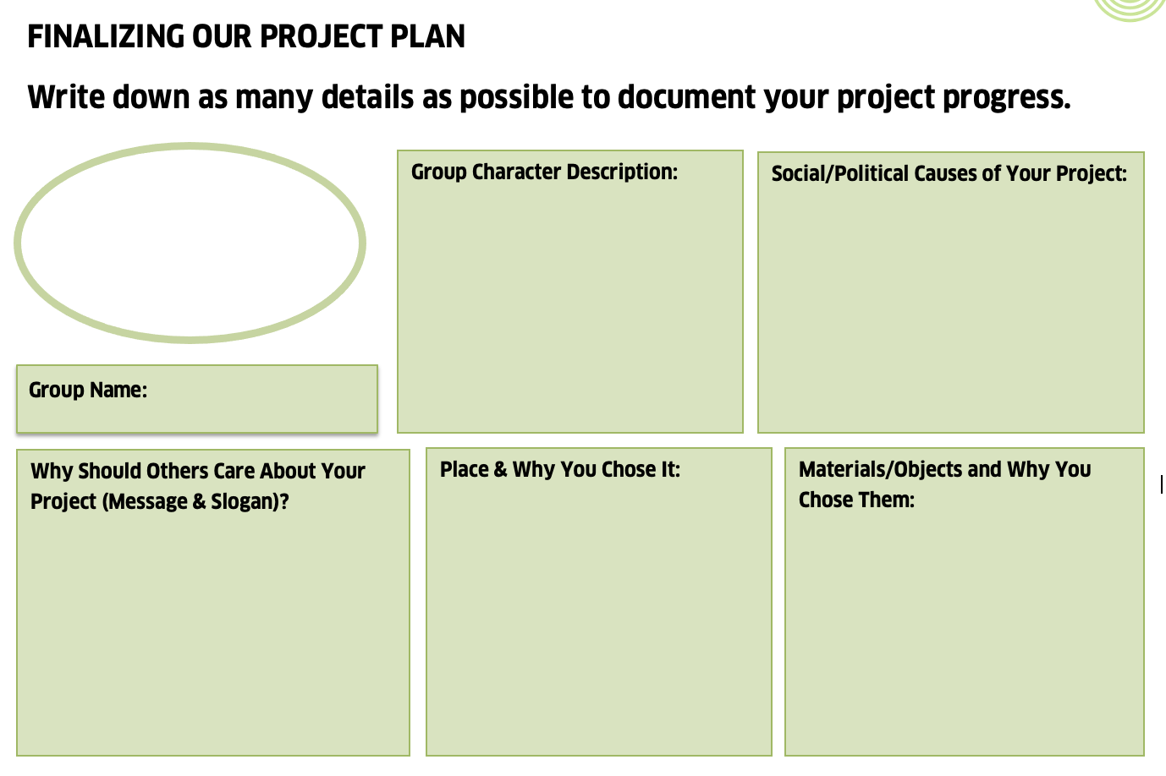


Finalizing your project plan
10 Min
Hinweis an LK
QR-Code vom
Miro-Board
generieren und
hier einfügen
IN YOUR GROUP, DOCUMENT THE DIFFERENT ELEMENTS
OF YOUR ART PROJECT PROGRESS.
Fill out each section as
comprehensively as
possible.
You can use your notes
on the Miro Board as a
reference.

Slide 19






Finalizing your project plan
20 Min
DISCUSS THE FOLLOWING QUESTIONS:
What is the goal of your project?
What is the message you want to convey?
3. In which format would you like to present your project
plan?
Video / Audio
Collage
Photography
Power Point/
Presentation
Poem
*If you’ve answered all the questions, you can already get started
on your presentation. Start visualizing your project plan with the
format you’ve chosen (Power Point, Video, Poem …) .

Slide 20
Finalizing your project plan
3 Min
PRESENT THE PROJECT PLAN FORMAT YOU DECIDED ON.
We decided to present
our project as a ______
because …

Slide 21


Goals for today
you chose a name for your art project group.
You finalized your project plan.
you decided on a way to visualize
your project plan.

Slide 22



Reflection: Snowball fight
5 Min
WHAT WAS EASY/DIFFICULT FOR YOU TODAY? WRITE ONE
ASPECT FOR EACH CATEGORY ON A SMALL PIECE OF PAPER.
I FOUND EASY…
I FOUND DIFFICULT…
DONE? Crumple up your pieces of paper and make a snowball fight.
Pick up a new snowball and read the reflection notes out loud.

Slide 23
Preview: Session 9
You will …
… visualize your project plans.
… present your project.
… and you will reflect on
your team performance.
(JOSEPH BEUYS)

Slide 24
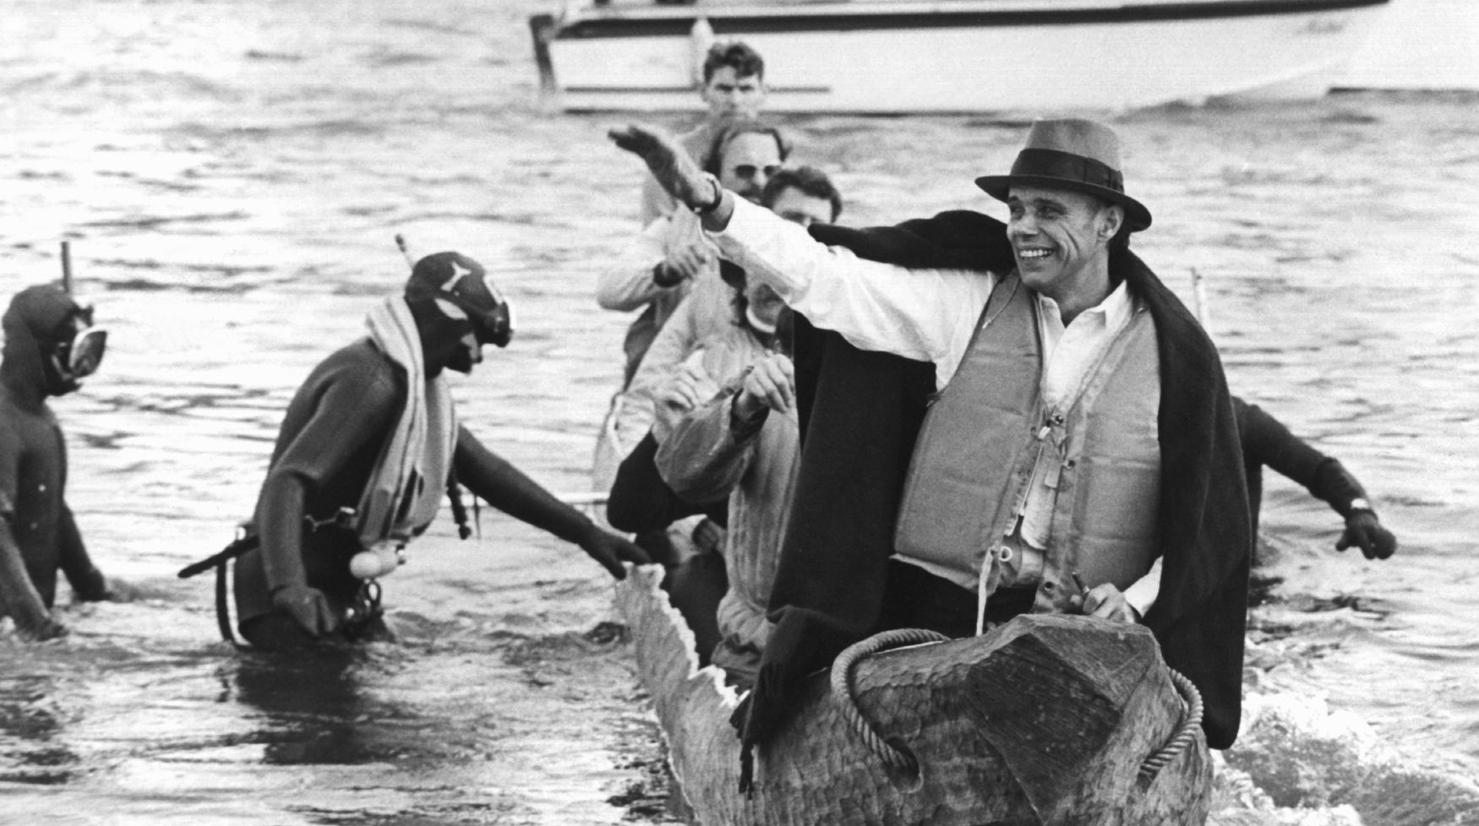
See you next week!
ČTK/DPA/Roland Scheidemann

Slide 25
Scheidemann, R. (1973, October 20). Joseph Beuys in a log-boat.[Photograph]. ČTK/DPA, Düsseldorf.
Müller, B. (1972, November 23). Joseph Beuys Maschendrahtzaun[Photograph]. DPA, Düsseldorf.
Citations

