Slide 1
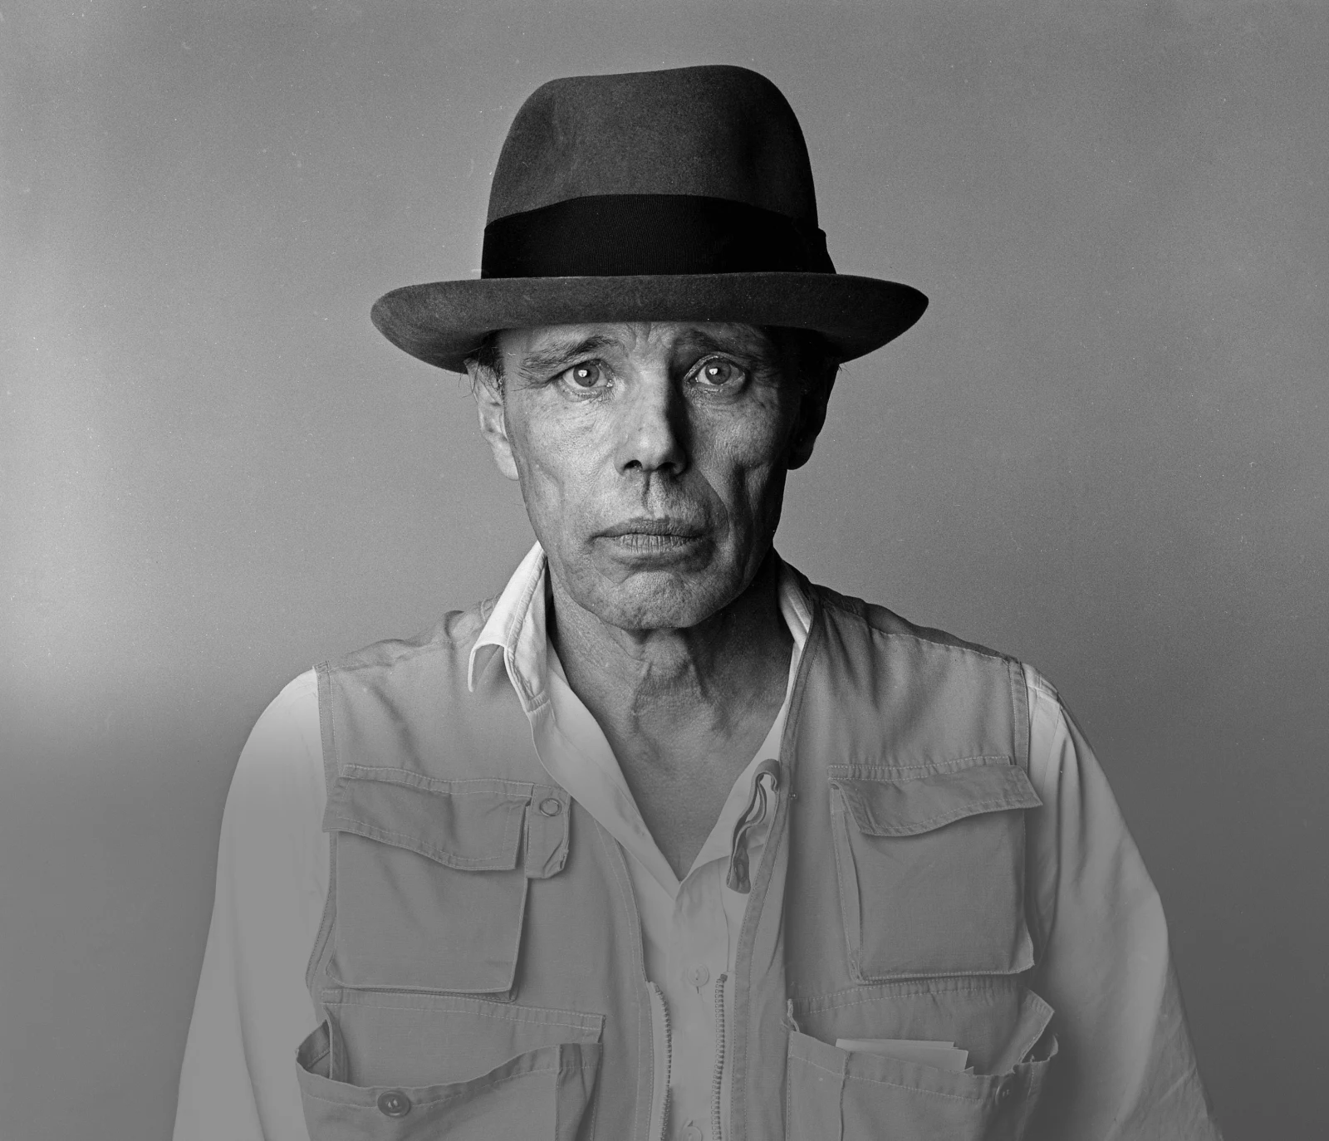
Afterschool Program: Be Beuys
Session 9 - Datum

Slide 2
Welcome to Session 9
How are you today?

Slide 3
Willkommen zu Sitzung 9
Wie geht‘s dir heute?

Slide 4
Goals for today → you visualize your project plan. → You present your project plan. → you reflect on your group performance.

Slide 5
PROGRAM OVERVIEW 1 MIN FIND OUT WHERE WE ARE IN OUR PROGRAM.
Find a Cause you’re Passionate About!
Choose Materials and Places that Matter to you!
Create your Brand and Art Persona!
Finalize and Present your Project Plan!
Share your Project in a Social Media Post!

Slide 6
Agenda
Steps | Time | Goal
Step 1 | 3 Minutes | Arrival
Step 2 | 5 Minutes | Warm-Up: Dream Places
Step 3 | 25 Minutes | Project Plan Visualization
Step 4 | 30 Minutes | Presenting your Art Project Plans
Step 5 | 10 Minutes | Team Performance Reflection
Step 6 | 2 Minutes | Reflection, Preview & Goodbye

Slide 7
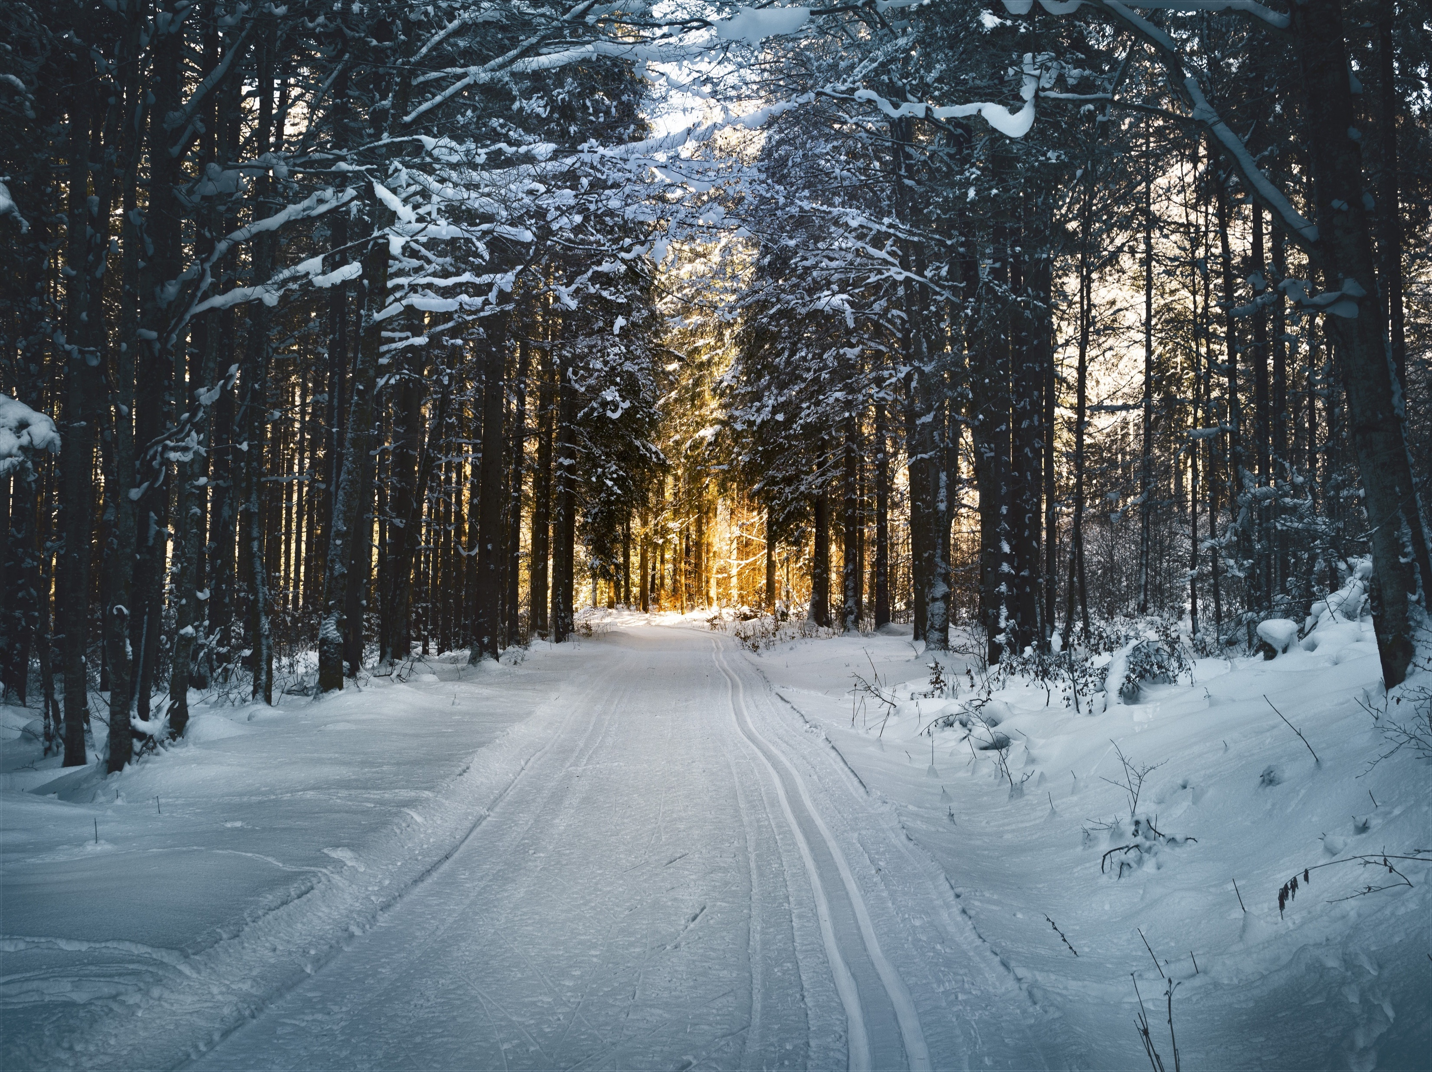
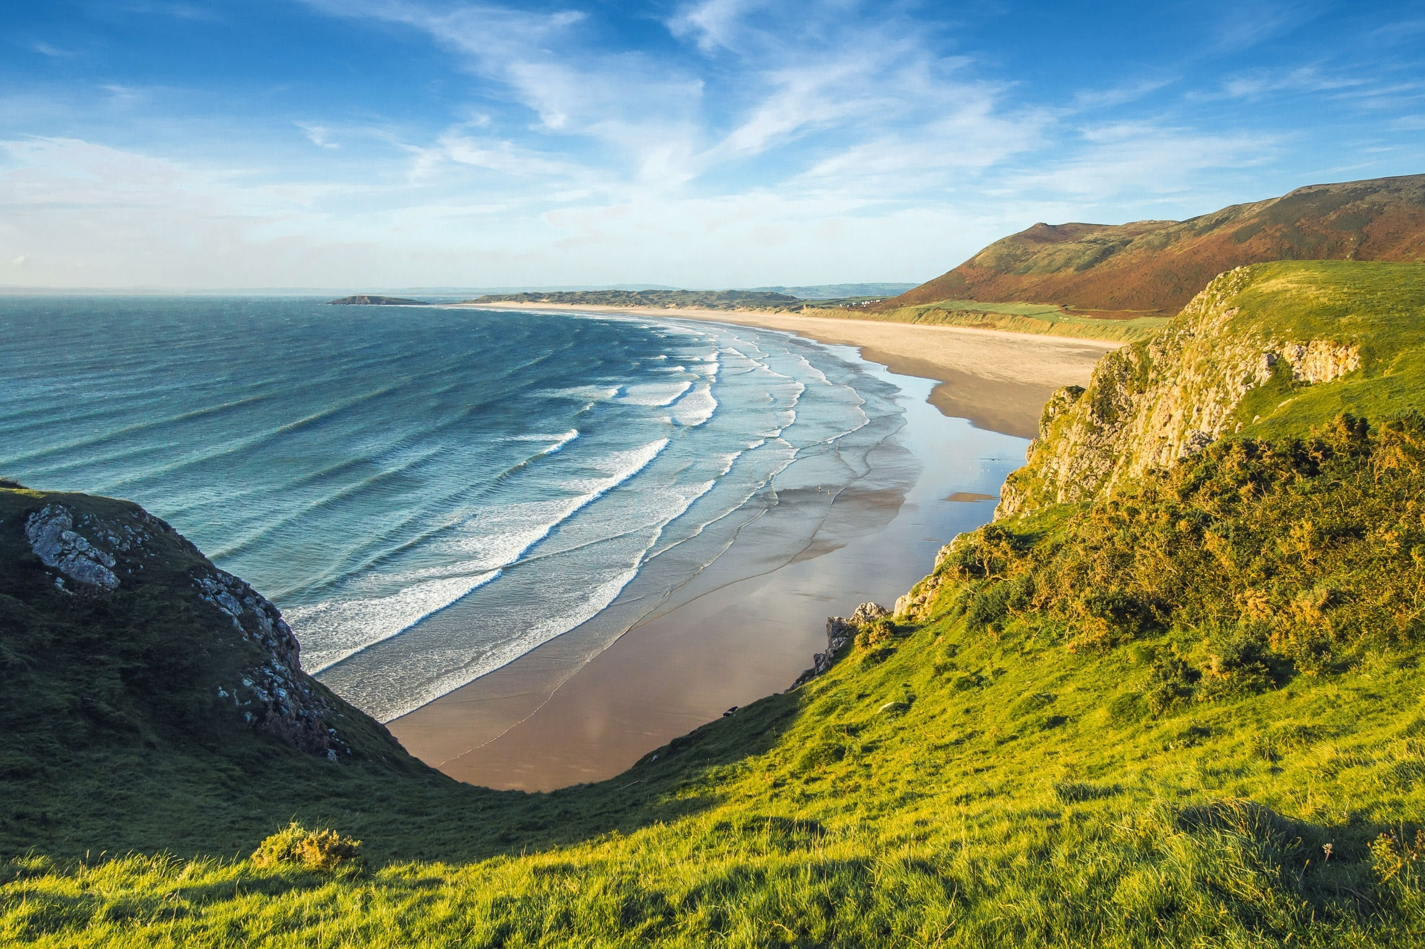
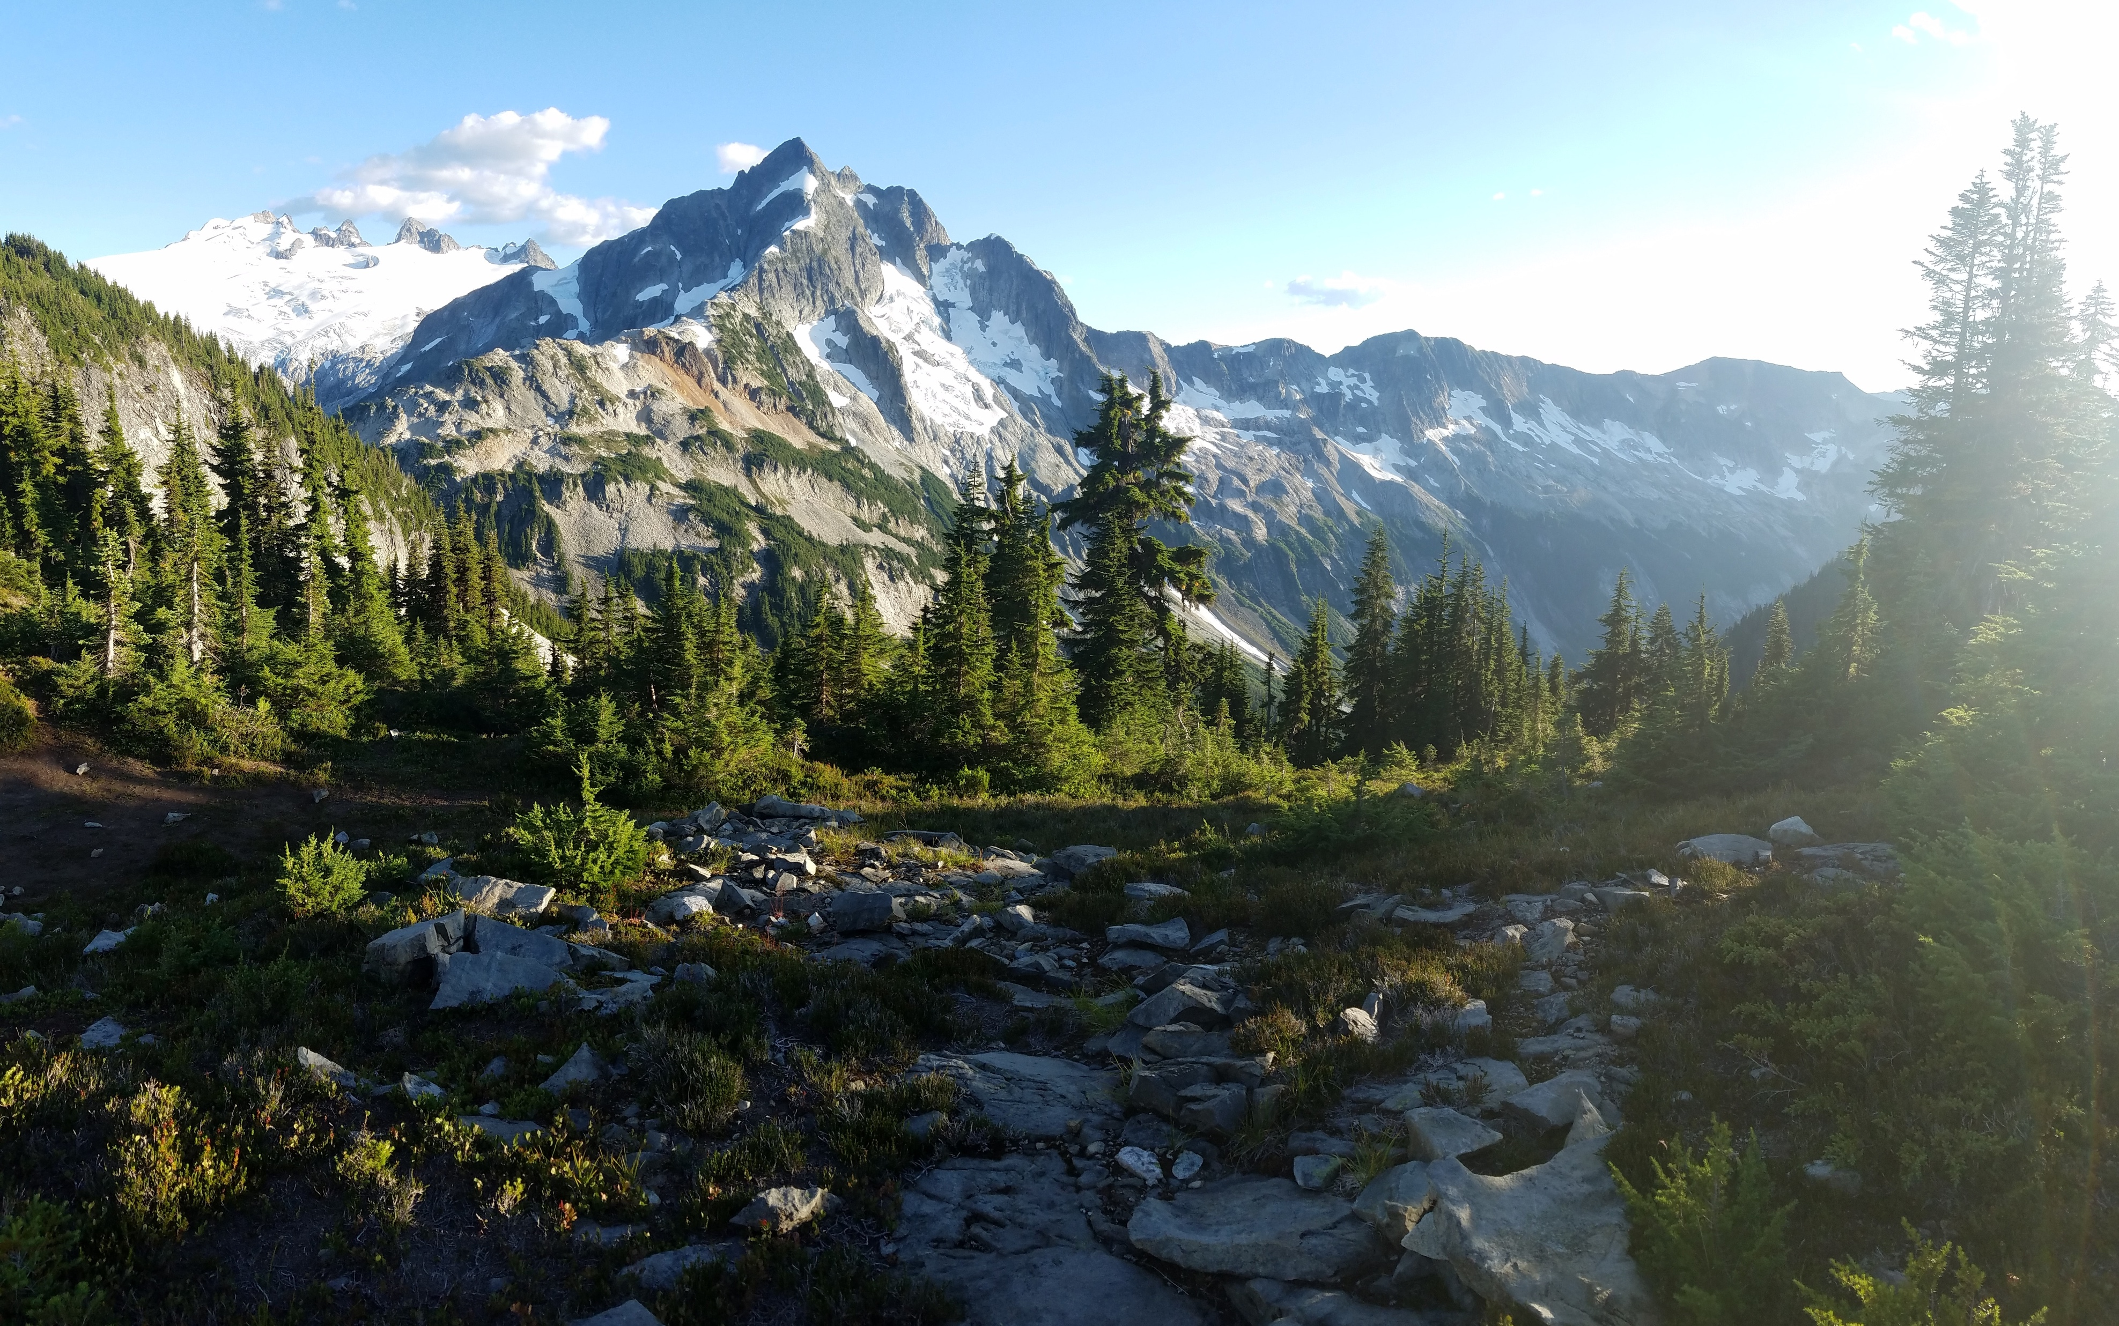
Warm-Up: Dream places 5 Min
WHERE WOULD YOU LIKE TO BE RIGHT NOW? AND WHY?

Slide 8
Warm-Up: Traumorte 5 Min
WOHIN MÖCHTET IHR GERN REISEN? WARUM?
Ich möchte gern ans Meer reisen, weil …
ans Meer
in den Regenwald
in die Berge
in die Wüste
in den Schnee

Slide 9
project plan visualization 25 Min
VISUALIZE YOUR PROJECT PLAN AND PREPARE YOUR PRESENTATION.
Last live session, you finalized your project plans. In your group, briefly recap the details you decided on. → goal of project / message to convey / presentation format
2. Visualize your project plan in the chosen format. → i.e. prepare a PPT, take a photo, write a poem… Tip: Try to include as many details as possible from your plan.
IMPORTANT: The goal is to present your project plan in ~4 mins. The visualization is the framework for your presentation.

Slide 10
Presenting your art project plans 25 Min
PRESENT YOUR PROJECT PLAN VISUALIZATIONS. PROVIDE AS MUCH DETAIL ABOUT YOUR PROJECT PLAN AS POSSIBLE.
Assign a timekeeper. S/he manages the time → Max. 4 minutes allotted per presentation.
2. Before each presentation, designate one person to provide feedback. This person will compliment the presenter once finished. i.e. What inspired you? What was particularly interesting? What did the group do well? …

Slide 11
Presenting your art project plans 5 Min
WHAT IMPRESSED YOU MOST ABOUT THE PRESENTATIONS OF YOUR CLASS COLLEAGUES?
things that impressed us

Slide 12
Team Performance Reflection 7 Min
Hinweis an LK
QR-Code vom Miro-Board generieren und hier einfügen
DISCUSS THE QUESTIONS. ASSIGN YOURSELF A BADGE.
1. How did you do as a group? 2. What went particularly well? 3. What could you optimize next time?
Done? Open the Miro Board. Based on your reflections, assign one of the badges to your own group.

Slide 13
Team Performance reflection 3 Min
PRESENT THE BADGE YOU AWARDED YOURSELF AND EXPLAIN WHY.
We awarded ourselves the badge _________, because …

Slide 14
Team-Performance reflexion 3 Min
PRÄSENTIERT EUER GEWÄHLTES ABZEICHEN UND BEGRÜNDET EURE WAHL.
Wir haben das Abzeichen ___________ gewählt,
Weil …

Slide 15
Goals for today you visualized your project plan. You presented your project plan. you reflected on your group performance.

Slide 16
Preview: Session 10
You will …
… learn about Joseph Beuys and his PR work.
… write a social media post about your group project.
… reflect the after school program.
(JOSEPH BEUYS)

Slide 17
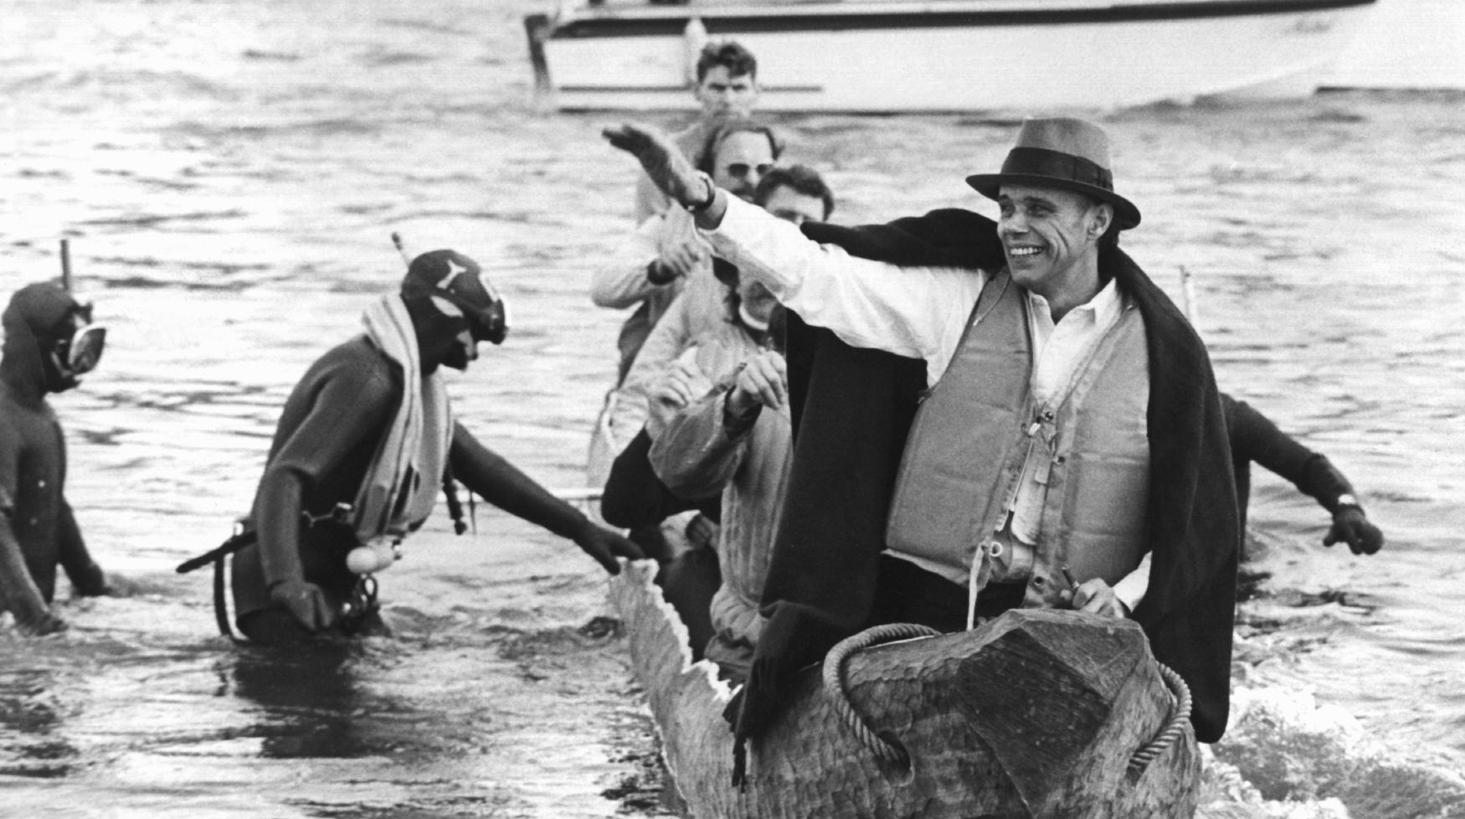
See you next week!
ČTK/DPA/Roland Scheidemann

Slide 18
Scheidemann, R. (1973, October 20). Joseph Beuys in a log-boat.[Photograph]. ČTK/DPA, Düsseldorf.
Citations

